Slide 1
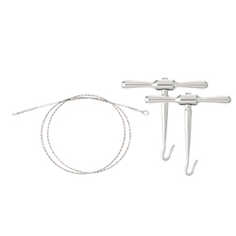
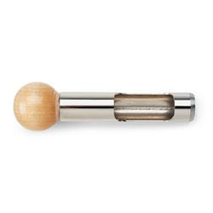
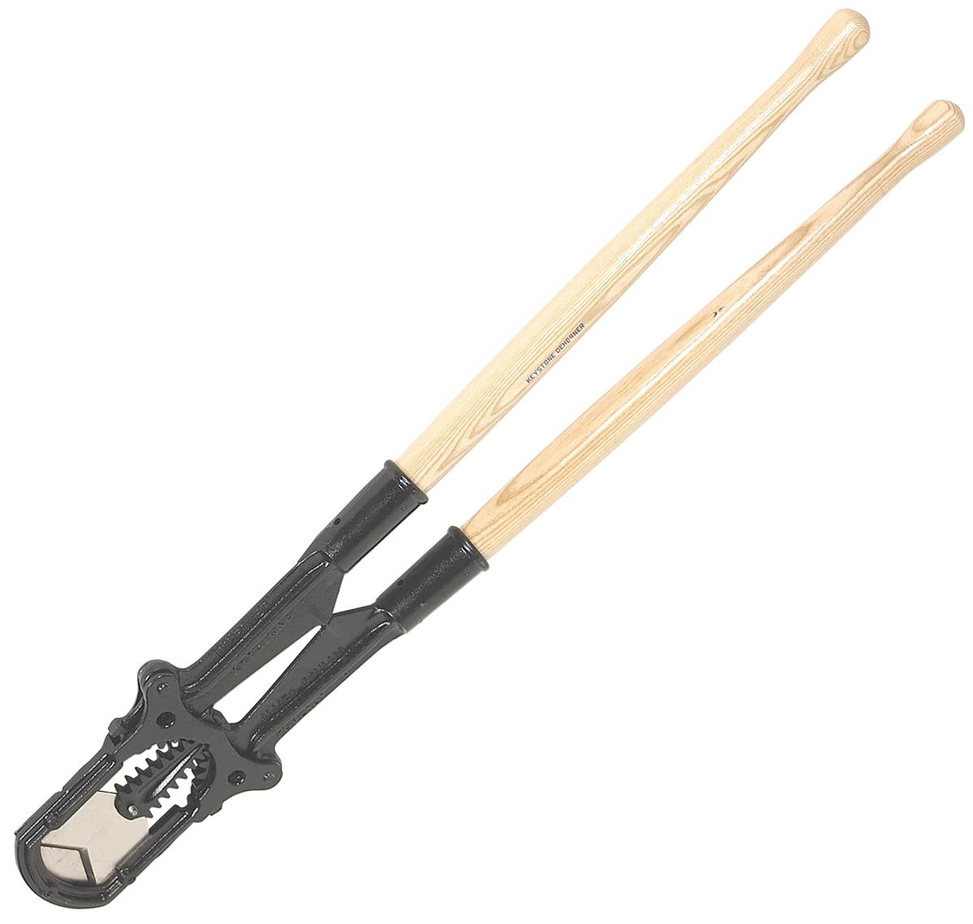
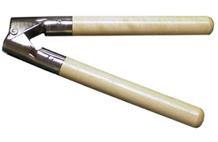
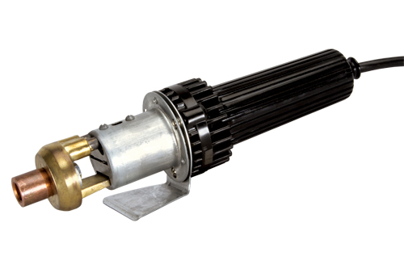
Instruments Used for Dehorning
Horn Gouge/
Gigli Wire & Handles
Keystone Dehorner
Barnes Dehorner
Disbudder

Slide 2
Instrument Name | Alternate Names | Brief Description of Instrument | Purpose/Indications | Important Considerations
Gigli Wire & Handles | - | A roughened piece of wire used for cutting is attached to two metal handles. | To remove large horns | Takes a a lot of ‘man power’ and force to remove a horn via this method. Must ensure a layer of epithelial cells is removed along with the horn, to ensure no more growth occurs.
Disbudder | Electric Dehorner | An electrical device with different sized tip that may be applied to remove small horns/buds. | Use to remove horn spurs or buds and to stop the growth of horn cells from lambs, kids and calves. | Tip of instrument becomes very hot. Care must be taken not to burn yourself or the animal. Can result in thermal meningitis.
Barnes Dehorner | - | Has sharp, half curved blades attached to handles. Blades form a complete circle when handles are brought together | To remove small horns from calves, goats and sheep | Only a powerful person is capable of operating it. It takes a lot of force to slice through horns with this instrument.
Horn Gouge | Tube Calf Dehorner | A small metal tube with a very short edge | Used to remove buds or very small horns. It is pushed down until it hits the skull then twisted around to remove the horn as well as tissue. | -
Keystone Dehorner | Guillotine | This instrument cuts through the horn when handles are closed in guillotine slicing motion | To remove medium-sized to large horns | Only a powerful person is capable of operating it. It is very heavy.

Slide 3
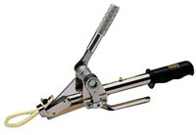
Callicrate Bander
Used for tail docking, castration, prolapse treatment and for horn removal.
Always wear safety glasses
Tetanus Toxoid must be administered to the animals as horn removal takes approximately 3 – 6 weeks to complete.
Must use adequate restraint on cattle’s head using nose tongs or a halter.
http://www.nobull.net/ shows how to use the tool.

