Slide 1
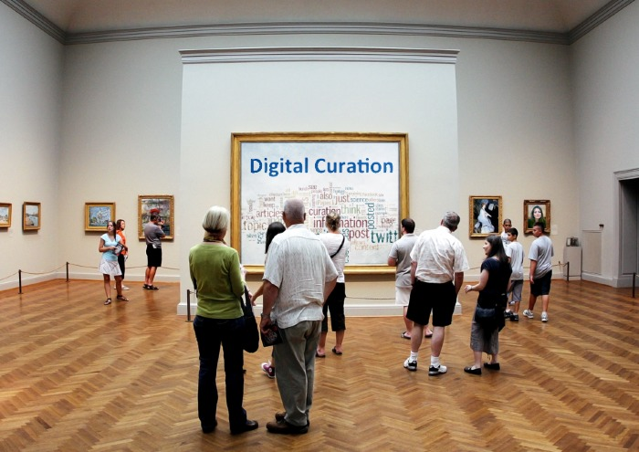
Notes:
This 1hr session aims to provide students with a brief introduction to the practice of digital curation and illustrate its relevance and value for learning and research.
It will explain what digital curation involves and why it is important to practice it.
Each phase of the curation process will be described and discussed.
A range of digital tools and services that can be used to curate digital content will be introduced.
Students will be instructed to curate content in relation to their assignment.
Follow-up – practice will be reviewed and discussed.
See: Curation as Digital Literacy Practice - http://ibrarspace.net/2014/05/21/curation-as-a-digital-literacy-practice/

Slide 2










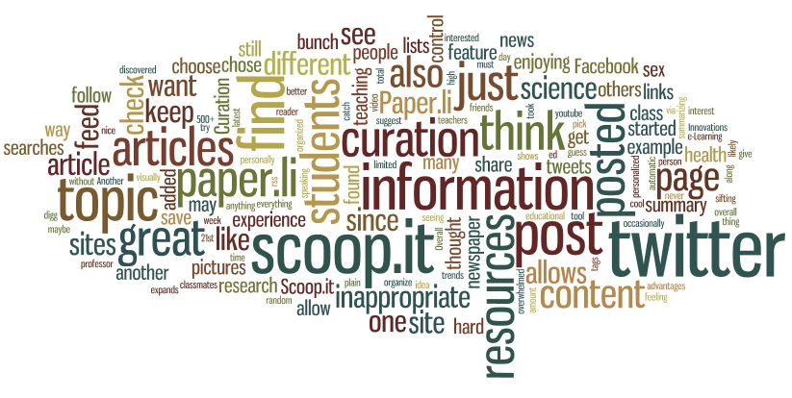




Monitoring
Finding
Engaging
What is
Digital Curation?
Selecting
Editing
Sharing
Creating
Arranging

Slide 3
Why you should be doing content curation
Dealing with an overwhelming abundance of digital content
increasing diversity of content and types of media
challenge to keep abreast, stay informed and up-to-date
coping with information overload – managing your attention, being selective and focusing effort
determining what is informative and useful – and creating added value
Coping with and managing continual change
you cannot remember everything
develop ways of quickly finding what is relevant and useful
knowing where to look for something when needed, learn to be selective and thinking critically
“Curation is an active filtering of the web’s infinite content.”
Notes:
http://www.masternewmedia.org/curation-for-education-and-learning/

Slide 4
Why you should be doing content curation
Developing essential information and digital literacies
developing the ‘mental abilities’ at the heart of learning to learn
developing the knowledge and skills to use digital tools/services effectively
curating is key to lifelong learning and becoming a knowledge worker, developing essential employability skills
Contributing and generating value for others
helping to inform and add value for others with similar concerns and interests as you
becoming known authority, recognised as someone interested and knowledgeable
working collaboratively with peers, your personal learning network, communities of interest
“A curator of information is really just a good researcher and organiser of information.”
Notes:
http://www.masternewmedia.org/curation-for-education-and-learning/

Slide 5


Curating for learning
and research
Consider...
What kinds of information are you looking for? Where are your sources?
What will be important and useful?
Criteria for selection?
Relevance for grant application assignment?
How will you organise and manage what you find?
Who will you share your information with? Where is your audience?
How will you make your resources available?

Slide 6

Finding content
Seek, discover, locate and identify...
Specify the topics, issues, questions guiding your search for information
Develop habits that predispose you to exploring, browsing, scanning
Identify sources: websites, blogs, Twitter streams, RSS news feeds
Perform searches, set up alerts, sign-up to forums and discussion lists
Collect, aggregate and store
Notes:
Searching
Image - http://thegaryartgood.blogspot.co.uk/2013/08/hoarding-man.html

Slide 7

Selecting the best
Sort, filter, assess, critically analyse and evaluate...
Determine what is worth keeping and what should thrown away
don’t capture unless you think it is high quality and will be useful
be discerning - decide what is current?, important?, the best?
Developing sensitivity to emerging patterns, themes
monitor how news/issues are developing
what is unusual and out of the ordinary?
how do the pieces fit together? what’s the big picture?
A vetted selection of what is found
comparative analysis, verification of alternative sources
judge relevance, originality, quality
then store, manage and archive
“What you leave out can be just as important as what you decide to keep.”
Notes:
selecting

Slide 8
Editing to add value
Make sense of what has been found...
Focus on adding value
Introduce, summarise and synthesise – distil out themes, issues and patterns
Ask questions of the material you have found – what significance does it have?
What is your perspective? contribute your own view, your understanding
Narrate and commentate on what you read and hear
Contextualise
where and how does the information fit with your area of interest?
what is the picture picture? What are the key issues?
make additional notes and annotate your resources
e.g., write a blog post, embed links to other relevant material
share links and comment on Twitter – add #hashtag ‘your topic’
Notes:
editing

Slide 9
Arranging
Managing and organising your collection...
Consider how to make your content locatable and discoverable
by you and by others – consider the needs of your target audience
how can you make it findable, searchable, accessible?
think about what needs to be salient, obvious, highlighted
Classify your content, use labeling, tagging, metadata
develop indexes, content lists and your taxonomy
sort, create structures, categorise, organise, arrange
aim to rank and prioritise in terms of importance and value
Notes:
arranging

Slide 10




Creating
Author, produce, contribute...
How people make sense of the the topics and issues
Annotate the links and content you share
Develop your own presentation and delivery of the information
Write to create meaning, with your audience in mind
  - recognising and constructing alternative views of a topic/issue
Remember to acknowledge and always give credit to your sources
Where to publish and share?
http://www.scoop.it/
https://storify.com/
https://www.diigo.com/
Notes:
Creating
Storify is a way to tell stories using social media such as Tweets, photos and videos. You search multiple social networks from one place, and then drag individual elements into your story. You can re-order the elements and also add text to give context to your readers.
Scoop.it is a terrific tool for discovering those super nichey, hidden gems relevant to specific topic. Use the dashboard to manage an unlimited amount of sources (websites, RSS feeds, specific social media accounts, etc.) and plug in relevant keywords and date parameters. Scoop.it does the rest and delivers you a constant feed of exactly the type of content you’re looking for.
BagTheWeb helps users curate Web content. For any topic, you can create a “bag” to collect, publish, and share any content from the Web. Beyond most curation tools’ capability, BagTheWeb enables users to build networks of bags. This way bags can be linked together to provide rich and complete information about any topic.
PerlTrees is a highly visual and interactive tool that aids discovery of new, relevant content by presenting it in a graphical way. The interface builds a hub-and-spoke style tree diagram of content that you search for, discover and collect. Hover over new “pearls” to see at-a-glance previews of the content which you can then “pick”, comment upon, and share.
Pinterest

Slide 11

Sharing
Disseminate, publish and make available to others...
Be open
Identify your audience
Find out where and how to best share with your target readers and listeners
Focus on known communities of interest and practice
Feed your Personal Learning Network
Make available the best nuggets in a format that is easily digested
Present in a meaningful, organised way – make it accessible, locatable, usable
Notes:
sharing

Slide 12

Engaging
Participate, contribute, comment, communicate...
Develop your Personal Learning Network
Find out who is interested in the same things as you?
Who are the ‘thought leaders’? relevant people to listen and talk to?
Identify those who are messaging and curating on similar topics
Identify online communities of interest and practice – connected and networked
It is about feeding and tuning your network
Respond to what other people are saying and doing
  - comment on other peoples’ stuff – tweets, blogs posts,
Encourage and invite others to get involved and have their say
Initiate and host the conversation
  - ask questions, stimulate and facilitate the discussion
Identify where and how people can participate
e.g., Twitter, Google+, Facebook, discussion lists
Notes:
engage

Slide 13


Monitoring
Keep track of developments...
what is happening as a result of sharing your content?
what impact is it having on what others are saying and doing?
Is your contribution being followed?
Tweets being re-tweeted and favourited?
Blog posts being mentioned and commented on?
Notes:
Monitor

Slide 14
Plan of attack!
Over the next week, as a group, working together try out each of the steps
Report back in a weeks time to review what you have curated
- be prepared to explain relevance and value for the assignment
Review how you have gone about curating
- we will discuss successes and challenges, what has worked and what hasn’t and why

Slide 15
Summary
When curating think about:
What is the purpose?
What do you want to accomplish for yourself and for your audience?
What themes and topics do you want to follow?
Identify the best sources to follow – blogs, people on Twitter, web sites, news sites
Start small and build gradually
Think about how you will organise and managewhat you’ve found
How will you make sense of what you find? What questions will you ask?
What makes something important and of value?
Be selective and share only the best stuff
Who are you going to share with? What networks, communities,
How are you going to make available what you have produced?
Read/comment on other people’s curated content

Slide 16


Time and task management
Think about the way you learn and work
  avoid feeling overwhelmed - you won’t find everything
  new practices require time, effort and focus to develop
  you don’t need to do it for hours
Try to integrate into your daily routine
  plan and schedule to fit in with what you already do
  do a little bit everyday, decide when and for how long
  work at developing new habits

Slide 17
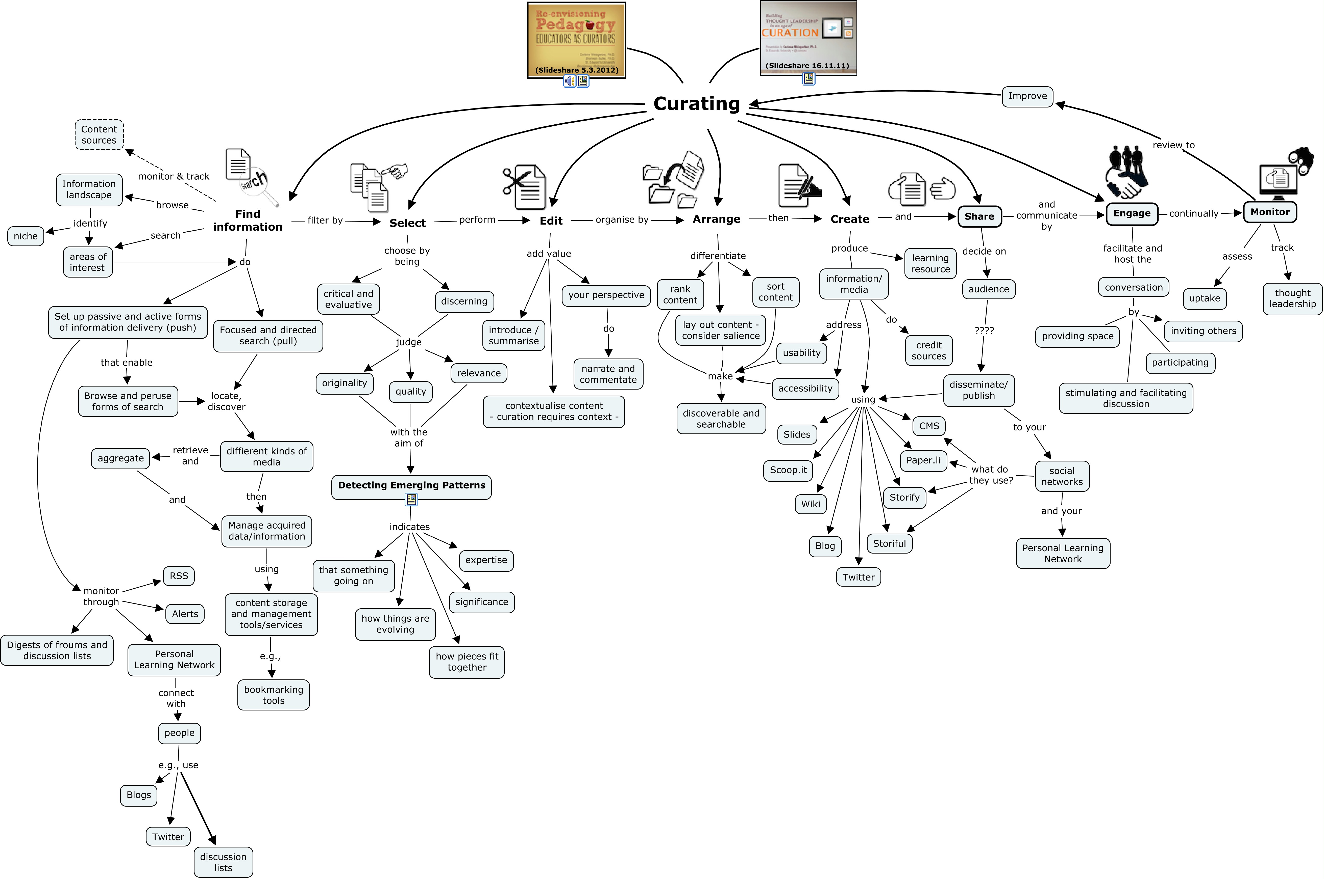
Further information
http://cmapspublic3.ihmc.us/rid=1MMBX3X84-1BR00LM-MCXC/Curation%20as%20education.cmap
Mihalidis, P and Cohen, J.N. (2013). Exploring Curation as a Core Competency in Digital and Media Literacy Education. Journal of Interactive Media in Education.
http://jime.open.ac.uk/2013/02
Rivki, G. and Ilya, L. (2012). Digital curation as learning activity. Proceedings of EDULEARN12 Conference, 2nd-4th July 2012, Barcelona, Spain.
http://www.tau.ac.il/~ilia1/MY_PAPERS-PDF/Procidings/Curation.pdf

