Slide 1
TYPES OF SNIPER RIFLES
TYPE OF SNIPER RIFLE
SEMI AUTOMANTIC RIFLES
BOLT ACTION RIFLES
Welcome to the World of Sniper Rifle!
Lets take a tour on Sniper Rifles around the world!
Click on the Individual Rifle Button for more info!
Let’s go Sniper!

Slide 2
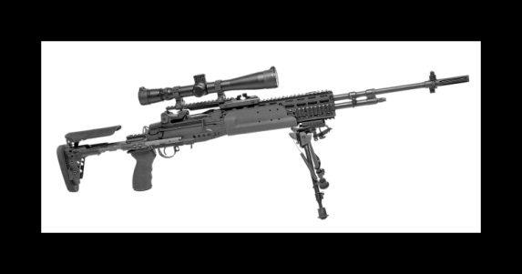
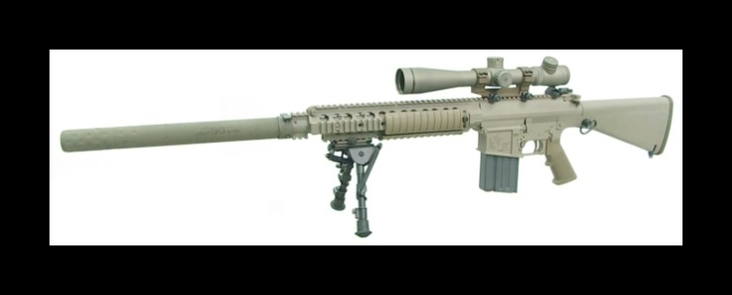
SEMI AUTOMANTIC RIFLES
A semi-automatic rifle is a rifle that fires a single round each time the trigger is pulled, uses gas, blow forward, blowback, or recoil to eject the spent cartridge after the round has travelled down the barrel, chambers a new cartridge from its magazine, and resets the action; enabling another round to be fired once the trigger is depressed again.
M14 EBR
M110 SASS
CLICK THE RIFLE FOR MORE INFO!

Slide 3
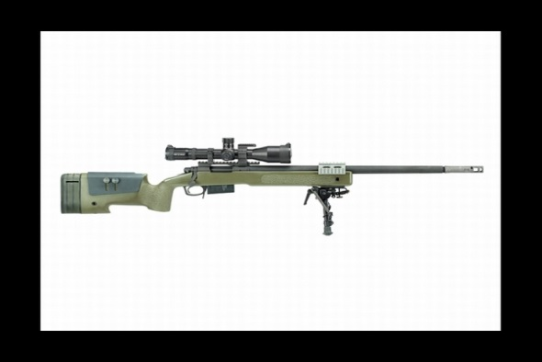
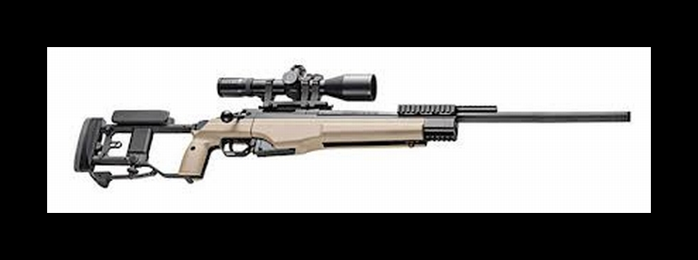
BOLT ACTION RIFLES
Bolt action is a type of firearm action in which the weapon's bolt is operated manually by the opening and closing of the breech (barrel) with a small handle, most commonly placed on the right-hand side of the weapon (for right-handed users). As the handle is operated, the bolt is unlocked, the breech is opened, the spent cartridge case is withdrawn and ejected, the firing pin is cocked (this occurs either on the opening or closing of the bolt, depending on design), and finally a new round/cartridge is placed into the breech and the bolt closed.
M40A5
SAKO TR22
CLICK THE RIFLE FOR MORE INFO!

