Slide 1
Using a Mac RQ Template
Please press F5 to begin the slideshow. Then, please use the spacebar to advance forward and backspace to reverse. The tutorial is much more easily viewed as a slideshow.

Slide 2
The Template
The RQ template file has been provided as an image. Please make sure to save it as a .jpeg file.

Slide 3
Be sure to remember where you saved the file! You now need to open the file in Seashore. You can either right click the file itself and click “open with…” or open seashore and use the program to open the template.

Slide 4
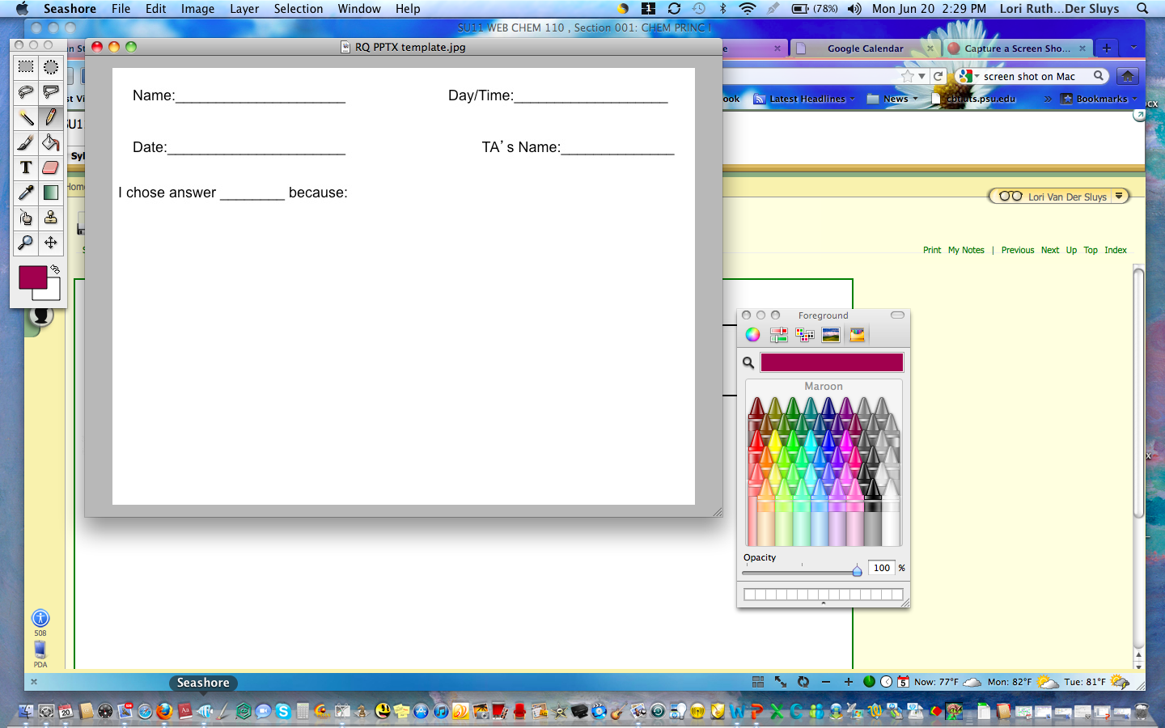
After opening the file, you must select the pencil and color you want. Please DO NOT USE RED! Please leave the background WHITE!

Slide 5
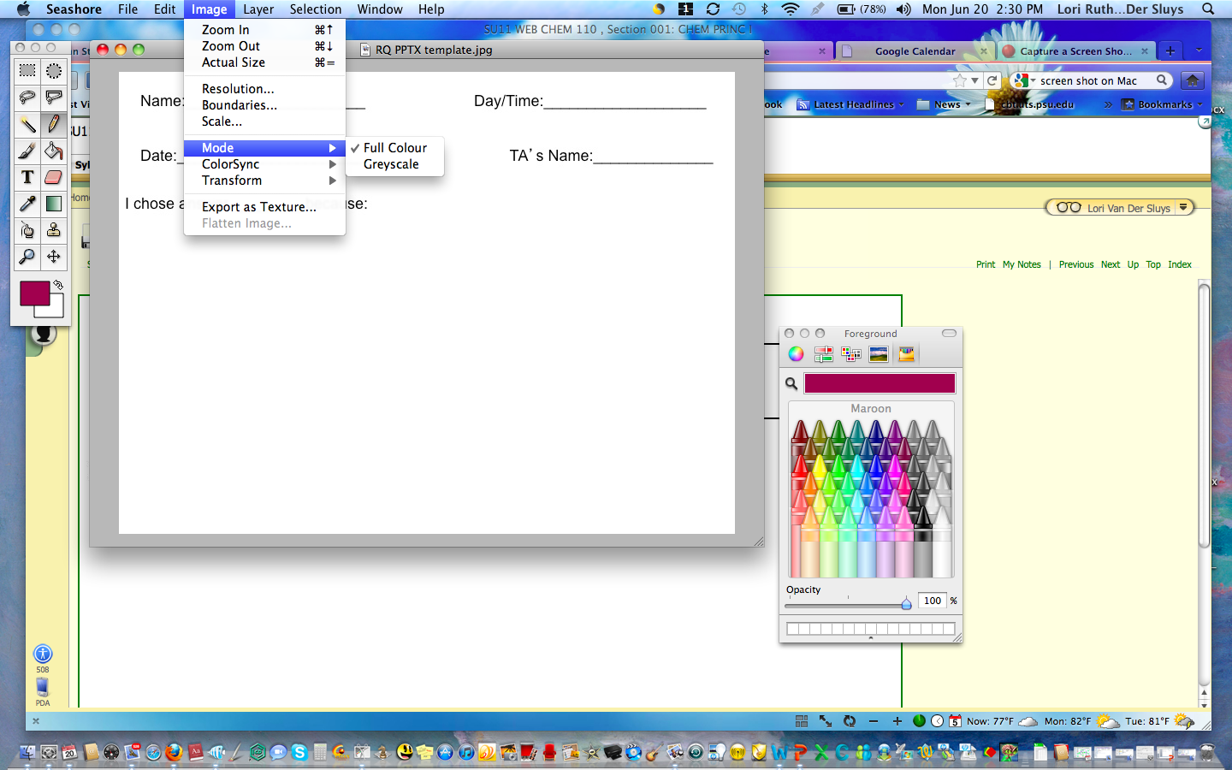
Next, please be sure that the picture mode is set to color. Simply click “image,” “mode,” and “Full Color”

Slide 6
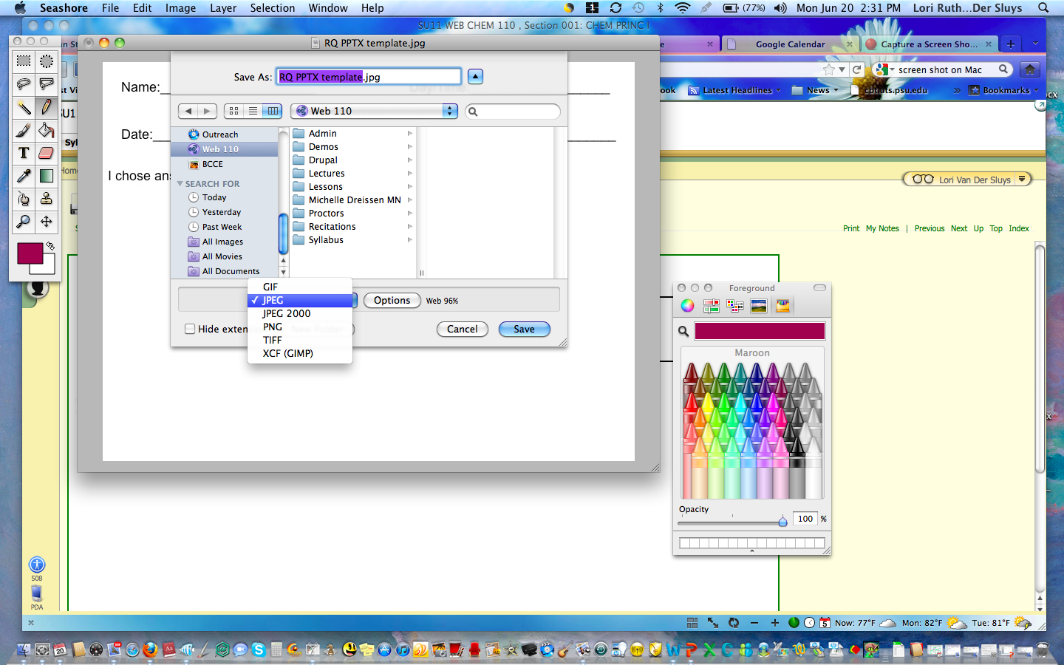
You can now write your answer. When you are finished, please be sure to save the file in JPG format!

Slide 7
Please write your answer to the RQ and save your file as a JPEG image. Please use our requested nomenclature system consistently. When naming your file follow this format “Last Name_RQ#”. So an example would be “Smith_RQ4”. Then, submit it via Coursesite dropbox unique to your TA. If you’re unsure of how to use this dropbox, please see the related tutorial.

