Slide 1
Using a RQ Template
Please press F5 to begin the slideshow. Then, please use the spacebar to advance forward and backspace to reverse.

Slide 2
The Template File
Template files have been provided as both PowerPoint and Word documents. You may use whichever is more convenient for you.

Slide 3
Which template do you want to use?
Please click.
PowerPoint
Word

Slide 4
Microsoft Word
Allow the file to download and then open.

Slide 5
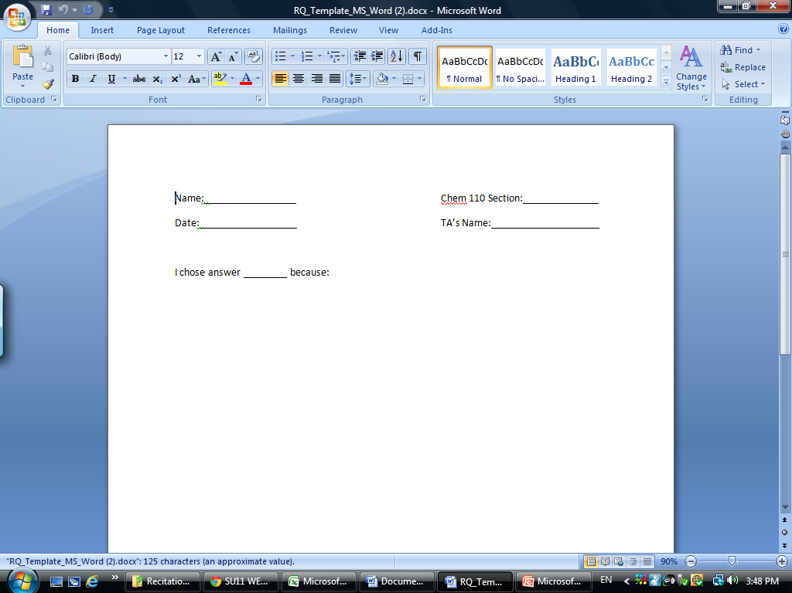
If your version of Word supports “inking,” click the “Review” tab.

Slide 6
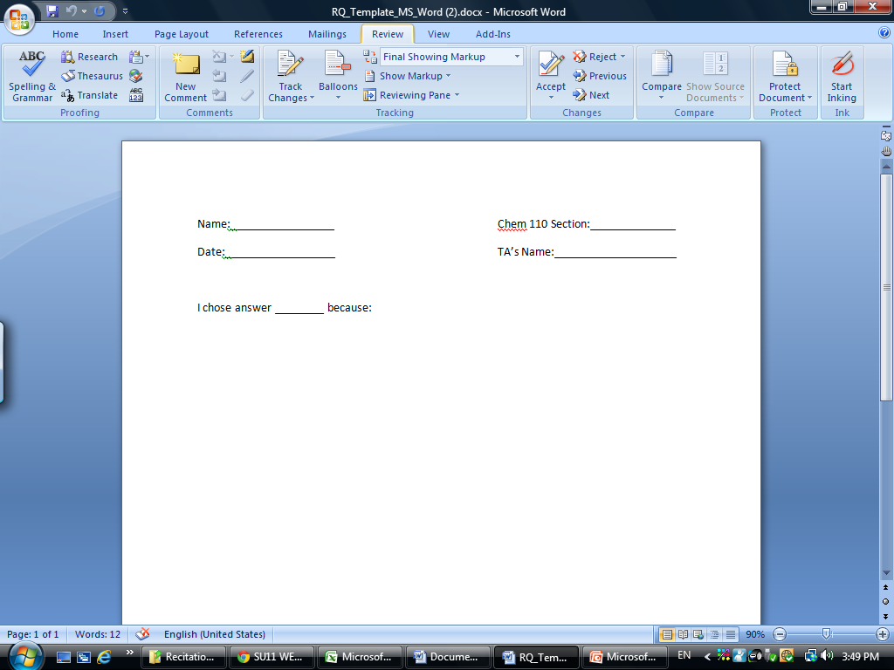
On the right hand side of the menu you will see a “Start Inking” button. Click this.

Slide 7
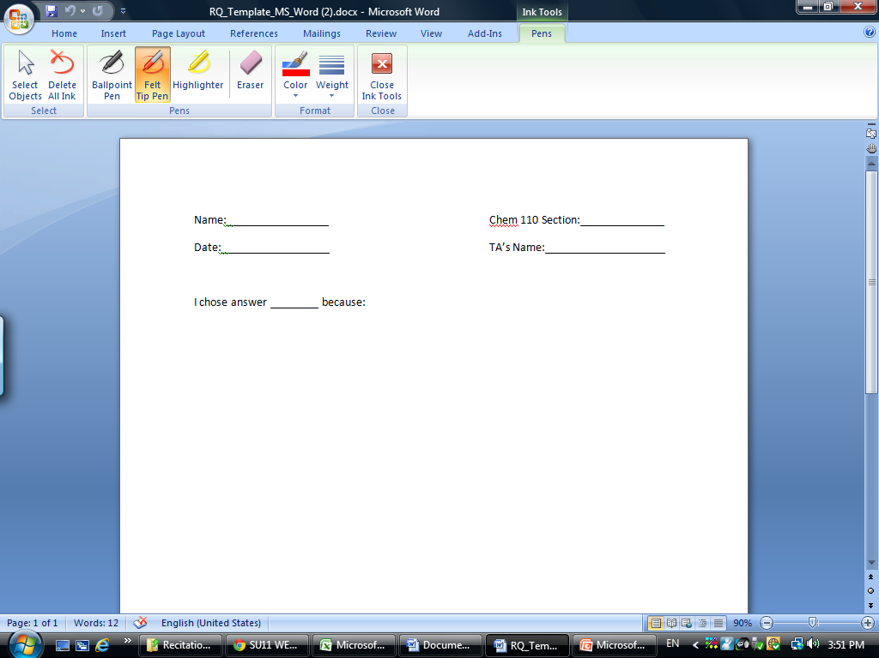
Select “Ballpoint Pen” and the color and weight you prefer. Please DO NOT USE RED.

Slide 8
Your mouse cursor is not able to be used as a pen with the bamboo tablet. Please write your answer to the RQ and save your file as a Word document. Please use our requested nomenclature system consistently. When naming your file follow this format “Last Name_RQ#”. So an example would be “Smith_RQ4”. Then, submit it via the Coursesite dropbox unique to your TA. If you’re unsure of how to use this dropbox, please see the related tutorial.

Slide 9
Microsoft PowerPoint
Allow the file to download and then open.

Slide 10
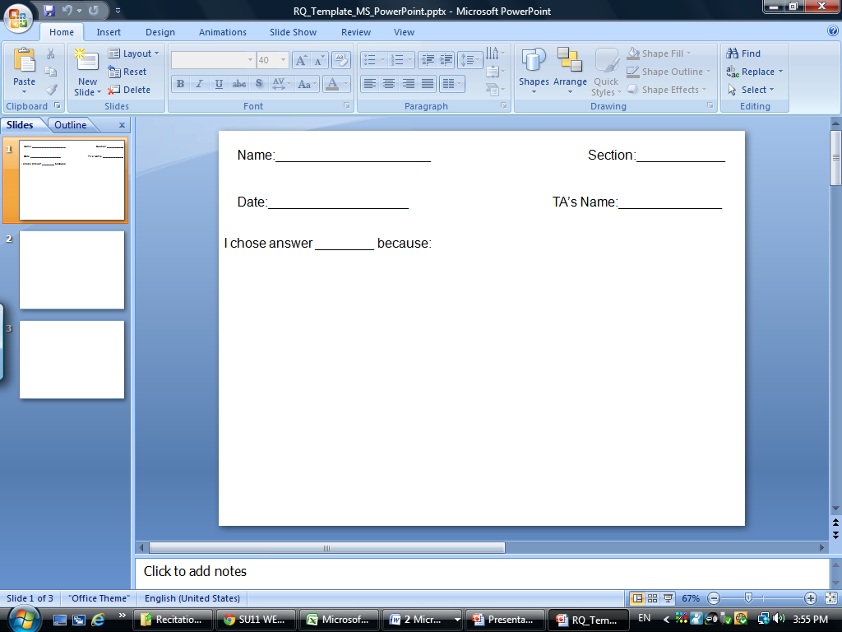
PowerPoint offers two methods of using your Bamboo. We will present both here. You can create your response either in the initial PowerPoint screen or while running a slideshow. This is personal preference. To use the default screen click the “Review” tab.

Slide 11
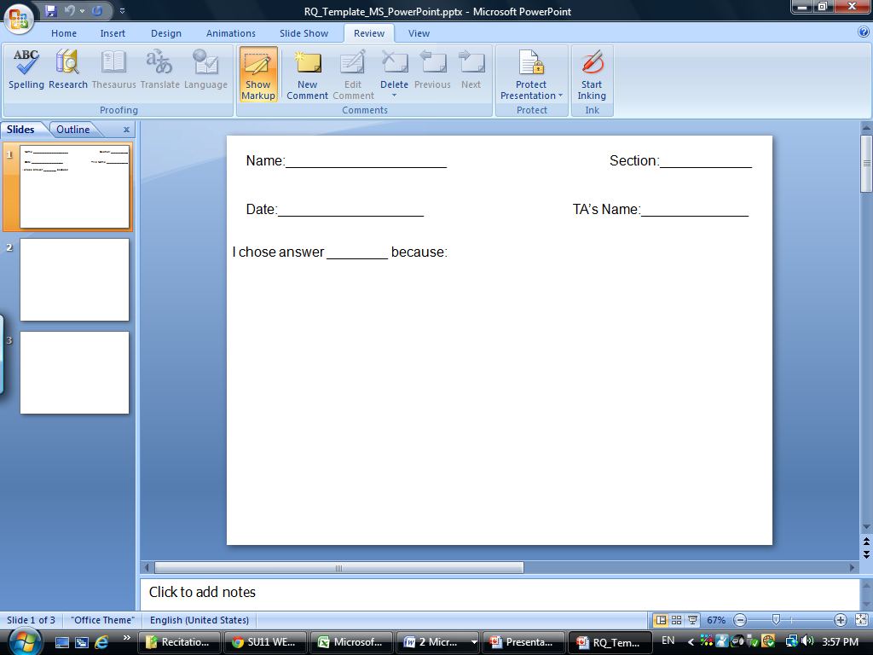
Now, click “Start Inking”

Slide 12
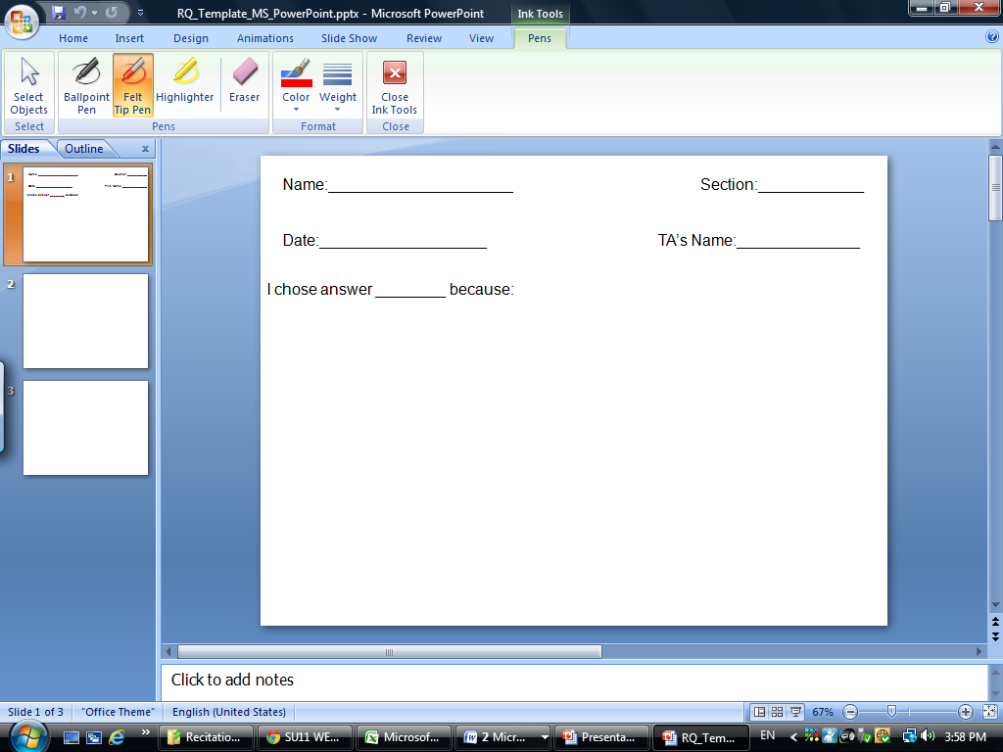
Now, select “Ballpoint Pen” along with the color and the weight you prefer.
Please DO NOT USE RED!

Slide 13
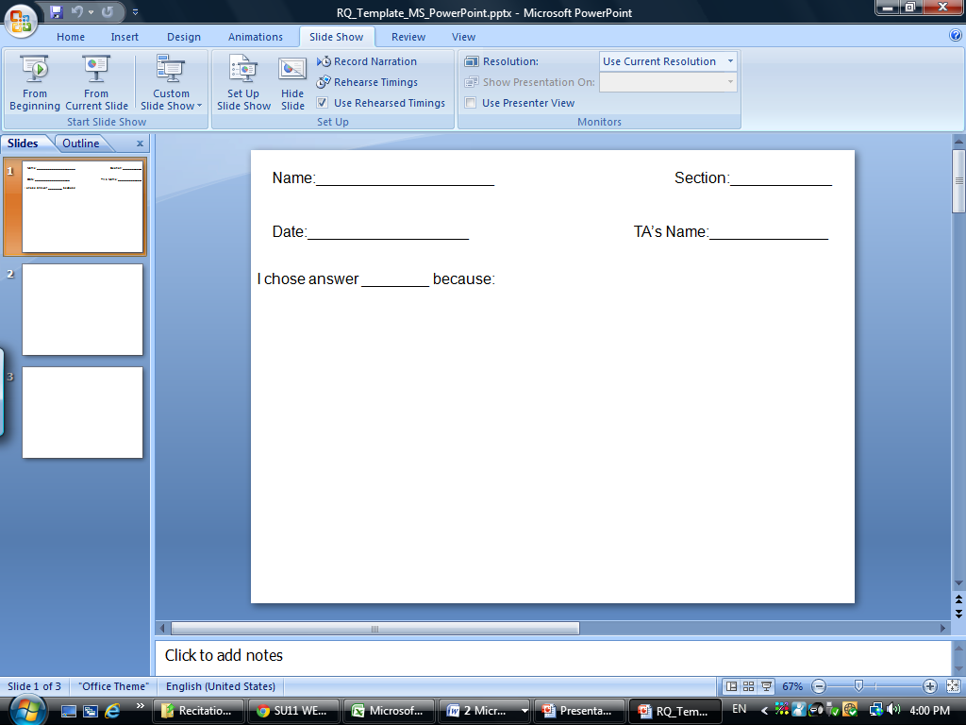
If you prefer, you can do this while displaying the “slideshow.” Begin by clicking the “Slide Show” tab and then click “From Beginning”

Slide 14
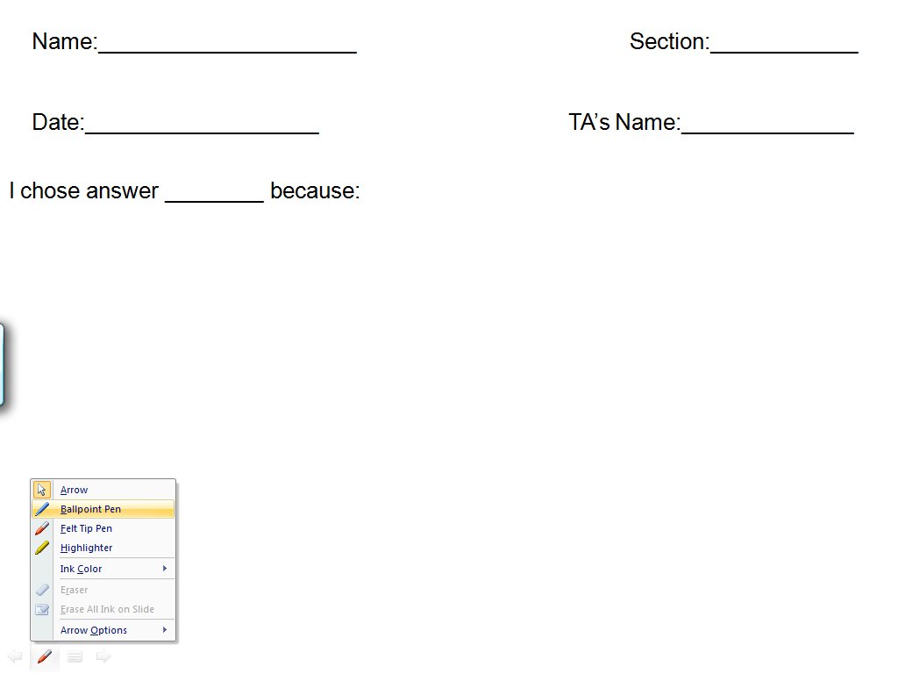
Move your cursor to the bottom left side of the screen and a pen will appear. Click the pen and select “ballpoint pen.” Repeat the process to select your color. Again, please DO NOT USE RED!

Slide 15
Your mouse cursor is not able to be used as a pen with the bamboo tablet. Please write your answer to the RQ and save your file as a PowerPoint document. Please use our requested nomenclature system consistently. When naming your file follow this format “Last Name_RQ#”. So an example would be “Smith_RQ4”. Then, submit it via the Coursesite dropbox unique to your TA. If you’re unsure of how to use this dropbox, please see the related tutorial.

