Slide 1
Practice Problem 12.2
Effusion of an unknown gas
Before you begin make sure the problem is printed out and in front of you.

Slide 2
The Question
An unknown gas is found to effuse at a rate that is 1.864 times faster than Br₂ at the same temperature. What is the identity of the gas?
Cl₂
Ar
NO₂
CH₄
O₂

Slide 3
Concepts
An unknown gas is found to effuse at a rate that is 1.864 times faster than Br2 at the same temperature. What is the identity of the gas?

Slide 4
Connections
What is given?
  The relationship between the two gases’ effusion rates.
What do I want to know?
  The identity of the unknown gas
What else do I need to know?
  What is effusion?

Slide 5
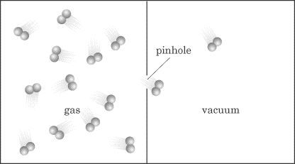
What is effusion?

Slide 6
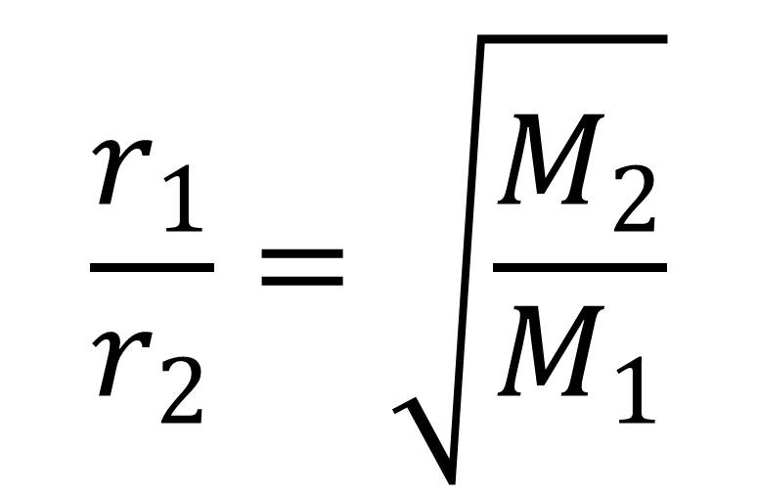
How does effusion relate to two gases?
$$\frac{r_{1}}{r_{2}}=\sqrt{\frac{M_{2}}{M_{1}}}$$

Slide 7

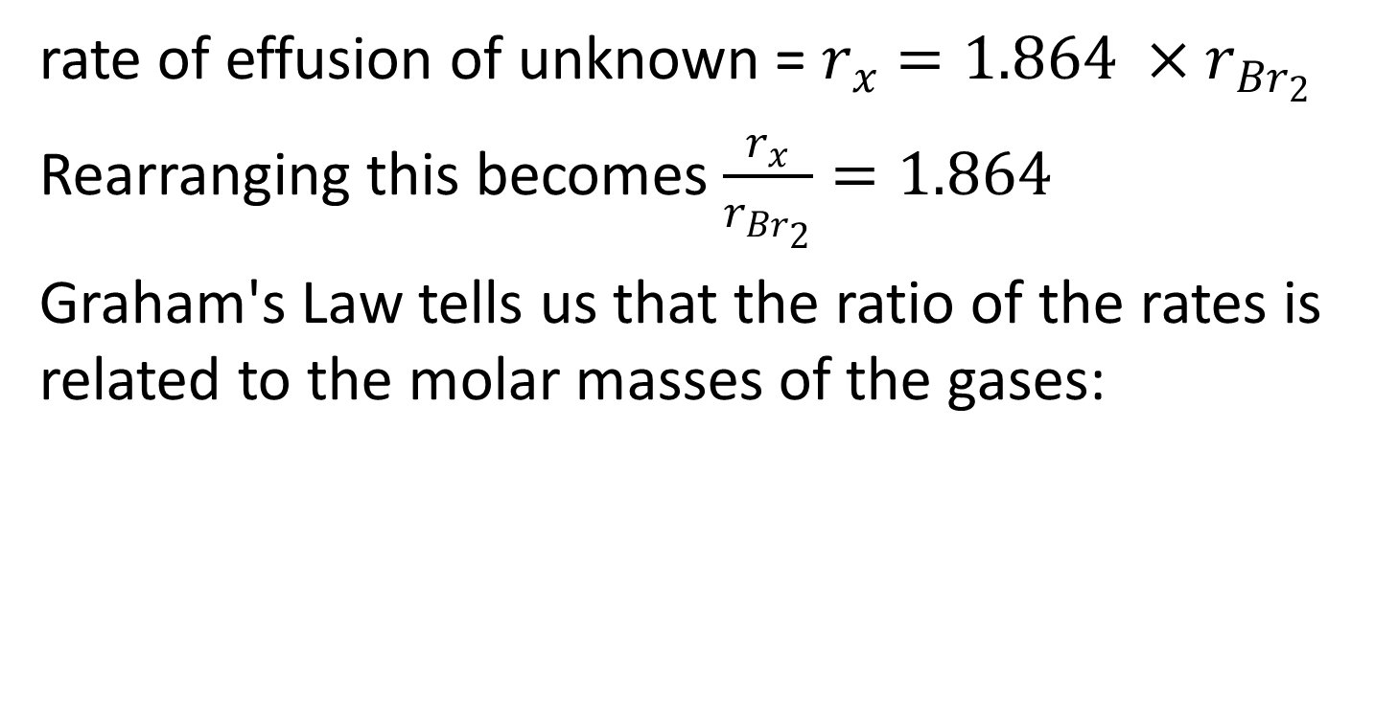
Summarize your Information…THEN solve
rate of effusion of unknown = $r_{x}=1.864 ×r_{{Br}_{2}}$
Rearranging this becomes $\frac{r_{x}}{r_{{Br}_{2}}}=1.864$
Graham's Law tells us that the ratio of the rates is related to the molar masses of the gases:
$$\frac{r_{1}}{r_{2}}=\sqrt{\frac{M_{2}}{M_{1}}}$$

