Slide 1
Flow Theory
(Csikszentmihalyi, 2008)
We are all driven to experience a “flow state” which is the optimum experience that we can have.
  It is characterized by total awareness of the task at hand and only the task at hand.
  When in a flow state, the sense of time, awareness of surroundings, and concern for self are dramatically altered.
    Athletes call it being “in the zone”
    It is common amongst those playing video games or engrossed in reading, both of which can go on for hours often without any realization of the passage of time.

Slide 2
Extrinsic vs. Intrinsic Motivation in Flow
Flow by its very definition is an intrinsically motivated state (Csikszentmihalyi, 2008).
Tasks are performed simply for their own sake. A state of flow cannot be obtained if the motivation for performing the task is extrinsic unless the motivating factor leads to an internal desire to perform the task (Csikszentmihalyi, 2008).

Slide 3
Flow Theory in Instructional Design
We learn most efficiently when a “state of flow” is achieved.
  This is most likely to happen when a task is challenging but possible given the level of student skill (Csikszentmihalyi, 2008).
  Much like a video game, proper spacing of new material, reinforcement of old material, and consistent positive feedback can maintain a student’s flow state and enhance learning to optimum levels (Dirksen, 2012)

Slide 4
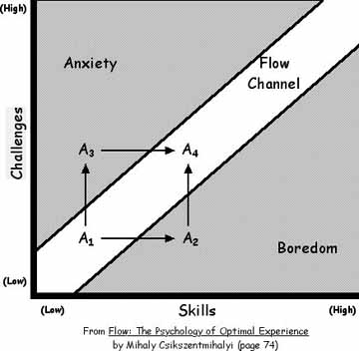
Flow – A Balance of Challenge and Skills
When the proper level of challenge is balanced against the skill level of the student (this can apply to any flow inducing task, not just education) then a state of flow can be reached (Csikszentmihalyi, 2008; Flow)

