Slide 1
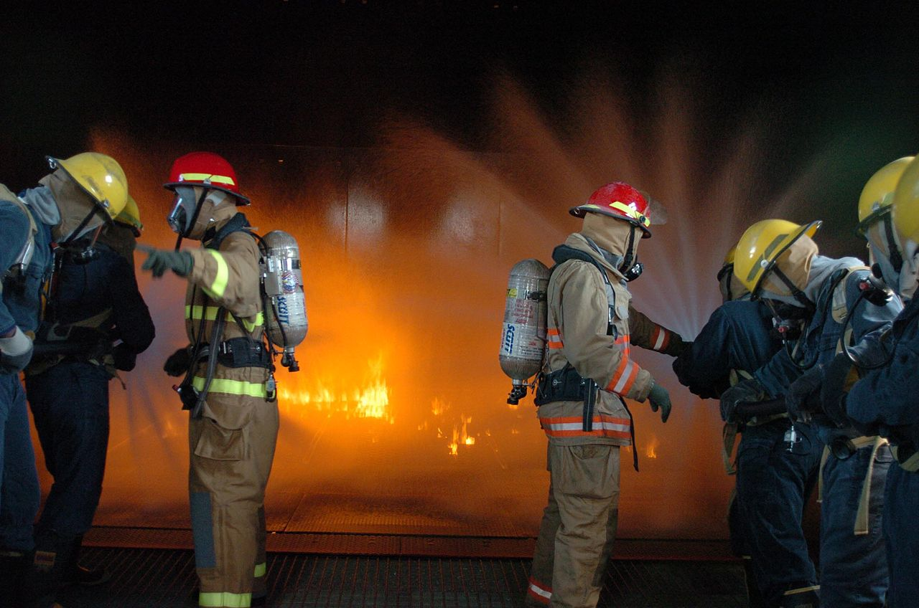
Basic Fire Fighting
Skill for L.I.F.E
Live In Fire-free Environment

Slide 2
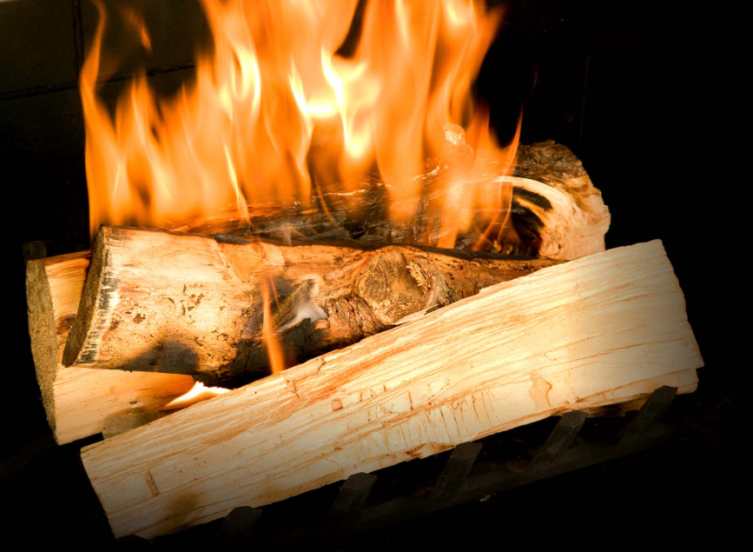
Class A
Click Here to See Suitable Extinguisher

Slide 3
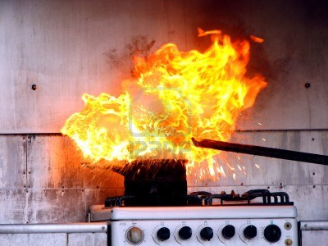
Class B
Click Here to See Suitable Extinguisher

Slide 4
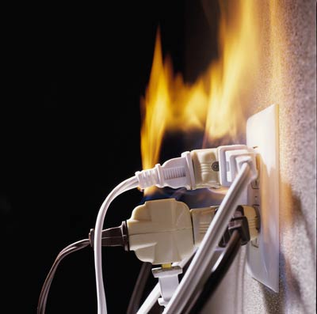
Class C
Click Here to See Suitable Extinguisher

Slide 5
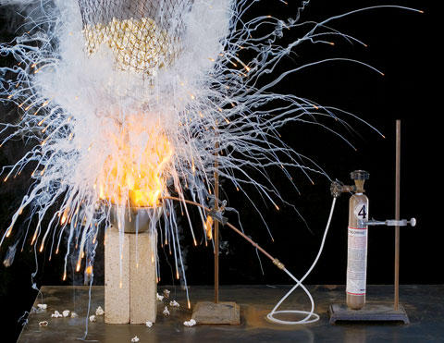
Class D
Click Here to See Suitable Extinguisher

Slide 6
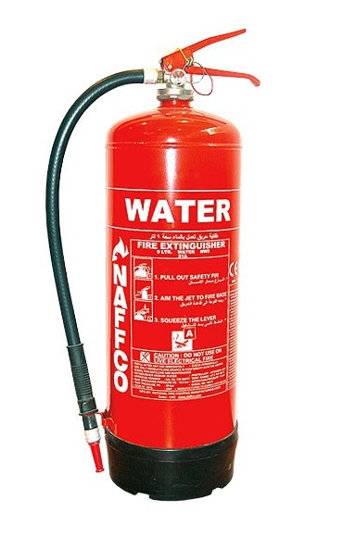
Water
Extinguisher
Back to slide

Slide 7
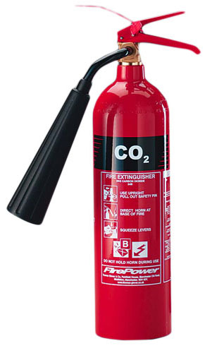
CO2
Extinguisher
Back to slide

Slide 8
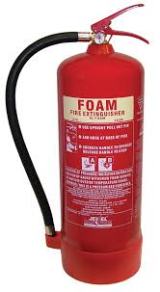
Foam
Extinguisher
Back to slide

Slide 9

Multi-purpose
Extinguisher
Back to slide

Slide 10
Thank You

