Slide 1
Mosquitoes
Aedes
Anopheles
Aedes Aegypti
Aedes Albopictus
Anopheles Maculatus
Anopheles Sundaicus
Mosquitoes are members of a family of nematocerid flies: the Culicidae
Their life cycle consists of 4 stages:
Egg
Larva
Pupa
Adult

Slide 2
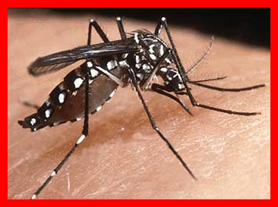
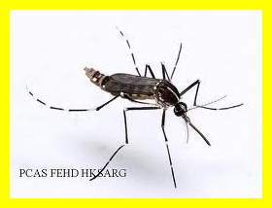
Aedes:
Identified by its black and white strips on the body
2 main species
Aedes Aegypti
  Click to see
Aedes Albopictus
  Click to see

Slide 3
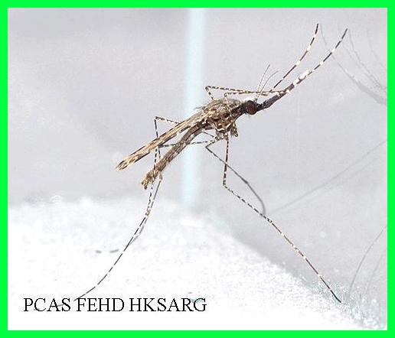
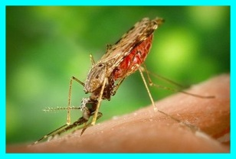
Anopheles:
Mosquito with brownish body which is known to spread malaria
2 main species
Anopheles Maculatus
  Click to see
Anopheles Sundaicus
  Click to see

