Slide 1
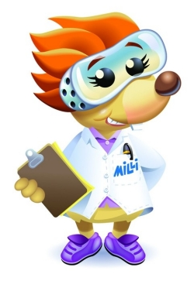
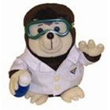
The Mole

Slide 2
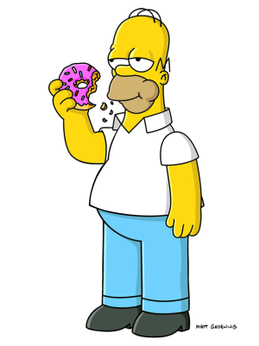
mmm…donuts
How many donuts are in the box?
  Dozen
  Twelve
If I have 1 dozen donuts how do I convert that number (mathematically) to individual donuts?
  Multiply by 12
  That was hard to remember!
Image taken from http://images.free-extras.com/pics/h/homer_simpson_and_donut-1090.png

Slide 3
The Mole
We use a similar concept in chemistry because the number of atoms in molecules is so large.
Remember there are 12 items in a dozen
Well there are 6.02x10²³ items in a mole
  This number is so large that if you had a mole of pennies you could give almost 900 BILLION dollars to every person on the planet.

Slide 4
More complicated than a dozen…
We can use the number of something to determine moles
We can also use the mass of something (using its molar mass) or the volume of a gas (22.4 L in 1 mole)
So many conversions!! How can we remember all the relationships, and the conversions if remembering a dozen was hard…

Slide 5

ROLEY MOLEY…she likes to DANCE!
A mole is an animal it has THREE FEET:
GRAMS, PARTICLES AND LITERS
When you go up, you divide!
When you go down, you multiply!
ROLEY MOLEY
MOLES
GRAMS (Molar Mass)
LITERS (22.4 Liters)
PARTICLES (Avogadro’s Number)

