Slide 1
Type of fruits in singapore
Hard Skin
Soft Skin
Mangosteen
Durians
Mango
Papaya
Type of Fruits in Singapore
Many fruits in singapore. Hard Skin and Soft Skin.

Slide 2
Hard Skin
Hard Skin Fruits to protect the fruits, against animal attack

Slide 3
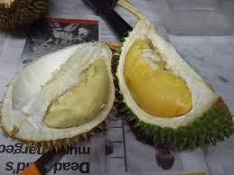
Durians
Durins. “ King of fruits.

Slide 4
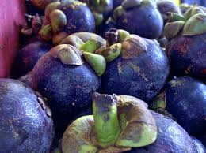
Mangosteen
Mangosteens purple.

Slide 5
Soft Skin
Entice animals to feed on the fruits.

Slide 6
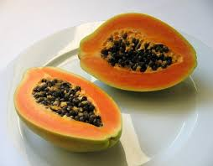
Papaya
Orangish yellow fruits in singapore . Many seeds

Slide 7
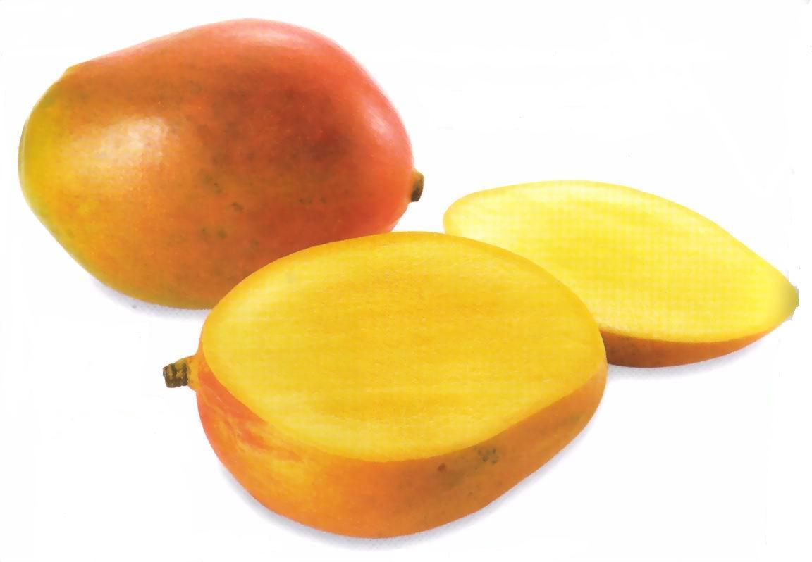
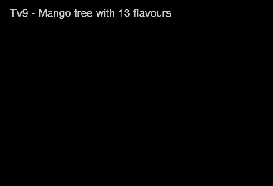
Mango
Some useful links on mango. Click here the clip below
Sweet and nice fruits.

