Slide 1
Types of Vehicles
Good Vehicles
Passenger Vehicles
Heavy
Light
Turbo Charged
Naturally Apirated

Slide 2
Goods Vehicles
Heavy
Light

Slide 3
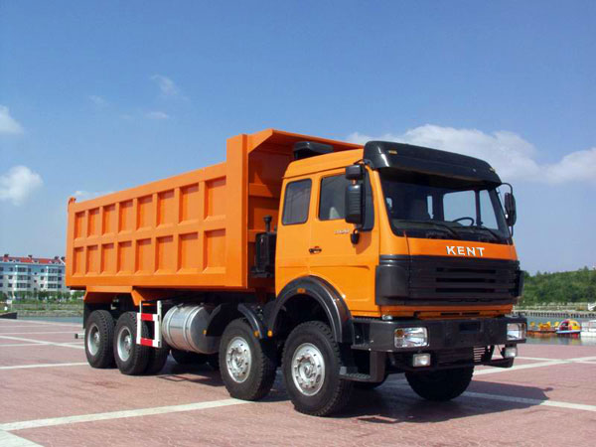
Heavy
Goods Veicles

Slide 4
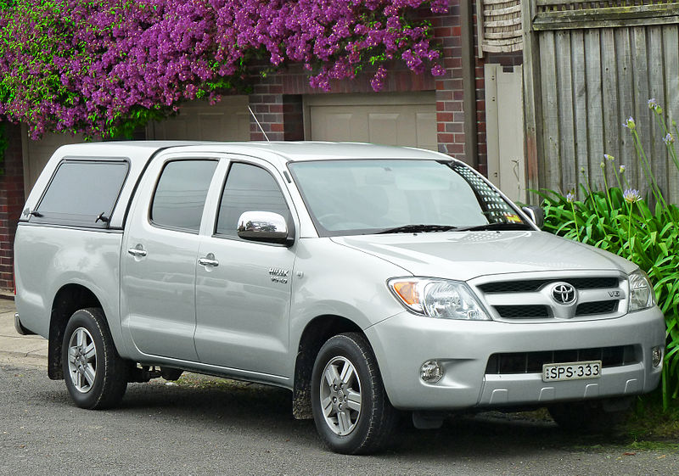
Goods Vehicles
Light

Slide 5
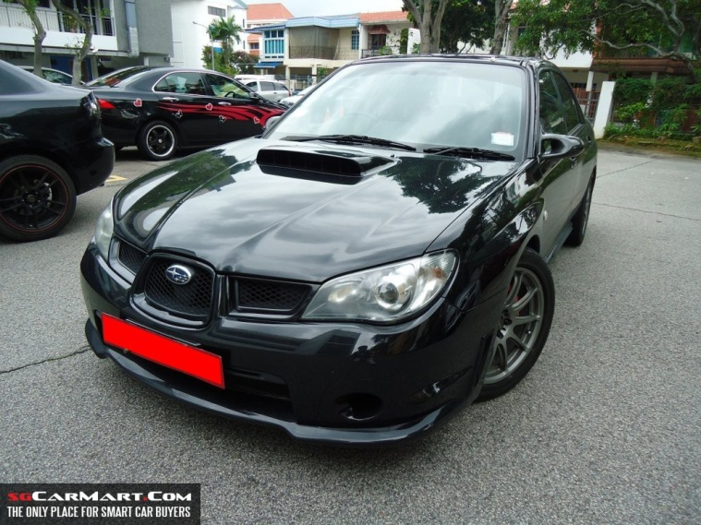
PassengerVehicles
Turbo Charged

Slide 6
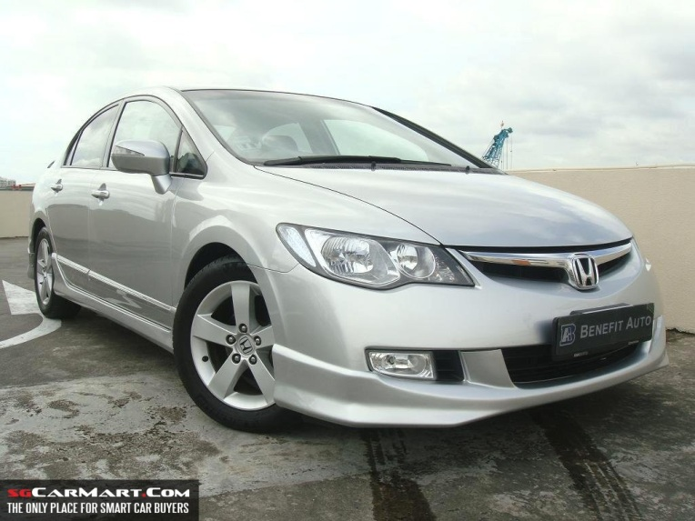
PassengerVehicles
Naturally Apirated

