Slide 1
Plants
Click to Start

Slide 2
Question 1
Which of the following is a type of Flower?
Mints
Parsley
Kitten
Roses
PRESS TO ANSWER
PRESS TO ANSWER
PRESS TO ANSWER
PRESSS TO ANSWER
Press For Q2

Slide 3
Question 2
Which Flower symbolizes passionate love?
Turnip
Sunflower
Lilies
Roses
PRESS TO ANSWER
PRESS TO ANSWER
PRESS TO ANSWER
PRESSS TO ANSWER

Slide 4

Wrong !
Press to go back to Q1

Slide 5



CORRECT !
Press to go to Q2

Slide 6
Wrong !
Press to go back to Q2

Slide 7
CORRECT !
Press to Exit

Slide 8
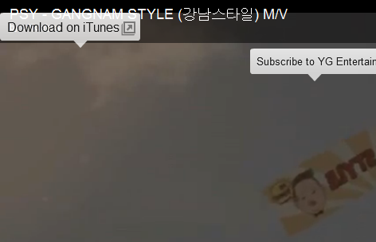
Click to Enjoy
Or
You may close the Program
The End

