Slide 1
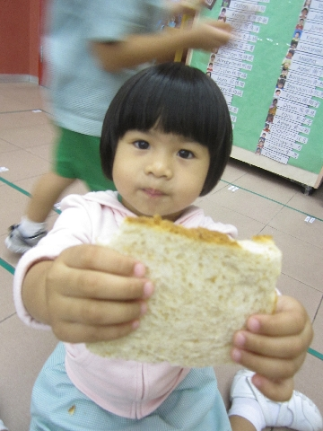
Good Afternoon, my name is Freya. I’m right now studying at St. Francis Xavier Kindergarten.
I will show you some of the activities that we have in school!!!

Slide 2
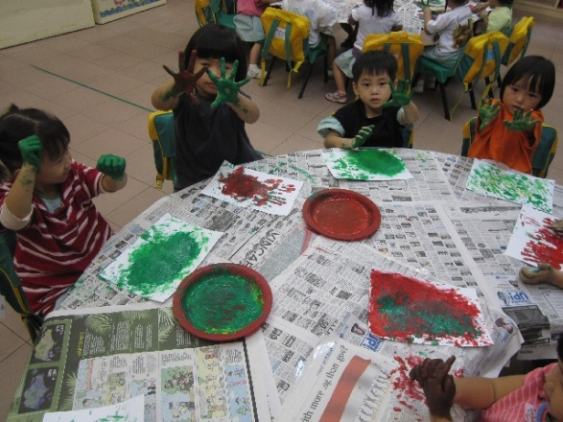
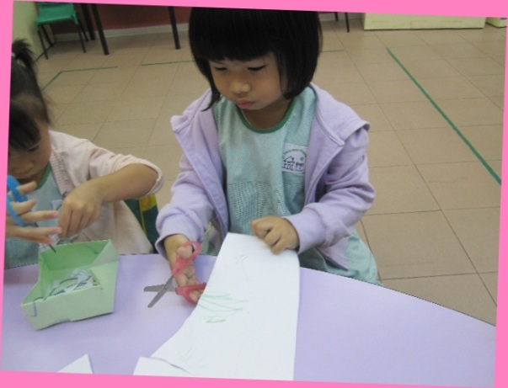
On the right, you can see that we are having Art & Craft Lesson.
Look at us, we are doing Finger Painting & Cutting to train our Hand- Eye Co-ordination.

Slide 3
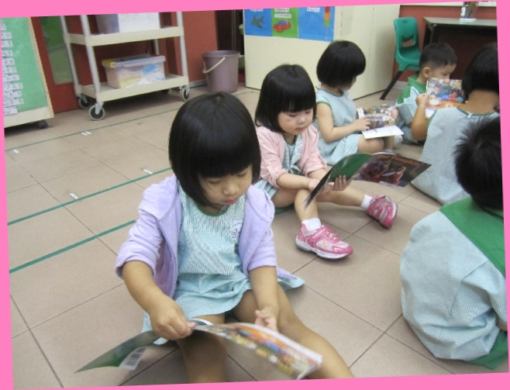
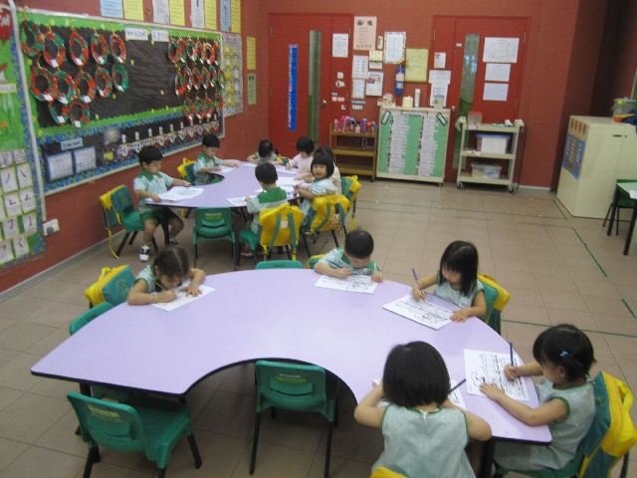
After the Art & Craft, it’s time for some reading!

Slide 4
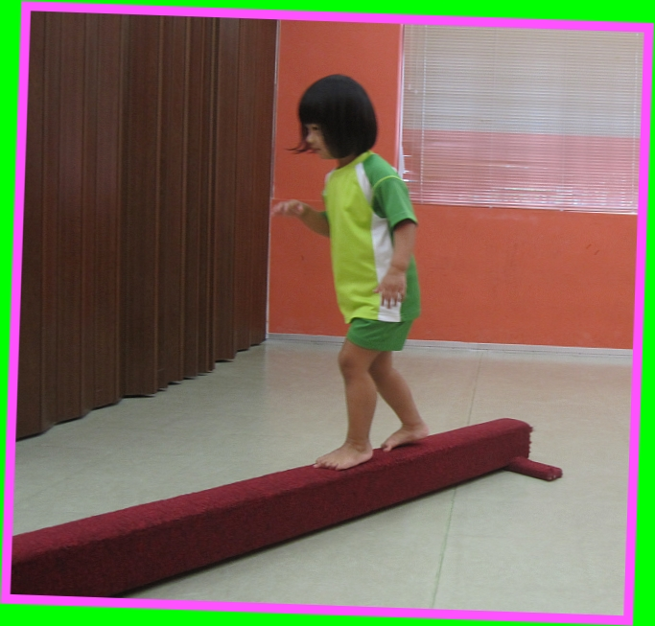
It’s time for Sports & Games!!!
Look at my performing some balancing acts!

Slide 5
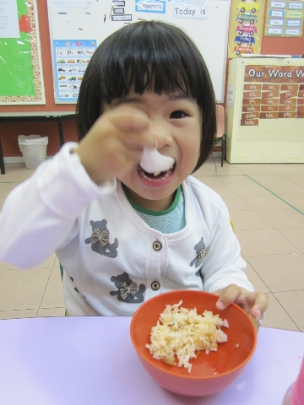
More to come….
Break Time!!!

Slide 6
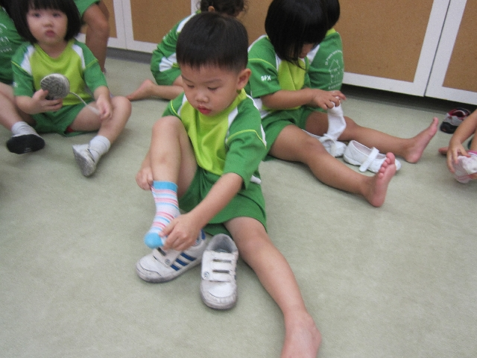
Time flies, and it now time to GO HOME!!!

