Slide 1
The Literacy Narrative
Writing about your literacy and its impact on you today!

Slide 2
Focus:
Pick an experience that:
Means something to you
Influenced your literacy/education
Can be snapshot in the reader’s mind

Slide 3
Snapshot
What image comes to mind in Se Habla Espanol?
What image comes to mind in Literacy Behind Bars?

Slide 4
Impact of event
How did this event impact the writer’s life?
Se Habla Espanol
Literacy Behind Bars

Slide 5
What Makes a Strong Story?
Beginning: Engage the reader
Middle
End

Slide 6
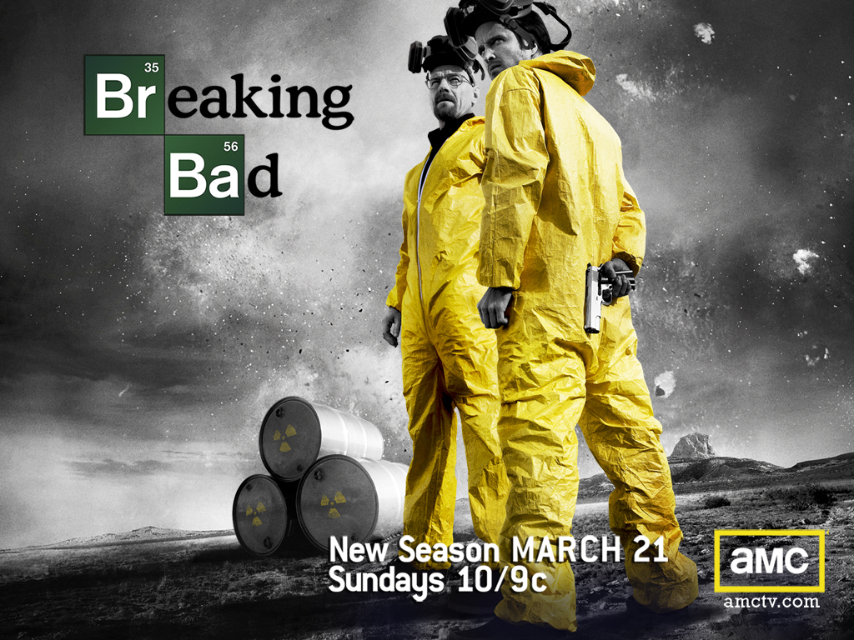
Enticing Introduction
Enticing Introduction
            http://www.youtube.com/watch?v=QyGxROwihHs&feature=related

Slide 7
Thesis
The most important sentence in the whole paper

Slide 8
Thesis Statements
Specifically tell the reader what the paper is about.
Has three main points to it and are put in order of discussion of paper
Is the last sentence of first paragraph. ALWAYS

Slide 9
Middle of Story
What details to include:
Sensory details:
Help reader feel like he/she is there
Dialogue: Use “ “ to capture what was likely said.

Slide 10
What to leave out
Repetitive details
Obvious statements

Slide 11
Endings:
Leave the reader with a new idea:
  How did this event bring you here?
  How did it impact your life?
  Please leave out:
  In Conclusion
  To Summarize

Slide 12
What do you think of these?
Does it match a literacy narrative?
Do they intrigue you?
Is there a thesis?

Slide 13
I remember it very well. I was sitting at a small, worn wooden table in the corner of McCullough library in North Bennington, Vermont. It was a very quite town and an even more quite of a library. My best friend Daniel was sitting across from me, each of us with a stack of books. It was my first day spent in a library. The air was stiff and filled with countless unread words and as the sun shined through the unshaded window I saw a thick dust dancing in the silence.

Slide 14
When I was seven years old, my family moved from Washington State to Kentucky because of some job prospect my father had in Elizabethtown, KY which I can hardly be expected to remember over twenty years later. The road trip, however, was moderately memorable. Parts evade memory altogether, being swallowed up in the sticky soup of childhood brain fuzz, but others remain dimly visible somewhere discreet and snug. I recall mimicking my idea of a Kentuckian accent repeatedly by twanging out the words: “I want me a bucket a Kentucky Fried Chicken!” ad nauseum to the exaggerated pretense of amusement from my parents and my older sister’s annoyed glare. More importantly, I learned a valuable lesson about the situational changes of the effect of words and phrases.

Slide 15
When I was young I used to play soldiers with my little brother, after seeing “Black Hawk Down” I thought it was the coolest thing ever. As I got older my obsession with the military grew stronger and stronger. It got to the point where every night I would study military tactics and strategies for hours then draw up a map and run a simulation using my own strategies. When I finally turned eighteen, I enlisted in the military. It was too my utmost horror that they rejected me due to a spinal condition I have.

Slide 16
There are many crucial points in our lives that define who we turn out to be. Most of these critical times are when we are but young innocent children, blind to the realites around us. Everyone has good moments, and bad just the same, but the way we let them affect us define the person we become. The most important thing that I believe happened to me was an elementary school teacher named Mr. Grammas.

Slide 17
I’m sure you remember your favorite bedtime story. My favorite happened to be The Very Hungry Caterpillar. Parents read stories to their kids to create the building blocks for reading and writing. I encourage all parents to read with their kids to develop an interest in reading and writing. Without my mother’s continuous efforts to make sure I was read a story before I went to sleep, I wouldn’t be as literate as I am today.

