Slide 1
An analysis

Slide 2
What is an analysis????
A way to look deeply at a topic from several points of view

Slide 3
What is the right college for you?
What did you take into account?
Cost
Location
Flexibility
Majors

Slide 4
How do you spend your day?
Classes
Work
Homework
Household
Family
Free Time
Electronics
Friends

Slide 5
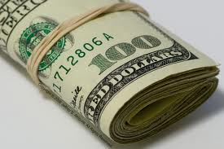
Where does your money go?
Housing
Food
Car– Gas
Car upkeep

Slide 6
How does ____________
Influence _____________
Examples from Election:
  Who do the debates affect?
  What influences “Swing Voters”?
  Why do both candidates play down their debate ability?

Slide 7
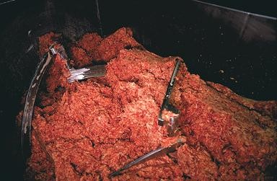
Food : Examples of Analysis
Pink Slime: How has the general knowledge of pink slime affected school lunches?

Slide 8
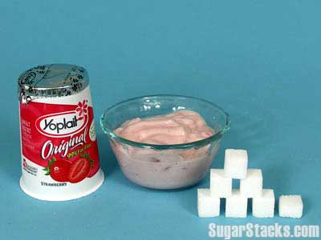
How much sugar is in your diet?

Slide 9
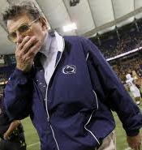
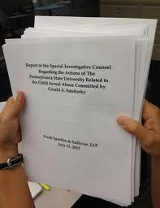
what went wrong with Penn State Football?

Slide 10
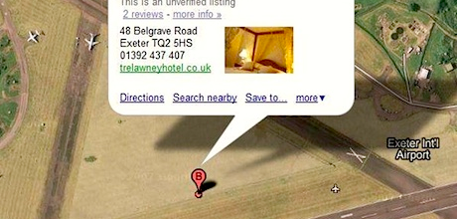
What happened with Apple Maps

Slide 11

Why would people create a new toilet?

Slide 12
Water, Sanitation & Hygiene
About 2.5 billion people use unsafe toilets or defecate in the open. Poor sanitation causes severe diarrhea, which kills 1.5 million children each year. Smart investments in sanitation can reduce disease, increase family incomes, keep girls in school, help preserve the environment, and enhance human dignity.

Slide 13
Bill And Melinda Gates Foundation Names Winners Of Toilet Reinvention Challenge
AP | By By DONNA GORDON BLANKINSHIP Posted: 08/15/2012 3:14 am Updated: 08/17/2012 11:35 am
SEATTLE (AP) — These aren't your typical loos. One uses microwave energy to transform human waste into electricity. Another captures urine and uses it for flushing. And still another turns excrement into charcoal.

Slide 14

How do they stack up against one another?
Iphone 5 iPhone 5 offers new innovations in phone photos, but a flaw
Kindle Fire Vs Small iPad

Slide 15
WHAT IS ______ ( SONG) REALLY ABOUT?
However this time these people are so incredibly off the mark, that there aren't any marks left within 100ks.
The song, 'Whistle' by Flo Rida...is actually about netball.
Yes, netball.

Slide 16
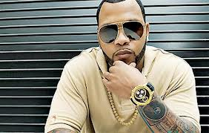
Blow My Whistle – Net Ball
Only this time Flo Rida is singing about the beauty of training up rookie umpires and the importance of proper whistle blowing technique when calling fouls and starting rounds.
Only this time Flo Rida is singing about the beauty of training up rookie umpires and the importance of proper whistle blowing technique when calling fouls and starting rounds.
3 of 42

Slide 17
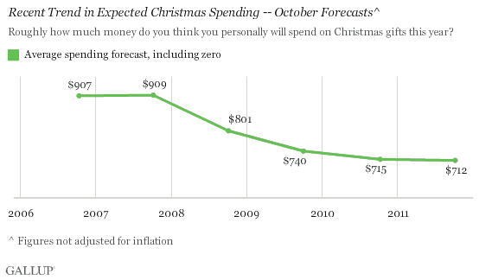
Financial Analysis

Slide 18
Analysis in our Text:
Chapter 7: EXAMPLES OF ANALYSIS

Slide 19
2 Analyses to Read:
Parallel Worlds: Write & Post Summary For Friday:
Find your own example of an analysis: What did it help you understand better?

