Slide 1
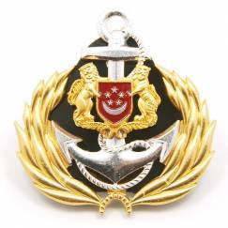
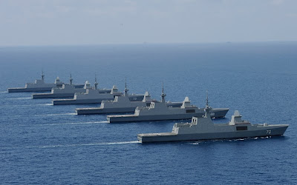
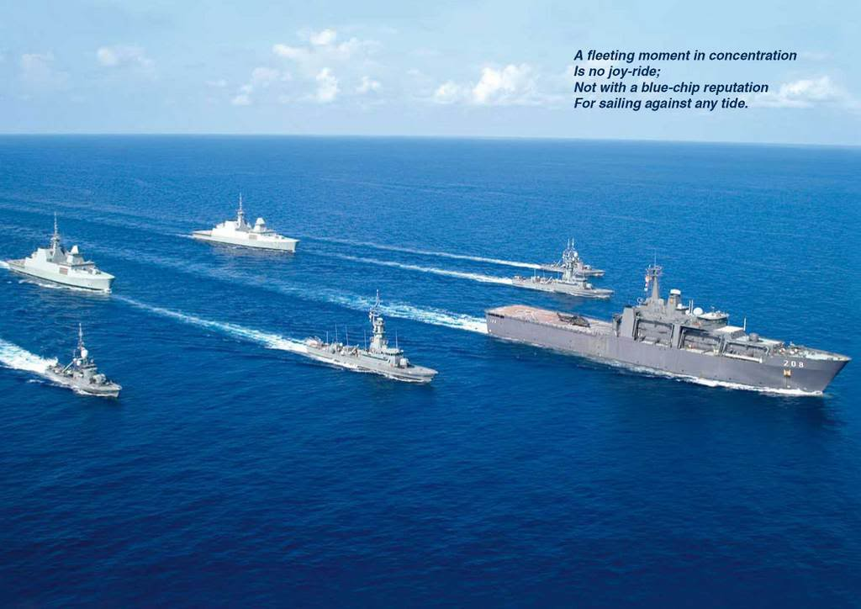
Singapore Naval Vessels

Slide 2
Overview
Singapore Naval Assets
Ships
Submarines
Missile Corvette
Challenger Class
Archer
Class
Frigate
LST
Patrol Vessel
MCMV

Slide 3
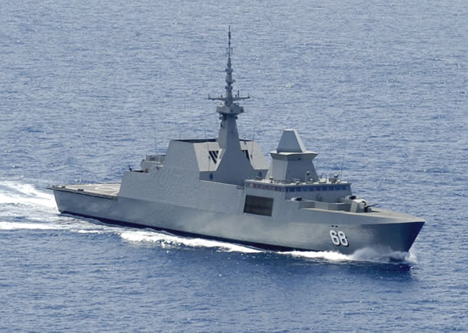
Frigate
RSS Formidable
RSS Intrepid
RSS Steadfast
RSS Tenacious
RSS Stalwart
RSS Supreme

Slide 4
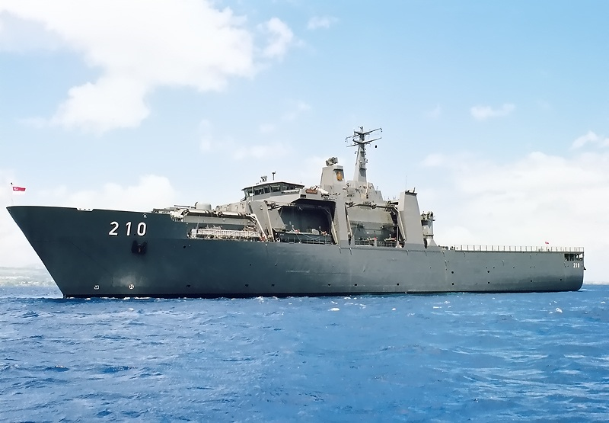
LST
RSS Endurance
RSS Resolution
RSS Persistence
RSS Endeavour

Slide 5
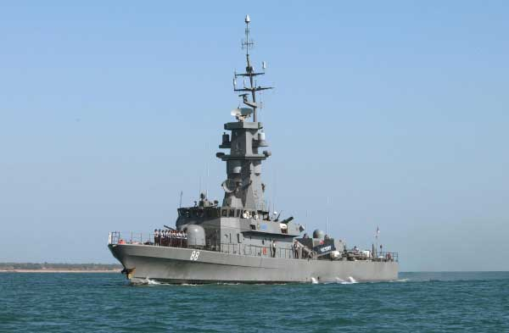
Missile Corvette
RSS Victory
RSS Valour
RSS Vigilance
RSS Valiant
RSS Vigour
RSS Vengence

Slide 6
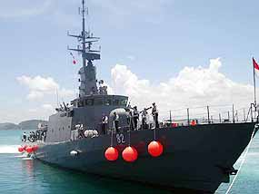
Patrol Vessel
RSS Fearless
RSS Brave
RSS Gallant
RSS Daring
RSS Dauntless
RSS Resilience
RSS Independence
RSS Justice
RSS Freedom
RSS Sovereignty
RSS Unity

Slide 7
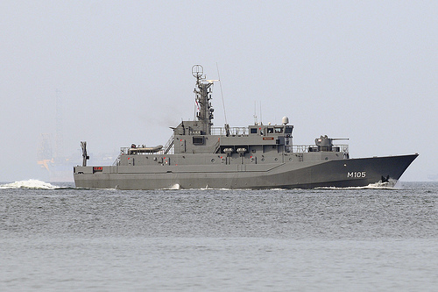
MCMV
RSS Bedok
RSS Kallang
RSS Katong
RSS Punggol

Slide 8
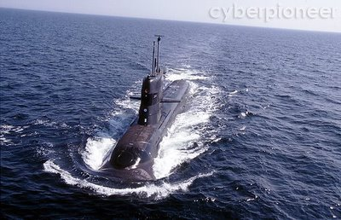
Challenger Class
RSS Challenger
RSS Centurion
RSS Conqueror
RSS Chieftain

Slide 9
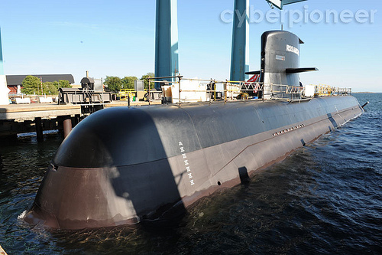
Archer Class
RSS Archer
RSS Swordsman

