Slide 1
What is CMap tools?
WELCOME!
This is a module to give you an introduction on CMap.
This knowledge may help you decide how CMap can help you in your work.
Click a particular topic in the Navigation Map on the right to go to a particular topic.
Or use the navigation buttons at the bottom right to move between the pages or to return to this Home page.
Enjoy the module!
What is CMap?
How does it look like?
Support

Slide 2
What is CMap?
The IHMC CmapTools program empowers users to construct, navigate, share and criticize knowledge models represented as concept maps. It allows users to, among many other features, construct their Cmaps in their personal computer, share them on servers (CmapServers) anywhere on the Internet, link their Cmaps to other Cmaps on servers, automatically create web pages of their concept maps on servers, edit their maps synchronously (at the same time) with other users on the Internet, and search the web for information relevant to a concept map.
CmapTools is used worldwide in all domains of knowledge and by users of all ages to graphically express their understanding. In particular, CmapTools is used in schools, universities, government organizations, corporations, small companies, and other organizations, both individually and in groups, for education, training, knowledge management, brainstorming, organizing information, among other applications. The collaboration and publishing features provide a powerful means for representing and sharing knowledge.
The IHMC CmapTools client is FREE for use by anybody, whether its use is commercial or non-commercial. In particular, schools and universities are encouraged to download it and install it in as many computers as desired, and students and teachers may make copies of it and install it at home.

Slide 3
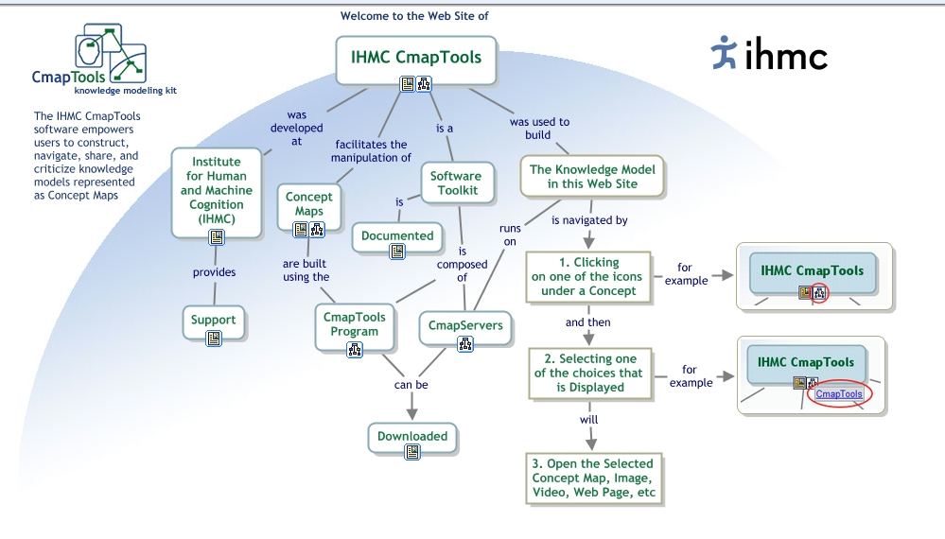
How does it look like?

