Slide 1


Mission Architectures for Mars and Habitation Capability for Deep Space
ICED Innovative Conceptual Engineering Design
MIT
24 - 29 June 2012
Larry Toups
Johnson Space Center
larry.toups-1@nasa.gvo

Slide 2
Timeline for Mars Studies*
Study of Conjunction
Class Manned Mars Trips
Douglas Missile & Space
Manned Mars
Exploration, NASA
America at the Threshold
SEI Synthesis Group
243 Annotations
The Annotated Bibliography
D.S. Portree
Study of NERVA-Electric
Manned Mars…,
E. Stuhlinger, et al
The Mars Transit
System, B Aldrin
ExPO Mars Program
Study, NASA
A Study of Manned
Nuclear-Rocket Missions
To Mars, S. Himmel, et al
Exploration Tech Studies,
Office of Explor., NASA
First Lunar Outpost,
A.L. Dupont, et al
Electromagnetic Launching
As a Major Contribution to
Spaceflight, A.C. Clarke
EMPIRE, Study of Early
Manned Interplanetary…,
Ford Aeronautic
Report on the 90-Day Study on
Human Exploration…, NASA
The Moon as a Way station
for Planetary Exploration, M. Duke
The Viking Results-The
Case for Man on Mars, B. Clark
Collier’s
W. von Braun
A Study of Early Inter-
planetary Missions…,
General Dynamics
Combination Lander
All-Up Mission, NASA
A Case for Mars: Concept
Devlpmt for Mars Research
Three-Magnum Split
Mission, NASA
1950
1960
1970
1980
1990
2000
The Mars Project
W. von Braun
Planetary Engineering
On Mars, C. Sagan
Libration-Point Staging
Concepts for Earth-Mars
R. Farquhar & D. Durham
Dual Landers Presentation
NASA (B. Drake)
Can we Get to Mars?
W. von Braun
Manned Interplanetary
Mission Study, Lockheed
(2) Design Reference Mission 4.0,
Bimodal and SEP, NASA
Pioneering the Space
Frontier, Nat’l
Comm on Space
Concept for a Manned Mars
Expedition with Electrically...
E. Stuhlinger & J. King
Design Reference
Mission 3.0, NASA
The Exploration of Mars
W. Ley & W. von Braun
Leadership and America’s
Future in Space, NASA
Design Reference
Mission 1.0, NASA
Conceptual Design for a
Manned Mars Vehicle, P. Bono
Manned Entry Missions
To Mars and Venus,
Lowe & Cervais
Exploration Tech Studies,
Office of Explor., NASA
The L1 Transportation
Node, N. Lemke
Capability of the Saturn V
To Support Planetary Exploration
G.R. Woodcock
A Smaller Scale Manned
Mars Evolutionary Program
I. Bekey
Mars Direct: A Simple,
Robust…, R. Zubrin
*A Comparison of Transportation Systems for Human Missions to Mars, AIAA 2004-3834
**Bold type represents selected studies

Slide 3

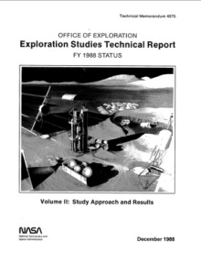
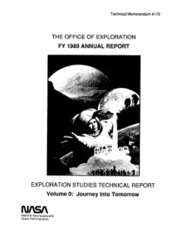

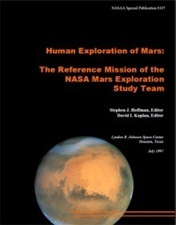
Mars Design Reference Mission Evolution and Purpose
Exploration mission planners maintain “Reference Mission” or “Reference Architecture”
Represents current “best” strategy for human missions
1988: NASA “Case Studies”
1989: NASA “Case Studies”
1990: “90-Day” Study
1991: White House “Synthesis Group”
1992-93: NASA Mars DRM v1.0
1998: NASA Mars DRM v3.0
Mars Design Reference Architecture 5.0 is not a formal plan, but provides a vision and context to tie current systems and technology developments to potential future missions
Also serves as benchmark against which alternative approaches can be measured
Updated as we learn
1998-2001: Associated v3.0 Analyses
JSC-63725
2002-2004: DPT/NExT
NASA’s Decadal Planning Team
Mars Mission Analysis Summary
Bret G. Drake
Editor
National Aeronautics and
Space Administration
Lyndon B. Johnson Space Center
Houston, Texas 77058
Released February 2007
Mars
Design Reference Architecture 5.0

Slide 4
Mars Design Reference Architecture 5.0 Refinement Process
Phase I: Top-down, High-level – Mission Design Emphasis
Focus on key architectural drivers and key decisions
Utilization of previous and current element designs, ops concepts, mission flow diagrams, and ESAS risk maturity approach information where applicable
Narrow architectural options (trimming the trade tree) based on risk, cost and performance
First order assessments to focus trade space on most promising options for Phase II
Phase II: Strategic With Emphasis on the Surface Strategy
Refinement of leading architectural approach based on trimmed trade tree
Elimination of options which are proven to be too risky, costly, or do not meet performance goals
Special studies to focus on key aspects of leading options to improve fundamental approach
Propose basic architecture decisions

Slide 5
Mars Design Reference Architecture 5.0 Top-level Trade Tree
Human Exploration
Of Mars
Mission
Type
Conjunction Class
Long Surface Stay
Opposition Class
Short Surface Stay
Special Case
1-year Round-trip
Cargo
Deployment
Pre-Deploy
All-up
Pre-Deploy
All-up
Mars Capture
Method (Cargo)
Aerocapture
Propulsive
Aerocapture
Propulsive
Aerocapture
Propulsive
Aerocapture
Propulsive
Mars Ascent
Propellant
ISRU
No
ISRU
ISRU
No
ISRU
ISRU
No
ISRU
ISRU
No
ISRU
ISRU
No
ISRU
ISRU
No
ISRU
ISRU
No
ISRU
ISRU
No
ISRU
Interplanetary
Propulsion
NTR
Electric
Electric
Electric
Electric
Electric
Electric
Electric
Chemical
NTR
Chemical
Chemical
NTR
NTR
Chemical
Chemical
NTR
Electric
NTR
Electric
Chemical
Chemical
NTR
Chemical
Electric
NTR
Electric
Chemical
NTR
NTR
Chemical
Chemical
NTR
NTR
Electric
Chemical
Chemical
NTR
Electric
NTR
Electric
Electric
Electric
Chemical
Chemical
NTR
NTR
Chemical
NTR- Nuclear Thermal Rocket
Electric= Solar or Nuclear Electric Propulsion

Slide 6
Mars Design Reference Architecture 5.0
Human Exploration
Of Mars
Mission
Type
Conjunction Class
Long Surface Stay
Opposition Class
Short Surface Stay
Special Case
1-year Round-trip
Cargo
Deployment
Pre-Deploy
All-up
Pre-Deploy
All-up
Mars Capture
Method (Cargo)
Aerocapture
Propulsive
Aerocapture
Propulsive
Aerocapture
Propulsive
Aerocapture
Propulsive
Mars Ascent
Propellant
ISRU
No
ISRU
ISRU
No
ISRU
ISRU
No
ISRU
ISRU
No
ISRU
ISRU
No
ISRU
ISRU
No
ISRU
ISRU
No
ISRU
ISRU
No
ISRU
Interplanetary
Propulsion
NTR
Electric
Electric
Electric
Electric
Electric
Electric
Electric
Chemical
NTR
Chemical
Chemical
NTR
NTR
Chemical
Chemical
NTR
Electric
NTR
Electric
Chemical
Chemical
NTR
Chemical
Electric
NTR
Electric
Chemical
NTR
NTR
Chemical
Chemical
NTR
NTR
Electric
Chemical
Chemical
NTR
Electric
NTR
Electric
Electric
Electric
Chemical
Chemical
NTR
NTR
Chemical
NTR- Nuclear Thermal Rocket
Electric= Solar or Nuclear Electric Propulsion

Slide 7
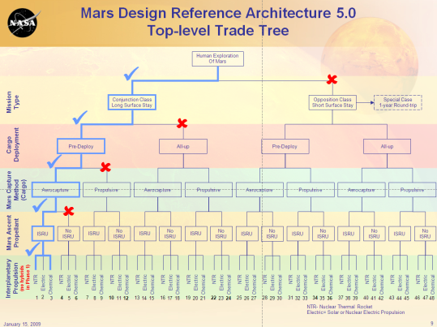
Mars Design Reference Architecture 5.0 Key Decision Packages
Trade Tree
Architecture Trade Tree Assessments
Focus on key architectural approaches which fundamentally drive cost, risk and performance
Mission Type:
Which mission type, conjunction class (long surface stay) or opposition class (short surface stay) provides the best balance of cost, risk, and performance?
Pre-Deployment of Mission Cargo:
Should mission assets, which are not used by the crew until arrival at Mars, be pre-deployed ahead of the crew?
Mars Orbit Capture Method
Should the atmosphere of Mars be used to capture mission assets into orbit (aerocapture)?
Use of In-Situ Resources for Mars Ascent
Should locally produced propellants be used for Mars ascent?
Mars Surface Power Strategy
Which surface power strategy provides the best balance of cost, risk, and performance?
Decision Concurrence: Conjunction – Long Stay
Trades: Performance, Cost , Risk
Decision Concurrence: Pre-Deploy Cargo
Decision Concurrence: Retain Aerocapture for Cargo
Decision Concurrence: Rely on Atmospheric ISRU
Recommendations
Decision Concurrence: Surface Fission Power

Slide 8
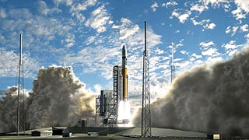
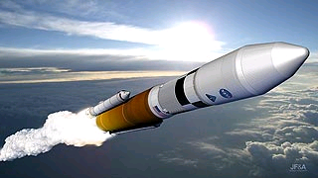
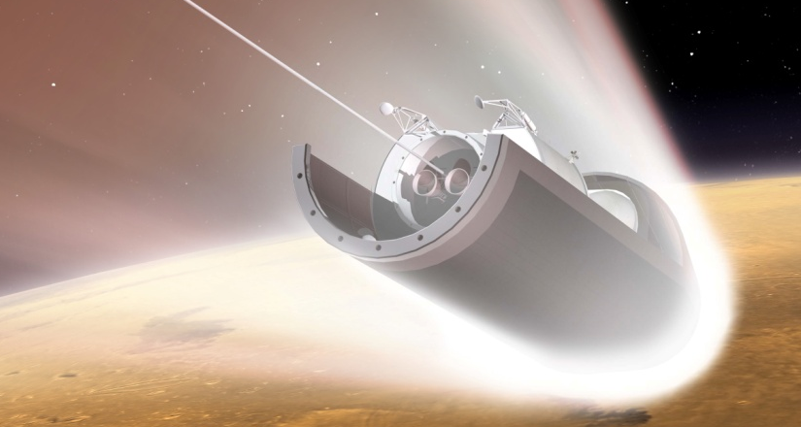
Mars Design Reference Architecture 5.0 Forward Deployment Strategy
Twenty-six months prior to crew departure from Earth, pre-deploy:
Mars surface habitat lander to Mars orbit
Mars ascent vehicle and exploration gear to Martian surface
Deployment of initial surface exploration assets
Production of ascent propellant (oxygen) prior to crew departure from Earth
Six crew travel to Mars on “fast” (six month) trajectory
Reduces risks associated with zero-g, radiation
Rendezvous with surface habitat lander in Mars orbit
Crew lands in surface habitat which becomes part of Mars infrastructure
Sufficient habitation and exploration resources for 18 month stay

Slide 9






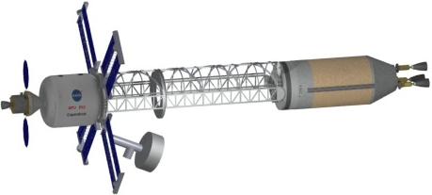
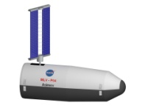
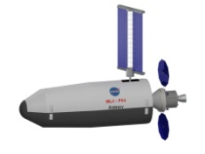



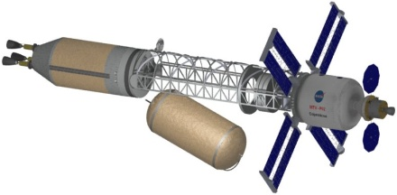
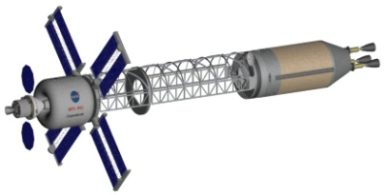
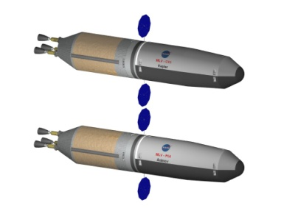
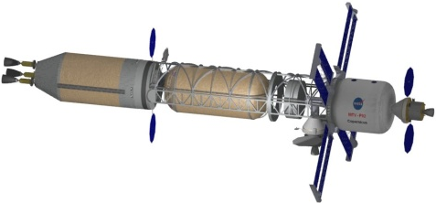
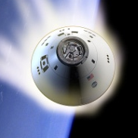

Mars Design Reference Architecture 5.0 Mission Profile
10
~500 days on Mars
In-Situ propellant production for Ascent Vehicle
5
11
Crew: Ascent to high Mars orbit
Aerocapture / Entry, Descent & Land Ascent Vehicle
4
Crew: Prepare for Trans-Earth Injection
12
Aerocapture Habitat Lander into Mars Orbit
3
9
Crew: Use Orion to transfer to Habitat Lander; then EDL on Mars
Cargo:
~350 days
to Mars
2
8
Crew: Jettison drop tank after trans-Mars injection
~180 days out to Mars
Crew: ~180 days
back to Earth
Cargo
Vehicles
13
Crew Transfer
Vehicle
7
Ares-I Crew Launch
4 Ares-V Cargo Launches
6
3 Ares-V Cargo Launches
1
~26
months
~30
months
14
Orion direct Earth return

Slide 10
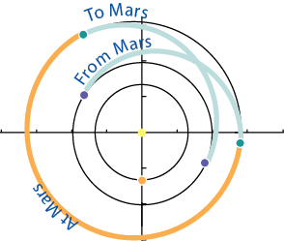
Mars Design Reference Architecture 5.0 Flight Sequence
Long-surface Stay + Forward Deployment
Mars mission elements pre-deployed to Mars prior to crew departure from Earth
Surface habitat and surface exploration gear
Mars ascent vehicle
Conjunction class missions (long-stay) with fast inter-planetary transits
Successive missions provide functional overlap of mission assets
Peak Dust Storm Season
Solar Conjunction
Year 1
Year 2
Year 3
Year 4
Year 5
Year 6
Year 7
J
F
M
A
M
J
J
A
S
O
N
D
J
F
M
A
M
J
J
A
S
O
N
D
J
F
M
A
M
J
J
A
S
O
N
D
J
F
M
A
M
J
J
A
S
O
N
D
J
F
M
A
M
J
J
A
S
O
N
D
J
F
M
A
M
J
J
A
S
O
N
D
J
F
M
A
M
J
J
A
S
O
N
D
Mission #1
Surface Habitat
Lander
Transit Vehicle
Depart
Arrive
Long-Stay Sequence
Depart
Arrive
Depart
Arrive
Mission #2
Surface Habitat
Lander
Transit Vehicle
Depart
Arrive
Depart
Arrive
Launch Campaign
Cargo Outbound
Unoccupied Wait
Crew Transits
Surface Mission
Overlapping Elements

Slide 11
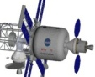


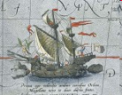
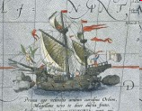
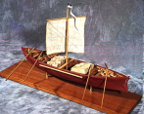
Human Exploration A Historical Perspective
Voyage Time
Crew Size
Vessels
6
(All water trade route between Europe and India)
150-170
(est.)
(Exploration of the Pacific Northwest)
33
Human mission to Mars will be long and complex, but the round trip duration is within the experience of some of the most successful exploration missions with significantly far fewer crew

Slide 12
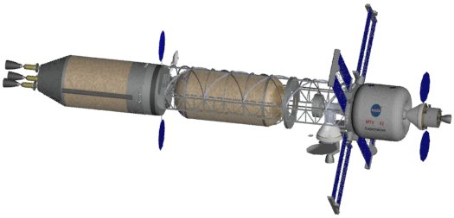
Crew Vehicle Mars Transit Vehicle (MTV)
NTR Vehicle
Common “core” propulsion stage with 3 - 25 klbf NTR engines (Isp ~900 s)
Core stage propellant loading augmented with “in-line” LH2 tank for TMI maneuver
Total Mass: 283.4 t
Transit Habitat & Orion Entry Vehicle
Transports 6 crew round trip from LEO to high-Mars orbit and return
Supports 6 crew for 400 days (plus 550 contingency days in Mars orbit)
Crew direct entry in Orion at 12 km/s
Advanced technologies assumed (composites, inflatables, closed life support, etc
Transit Habitat Mass: 41.3 t
Orion: 10.0 t
NTR Stage
In-line Tank
Transit Hab &
Orion Entry Vehicle
LEO Operations
NTR stage & payload elements are delivered to LEO and assembled via autonomous rendezvous & docking

Slide 13

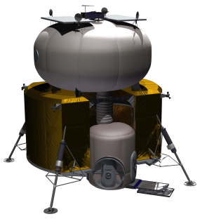
Cargo Vehicle Surface Habitat (SHAB)
NTR Vehicle
Common “core” propulsion stage with 3 - 25 klbf NTR engines (Isp ~900 s)
Total Mass: 238.1 t
Surface Habitat
Pre-deployed to Mars orbit
Transports 6 crew from Mars orbit to surface
Supports the crew for up to 550 days on the surface of Mars
Ares V shroud used as Mars entry aeroshell
Descent stage capable of landing ~40 t
Advanced technologies assumed (composites, O2/CH4 propulsion, closed life support, etc
Lander Mass: 64.2 t
Lander + Aeroshell: 107.0 t
NTR Stage
Aeroshell & DAV
LEO Operations
NTR stage & payload elements are delivered to LEO and assembled via autonomous rendezvous & docking

Slide 14
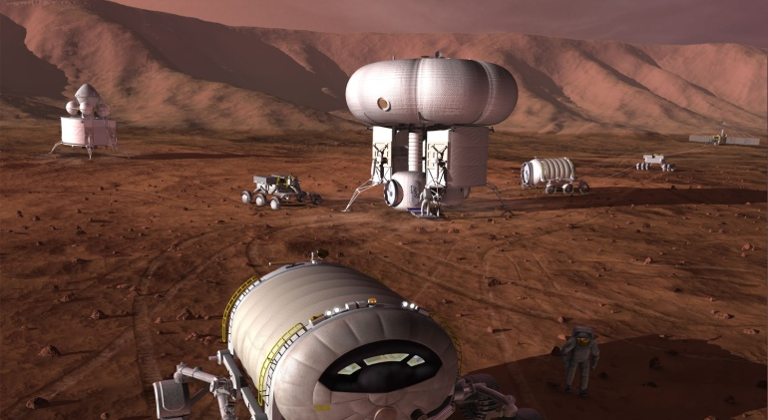
Mars Design Reference Architecture 5.0 Surface Strategy Options
Mobile Home
Multiple strategies developed stressing differing mixes of duration in the field, exploration range, and depth of sampling
Mobile Home: Emphasis on large pressurized rovers to maximize mobility range
Commuter: Balance of habitation and small pressurized rover for mobility and science
Telecommuter: Emphasis on robotic exploration enabled by teleoperation from a local habitat
Mobility including exploration at great distances from landing site, as well as sub-surface access, are key to Science Community
In-Situ Consumable Production of life support and EVA consumables coupled with nuclear surface power provides greatest exploration leverage
Development of systems which have high reliability with minimal human interaction is key to mission success
DRA 5.0
Reference
Commuter
Telecommuter
Central “monolithic” habitat
2 SPRs (crew of 2, 100 km traverse)
2 upressurized rovers (~LRV)
Nuclear power for base
ISRU (propellant and crew consumables)

Slide 15
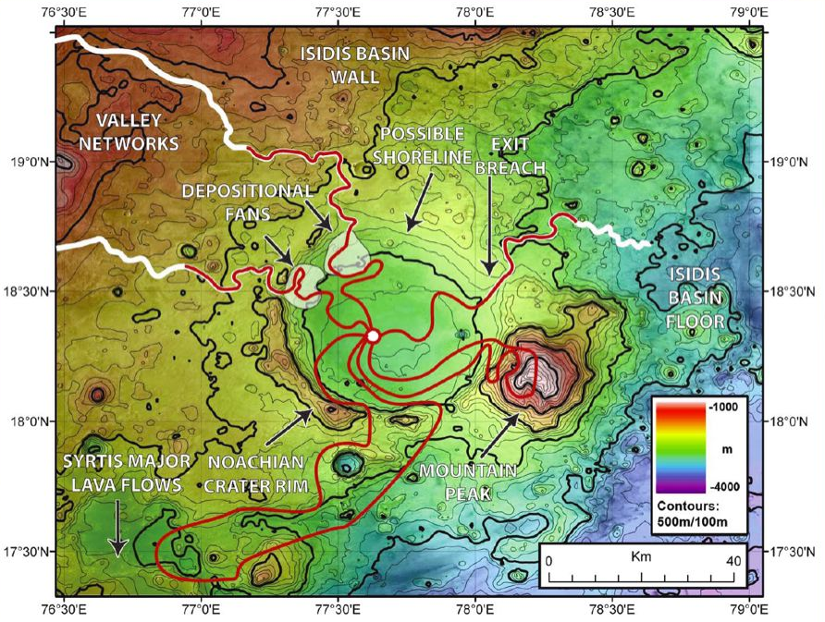
Mars Design Reference Architecture 5.0 Example Long-Range Exploration Scenario
Landing site in a “safe” but relatively uninteresting location
Geologic diversity obtained via exploration range
Example case studies developed to understand exploration capability needs
RED line indicates a set of example science traverses

Slide 16
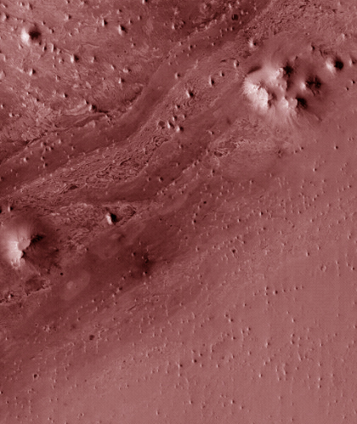
Mars Design Reference Architecture 5.0 Planetary Protection
NASA Planetary Protection Policy is consistent with the COSPAR policy and is documented in NASA Policy Directive NPD 8020.7
Specific requirements for human missions have not yet been issued.
"Special regions" are areas that can be identified as being especially vulnerable to biological contamination and requiring special protections
“A region within which terrestrial organisms are likely to propagate, OR A region that is interpreted to have a high potential for the existence of extant Martian life forms.“ COSPAR 2002
"Zones of Minimum Biological Risk" (ZMBRs) are regions that have been demonstrated to be safe for humans.
Astronauts will only be allowed in areas that have been demonstrated to be safe.
Exploration plans and systems must be designed to maximize exploration efficiency while maintaining effective planetary protection controls
Sterilization of hardware
Minimized contamination release from human systems into the environment
Human/robotic partnerships
Human health monitoring
Safeguarding the Earth, and by extension astronauts, from harmful backward contamination must always be the highest planetary protection priority
Conceptual Example
Hypothetical Special Region
Landing Site
Example Robotic Traverse
Example Human Traverse

Slide 17

Explore
Surface Strategy Functional Decomposition
Objective Functions
Support Functions
Sustain Humans
Perform Science
Prepare for Future Human Presence
Provide Nutrition
Bring Food
Grow Food
Make/Process Food
Provide Hydration
Bring Water
Process/Condition Water
Recycle Water
Find/Produce Water
Remove Waste
Reject/Dispose of Waste
Recycle Waste
Provide Habitable Environment (protection)
Provide Thermal Conditioning
Provide Breathable Atmosphere
Provide Pressure (to support phys needs)
Protect from Radiation
Maintain Health
Physical Exercise
Psychological Support
Volume, clothes, entertain, comm, privacy, self determ)
Medical Support
Sleep Support
Observe/Survey
Collect/Take Samples
Process Samples
Prep
Analyze
Store
Archive
Return
Communicate
Remote Observation of Samples/Data
Remote direction/control of science
Engage in a Balance of Science Domains
Atmospheric
Climatology
Biology
Geology
Human Physiology
Hydrology
Sustain Machines (Systems)
Provide/ Sustain Consumables
Build Up Infrastructure
Communications
Control
Weather
Human/System Support
Mobility
Power/Propulsion
Explore for Resources and/or Future Sites
Test/Demo Future Capabilities
Technologies
Operations
Reduce/Cut /Optimize Logistics Chain
Produce Resources
Recycle
Protect from Contamination
Economic Development
Mining?
Tourism?
Engage Public
Transport Humans, Machines, Cargo
Provide Power
Collect/Produce Power
Store Power
Distribute Power
Process/Convert Power
Provide Thermal Conditioning
Dissipate Heat
Heat
Transfer Heat
Provide Control
Operations Control
FDIR Control
Communications
Protect from Environment
Radiation protection
Dust protection
Assemble/ Maintain/Dispose
Fluid degradation
Filters
Joints/Seals
Contain (Store)
Collect/Distribute
Provide Thermal Conditioning
Protect from Environment
Communicate with Public
Public Events
Educational Events
Provide Public/ Edu Participation
Plan
Control/Drive
Analyze
Enable Commercial Partnership Action
Pre-Tourism
Pre-Mining
Deployment of commercial assets
Survey/Precursor for commercial interests (paid by commercial)
Transport between Surface and Space
Launch
Navigate
Steer/Attitude Control
Land( EDL)
Transport in Space
Navigate
Steer/Attitude Control
Accelerate
Decelerate
Transport on Surface
Navigate
Steer/Control
Accelerate
Decelerate
Ground Functions? (ops and or production)

Slide 18

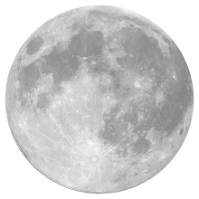
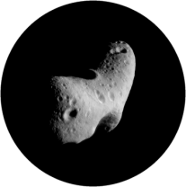
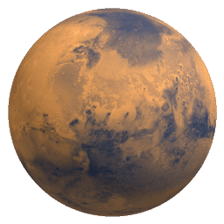
Mars Surface Exploration Envelopes Architectural Options
Lunar
Vicinity & Surface
Near Earth Objects
Gradual expansion of exploration capabilities, growing to extended durations
Establish surface systems & operations experience
Surface Habitat
Rovers & Mobility
Fission Surface Power
In-Situ Resources
Descent & Landing
Mars surface “dry run”
Common Systems
Expansion of humans into deep-space (180+ days) at greater distances from Earth
Establish deep-space transportation & operations experience
In-Space Propulsion
Transit Habitat
Humans to Mars orbit and back “dry run”
Heavy Lift
Launch ops
Crew LEO Transport
High-speed Earth Return
Systems & Operations
Systems & Operations
Systems & Operations
+
Mars unique capabilities
Aeroassist (large payload EDL)
ISRU (Atmospheric)
Descent and ascent (lunar derived)
Mars
Surface

Slide 19
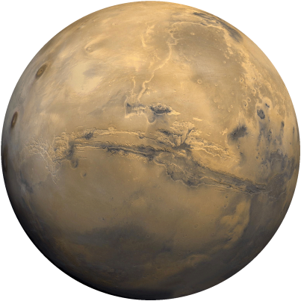
Key Risks and Challenges for Humans to Mars
Launch Campaign
7+ Heavy Lift Launches within 26-month Mars injection opportunity
800 – 1,200 t total mass in LEO
Large payload volume
Entry Descent and Landing
The ability to land large (40 t) payloads on the surface of Mars. Current limit is ~ 2 t
Human Support
Radiation protection (400 days deep space, 500 days on Mars)
Hypo-gravity (Mars surface) countermeasures
Reliable closed-loop life support (air and water)
In-Situ Resource Utilization
Generation and use of oxygen produced from the atmosphere
System Reliability, Maintenance, and Supportability
Lack of logistics and just-in-time supply necessitates highly reliable, maintainable systems
Advanced In-space Propulsion
Nuclear Propulsion Thermal Propulsion
Advanced chemical with Aerocapture at Mars
Zero-boiloff cryogenic storage of hydrogen, oxygen, and methane
LO₂/CH₄ propulsion for descent and ascent
Surface Nuclear Power
40 kWe continuous power with demonstrated long-life reliability
Mobility and Exploration
100+ km roving range
Light-weight, dexterous, maintainable EVA
In-situ laboratory analysis capabilities

Slide 20
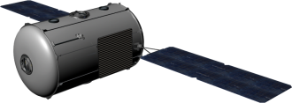
Deep Space Habitation Long Duration Mission Challenge and Risk Reduction
Challenge: Long-duration human interplanetary space missions, including NEA missions, present unique challenges for the crew, spacecraft systems, and the mission control team
The cumulative experience and knowledgebase for human space missions beyond six months and an understanding of the risks to humans and human-rated vehicle systems outside of the Earth’s protective magnetosphere is limited at this time
New challenges include:
Radiation exposure (cumulative dosage and episodic risks)
Physiological effects
Psychological and social-psychological concerns
Habitability issues
Supportability & Sustainability
System redundancy and life support systems reliability
Limited mission contingencies and abort scenarios
Consumables and trash management with no supply chain
Communications light-time delays (crew autonomy, mission control operations, etc.)
Risk Reduction:
Option 1: Utilize ISS for progressively longer crew missions (> 6 months) with advanced technologies required for NEA missions
Does not operate at pressure and radiation environments commensurate with deep-space
Option 2: Early deployment of NEA mission Deep-space Habitat in deep-space to allow for gradual increase in mission duration prior to NEA mission
Improves our understanding of the human response to radiation and micro-gravity environments with relatively quick Earth return
Development of radiation shielding approaches
Allows for the maturation of needed capabilities and development of high-reliability systems in the NEA mission environment

Slide 21
Enabling Capabilities
For 3 – 4 crew
Adequate volume and layout to support 365 – 400 days crewed habitation
Long duration logistics storage and management
Compact logistics storage methods
Methods for tracking, disposal and reuse of logistics and empty packaging
System designed for operational lifetime period no less than 10 years
Reliable subsystems and materials designed anticipating degradation caused by the space environment
Radiation protection for Solar Particle Events (SPEs) and Galactic Cosmic Radiation (GCRs)
Crew protection from or mitigation of biological effects caused by radiation exposure (cancer, central nervous system, heart disease, etc)
Electronics radiation hardening for 1000+ days
Countermeasures for physiological effects of microgravity and long duration spaceflight
Bone loss, muscle atrophy, cardiovascular functions, intracranial pressure on the optic nerve, etc.
Countermeasures including resistive exercise, pharmaceutical supplements, etc.
Long duration crew accommodations
Compact, storable accommodations designed for long duration mission requirements and maximum space efficiency
Particularly, smaller exercise equipment and workstations
Highly reliable and maintainable life support and thermal systems capable of current ISS levels of performance/closure
Higher reliability equipment reducing the need for redundant units/large amounts of spares and enabling long duration missions
Increased life support closure for Mars
Life support systems operable at 70.3 kPa (10.2 psi) atmospheric pressures (30% Oxygen)
Advanced exploration communications
High data rate forward link communications for critical software updates
Hardware and software to maintain functionality and safety in the event of comm. delay
Autonomous vehicle systems management
Vehicle monitoring, maintenance, control over subsystems, etc. necessary for vehicle to maintain good health as independently from crew as possible
Autonomous crew systems
Displays, controls, software, crew scheduling, and procedures necessary for crew to operate autonomously from mission control
Long duration crew medical care capability
Autonomous crew procedures for medical care
Equipment to deal with emergencies and long duration issues when return is no longer an option, such as surgery and in-situ sample analysis

Slide 22
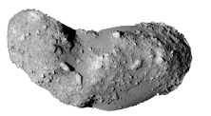

Habitat Systems Strategic Roadmap: Nominal
12
13
14
15
16
17
18
19
20
21
22
23
24
25
26
27
28
29
30
31
32
33
34
35
36
Significant Events
Orion Test
(EFT-1)
Heavy Lift/Orion
Crew Beyond
LEO Test
NEA
Test
L
L
C
Humans to Mars Orbit
Deep-Space
Test
International Space Station
System Development
Large Scale Integrated Tests (Earth Lab, Analogs, ISS)
Waypoint Facility
EM-2
PDR
CDR
NEO
Deep Space Habitat
PDR
CDR
Mars Transit Habitat
Mars
PDR
CDR
L
L
L
L
C
D
A
D
A
Launch Campaign
Crew
Launch
Crew
Mission
Life Support Gaps
Highly reliable, maintainable subsystems
Operation at 70.3 kPa atmosphere
Increased closure for Mars
Advanced ECLSS at ISS
70.3 kPa subsystems,
Highly reliable, maintainable subsystems
Testing at Waypoint
Increased Closure
Technology Gaps
Behavioral Health and Physiological testing at ISS
HRP Gaps
Behavioral health/Volume
Long duration physiological countermeasures (bone density loss, VI/IP)
Long duration, no abort medical care
Long duration food
All HRP gaps to 360 days
Testing at Waypoint
All HRP gaps to 1000 days
Long duration logistics, GCR Radiation, Exploration EVA
Exploration Comm., Autonomous Vehicle and Crew Subsystems, additional GCR
Habitation/Supportability Gaps
Long duration logistics management
Radiation protection from SPE
Radiation protection from GCR
Exploration communications
Autonomous vehicle management
Autonomous crew systems
Exploration EVA
SPE Radiation Protection
Testing at Waypoint
Technology test flights
Technology needed date

Slide 23
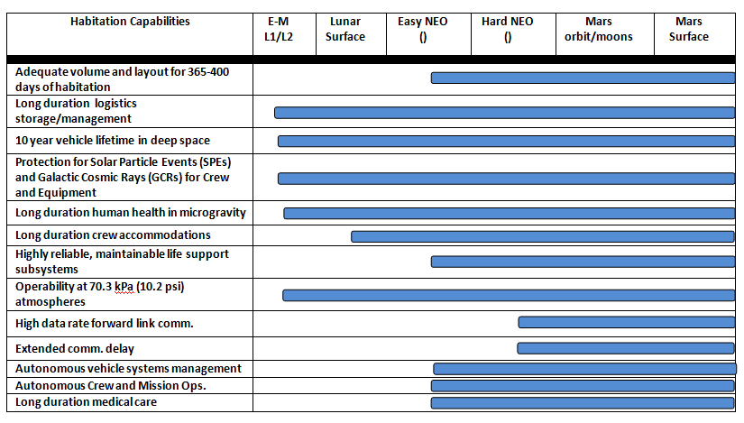
“Need-by” Dates for Enabling Capabilities

Slide 24
Artificial Gravity
Concessions
Bone loss
Renal stones
Muscle atrophy
Body fluid shift
Vision degeneration
Space adaptation sickness
Neuro-vestibular effects
Concessions to living/working in micro-gravity
Crew restraints
Airborne dust/debris
Food preparation concept
Sanitation & hygiene
CO₂ dispersal
Fire/smoke propagation
Fluid containment
No mission stopping risks due to µg: Artificial gravity not a requirement, but may trade favorably in Mars surface DRM
An in-space habitat that operates at partial or 1g increases the opportunity for commonality between it and a surface habitat
An on-board centrifuge countermeasure might address the medical issues (right-hand column) but not the operational issues (left column)
Candidate for trade in relaxed development profile. Validation required in LEO first – will drive a longer development timeline.

Slide 25
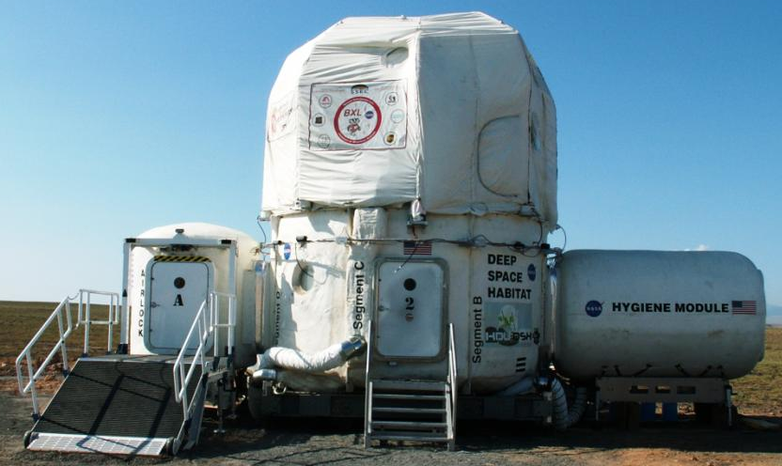
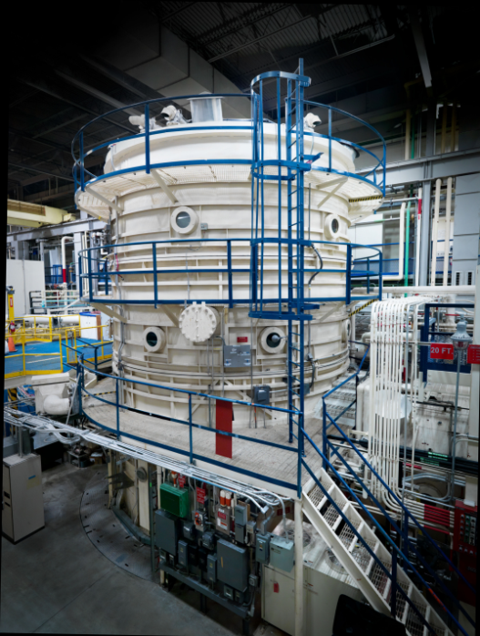
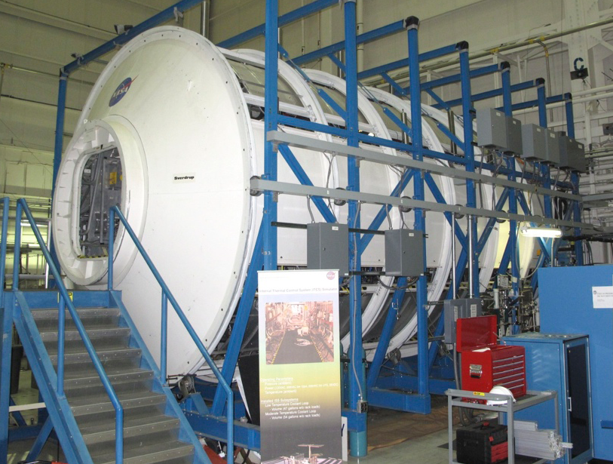
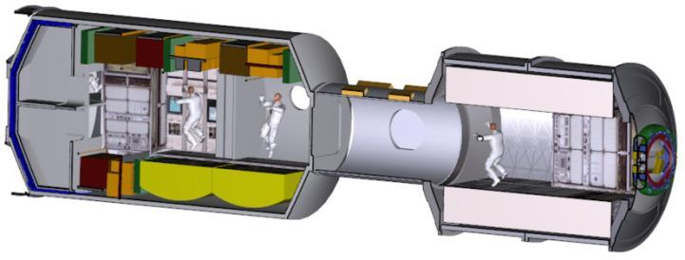
Habitation Analogs
20ft Chamber (Gen 3)
HDU-DSH (Gen 2)
ISS-Derived

Slide 26
Backup

Slide 27
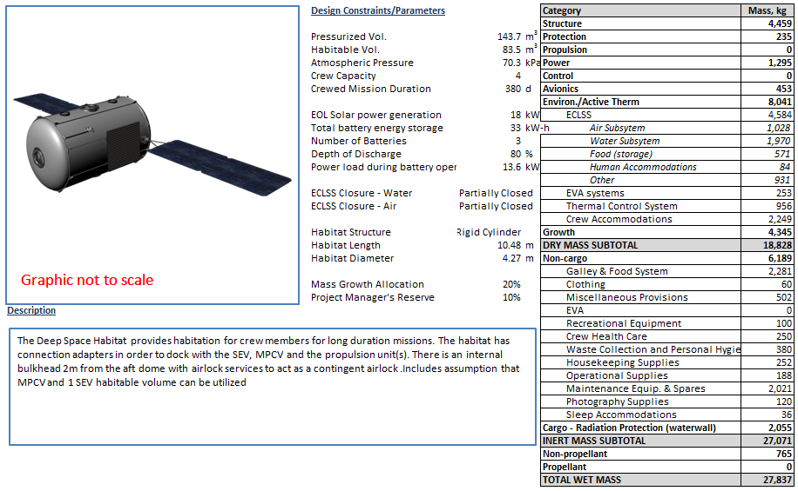
DSH Baseball Card – for HAT Cycle C
NEO_FUL_1A_C11C1 Mission, 380 day snapshot – 4 crew, 4.27 m diameter 1 SEV Updated model 8/26/2011
UPDATE

Slide 28
Detailed Enabling Capabilities
Capability | Desired Design Features | Necessary Tests | Conditions for Capability Demonstration/Testing
Adequate volume and layout for 365-400 days of habitation | At least 25 m³ / person habitable volume per crew across habitable vehicles Layout which supports crew psychological/ psychosocial health while maintaining task performance | Validation of crew psychological/behavioral health in confined, isolated spaces for long durations Demonstration of various layout strategies in confined environments for moderate durations | Provide real sense of isolation and “lack of escape” Sufficiently long duration to verify crew performance with long duration isolation and sensory deprivation An analogous operational environment and level of activity Microgravity testing preferred for analogous anthropometrics and space usage
Long duration logistics storage/management | Consumables/ logistics necessary to support crew and volume to store them | Demonstration of logistics management and storage strategies | Ground conditions sufficient for development Microgravity testing preferred for analogous anthropometrics and space usage
10 year vehicle lifetime in deep space (at least) | Upsized solar arrays for degradation Improved protection (MMOD, radiation, vacuum) Logistics management strategies to prevent buildup of trash | Validate spacecraft materials and avionics for deep space environment (radiation environment) Demonstrate reliability of subsystems | Testing requires analogous deep space environment (combination of vacuum, deep space radiation, microgravity) Prefers locations outside van Allen belts and magnetosphere

Slide 29
Detailed Enabling Capabilities continued..
Capability | Desired Design Features | Necessary Tests | Conditions for Capability Demonstration/Testing
Protection for Solar Particle Events (SPEs) and Galactic Cosmic Rays (GCRs) for crew and equipment | Advanced dosimetry hardware Radiation shielding/shelter Pharmaceutical countermeasures | Characterization of biological effects of deep space radiation (GCRs) on tissue and human DNA Reduce uncertainty to establish high-confidence dosage limits Large colony animal testing Development and testing of shielding for humans and for human rated electronics | Testing requires deep space location outside of the van Allen belts for combination of SPEs and high and low energy GCRs
Long duration human health in microgravity | Mitigations for physiological complications resulting from long duration microgravity exposure | Identify effective countermeasures to: Bone loss Muscle atrophy Intracranial pressure and vision loss Immunology Exercise equipment testing Pharmaceuticals testing | Testing requires long duration microgravity testing of humans or equivalent specimens Testing may require combined microgravity, isolation, and radiation exposure
Long duration crew accommodations | Reduced mass, volume, stowage accommodations with improved operability, particularly: Exercise equipment Private crew quarters Waste Collection Multifunctional shared spaces | Ground testing Analog testing of multifunctional shared space Usability testing of new accommodations Microgravity operations and usability testing | Adequate volume and test location Microgravity environment and crew testing

Slide 30
Detailed Enabling Capabilities continued..
Capability | Desired Design Features | Necessary Tests | Conditions for Capability Demonstration/Testing
Highly reliable, maintainable life support subsystems | Subsystems which can operate for longer durations with less spares and crew time required | Extensive ground tests; individual parts and integrated subsystems Full or subscale testing in microgravity to identify unknown issues | Ground test facilities allowing for integrated system testing Space for subsystem testing on ISS
Operability at 70.3 kPa (10.2 psi) atmospheres | Certified materials and subsystems (particularly ECLSS) designed for the lower pressures | Materials testing and certification for low pressure, high oxygen environments Subsystem operation tests | Microgravity Space on ISS for testing in an experiment rack
High data rate forward link comm. | High data rate forward link comm. for software updates and crew entertainment | Development of transceivers capable of data rates desired Verification of operation of high data rate in relevant environment | Clear RF spectrum as in E-M L2 location for analogous testing and characterization of potential unknown complications
Extended comm. delay | Operational procedures to ensure smooth operations in extended comm. delay situations Special hardware and software systems to increase crew independence from constant comm. | Testing of operational impacts of comm. delay Testing of behavioral health impacts of comm. delay, particularly in high stress situations | Spacecraft operational environment with analogous psychological stress, isolation, and workload

Slide 31
Detailed Enabling Capabilities continued..
Capability | Desired Design Features | Necessary Tests | Conditions for Capability Demonstration/Testing
Extended comm. delay | Operational procedures to ensure smooth operations in extended comm. delay situations Special hardware and software systems to increase crew independence from constant comm. | Testing of operational impacts of comm. delay Testing of behavioral health impacts of comm. delay, particularly in high stress situations | Spacecraft operational environment with analogous psychological stress, isolation, and workload
Autonomous vehicle systems management (Definition: Repair, monitoring, maintenance, route power, etc.) | On-board vehicle systems management for mission critical functions Vehicle health monitoring and maintenance scheduling Intelligent management of systems and power for vehicle operation | Development of subsystems and software with laboratory testing on the ground Testing of systems and software in an integrated environment | Station may be limiting from an integrated experimentation perspective. Needs a new free-flying vehicle for validation of systems
Autonomous crew and mission ops. (Definition: Displays, controls, crew scheduling, procedures, etc.) | On-board ECLSS monitoring Autonomous scheduling tools Medical and maintenance procedures | Usability/effectiveness of displays, controls, and crew scheduling tools On-orbit demonstration of on-board ECLSS monitoring | Microgravity environment for on-board ECLSS monitoring
Long duration medical care | Low volume, long duration medical equipment Autonomous medical references for emergencies Crew Health level of Care 3-4 as determined by medical community | Testing of autonomous long duration medical techniques and hardware Identification of medical conditions and treatments associated with long duration spaceflight Identification of the appropriate level of health care for long duration missions | Long crewed duration environment in microgravity Sufficient facilities to test non rack-based medical equipment

