Slide 1
BIKES IN CLASS 2B and 2A
What are the types of bikes ?
CLASS 2B
CLASS 2A

Slide 2
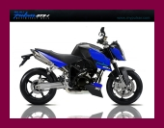

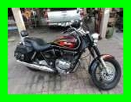
CLASS 2B

Slide 3
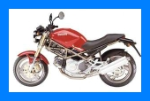


CLASS 2A

