Slide 1
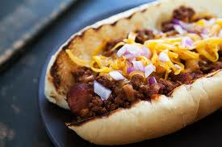
Want to know how to cook a classic American dish???

Slide 2
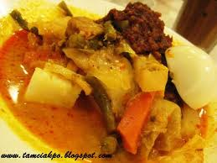
How about learning how to whip up a Malay Traditional Dish?

Slide 3
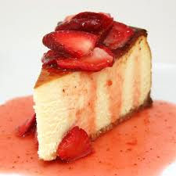
No better way to end a meal with a decedent dessert….. Here is a classic

