Slide 1

Types of Flex for Golf Shafts
Stiff Flex
Regular Flex

Slide 2
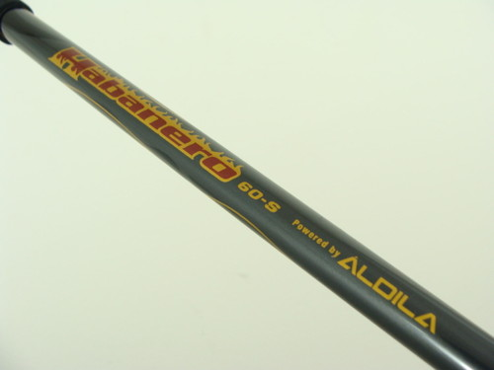
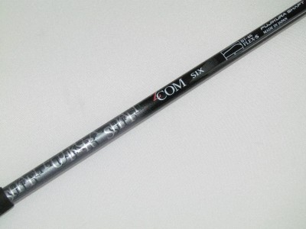
Stiff Shaft
Meant for players with higher swing speed
90 to 105mph club head speed

Slide 3
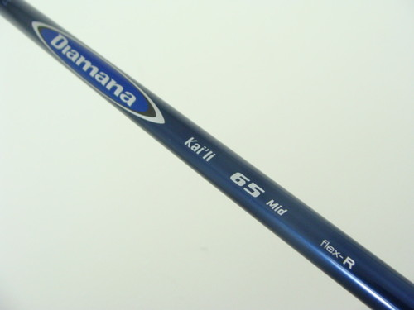
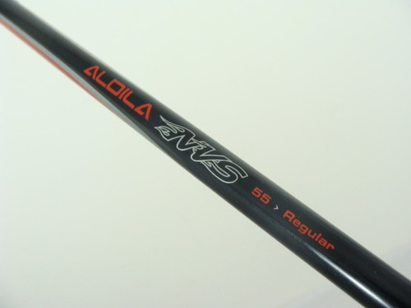
Regular Shaft
Meant for players with slower swing speed
90 to 5mph club head speed

