Slide 1
Click here for video

Slide 2

This is a rifle

Slide 3
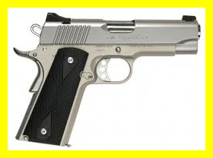
This is a pistol

