Slide 1
What are the types of chapati
Plain
Garlic

Slide 2
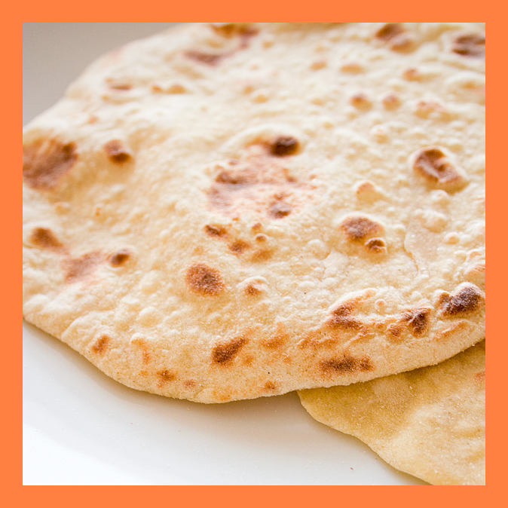

Slide 3
