Slide 1
Welcome to engineers ppt
Wanna sign on
EOD
CBRE
Armoured Engineers

Slide 2


Slide 3
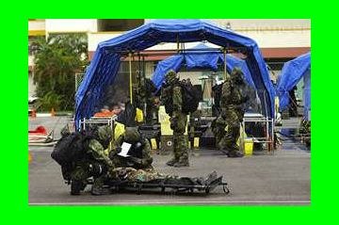

Slide 4


