Slide 1
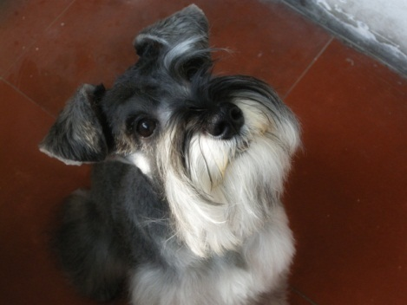
MY GIRLFRIEND
CLICK TO SEE MY WEEKEND GIRLFRIEND

Slide 2


MY GIRLFRIEND

Slide 3
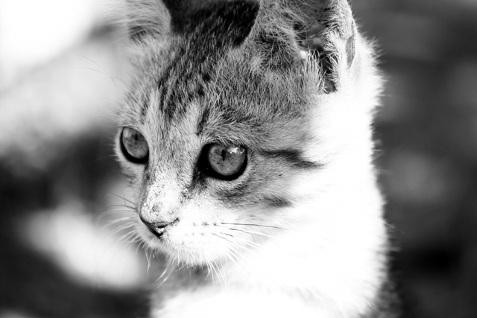

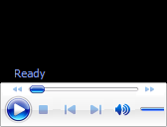
MY GIRLFRIEND
chinese
japanese
taiwanese
korean
thai

