Slide 1
1
CAT1
CAT2
DOG
DOG1
DOG2

Slide 2
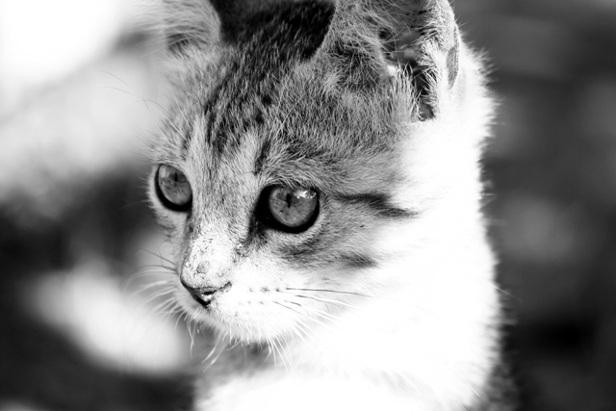

2
BABE CAT
This story is about life of SSG BABE from SCS 2 GOLF COY!!!

Slide 3

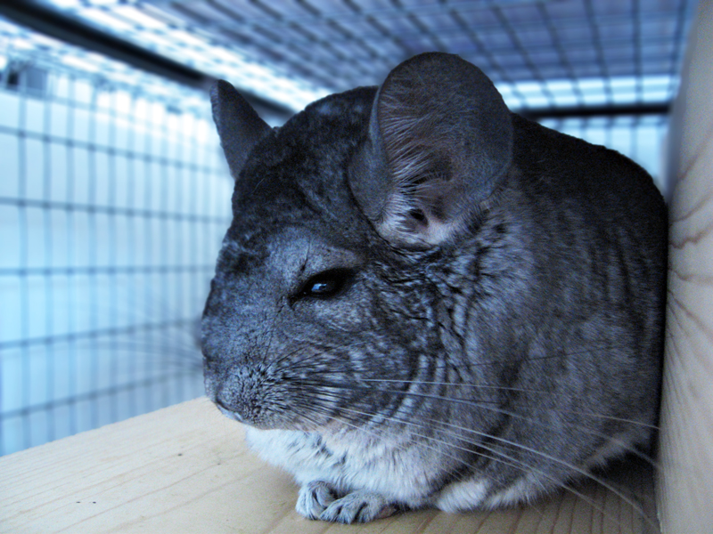
3
SURENDRA
WO SURENDRA love this PET ???

Slide 4
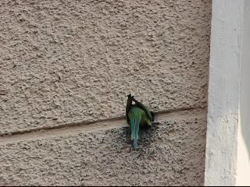
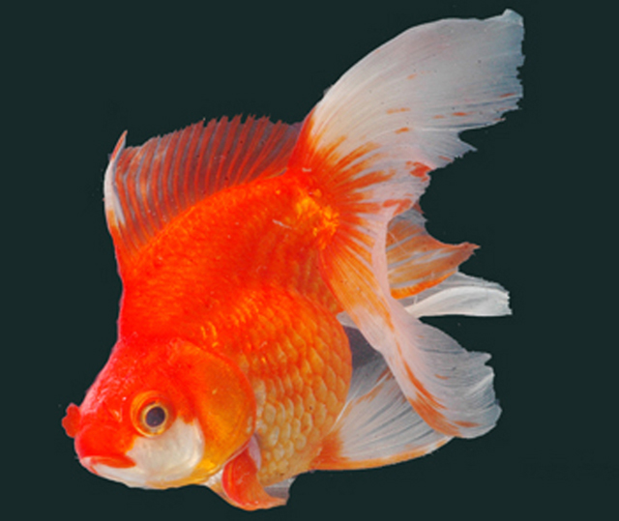
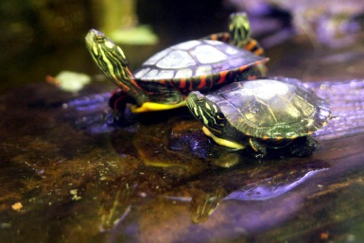
4
MUZZ
MUZZ looks like this Goldfish….

Slide 5

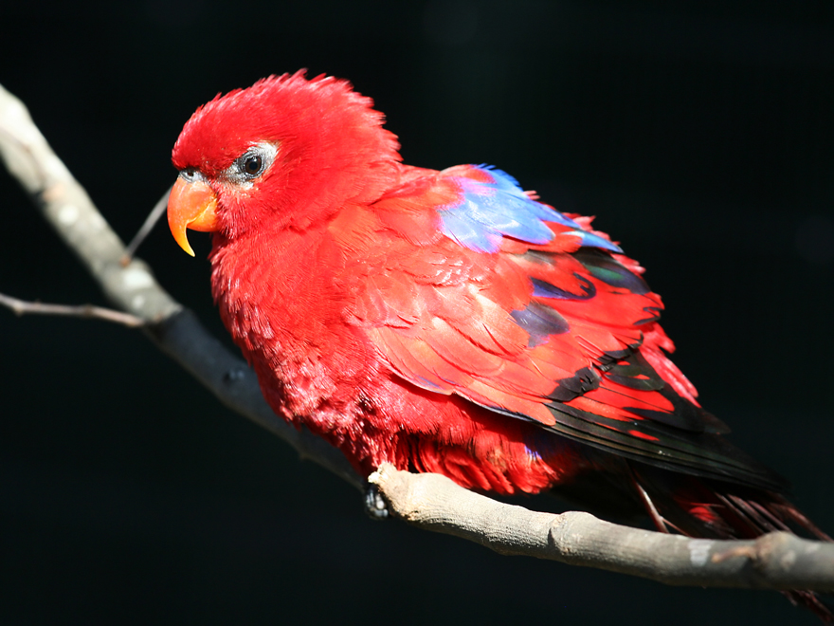
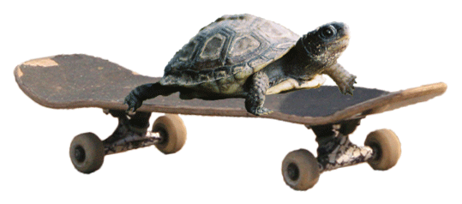
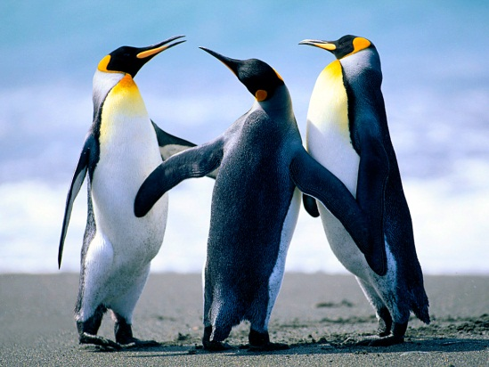
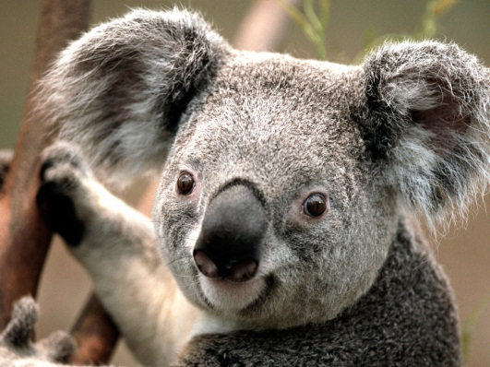
5
ANDY
HOW DOES ANDY LOOK ?????

Slide 6


