Slide 1
Formalizing a Student Affairs-Academic Affairs Partnership
Presented by:
Brenda Marsteller Kowalewski
Mike Moon
Weber State University
Continuums of Service Conference
April 12, 2012

Slide 2
Introduction

Slide 3
Objectives

Slide 4
Weber State University Mission Statement
Weber State University offers associate, baccalaureate and master degree programs in a broad variety of liberal arts, sciences, technical and professional fields. The university provides excellent educational experiences for its students through extensive personal contact among faculty, staff and students in and out of the classroom. To accomplish its mission, the university, in partnership with the broader community, engages in research, artistic expression, public service, economic development, and community-based learning experiences in an environment that encourages freedom of expression while valuing diversity.

Slide 5
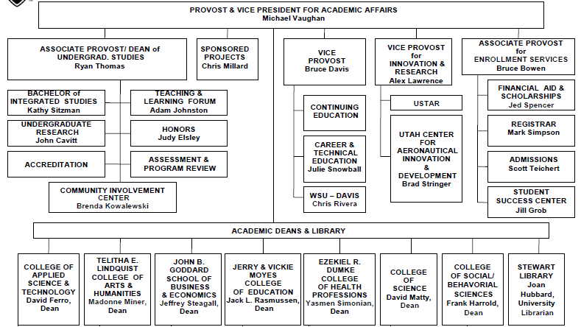

Slide 6
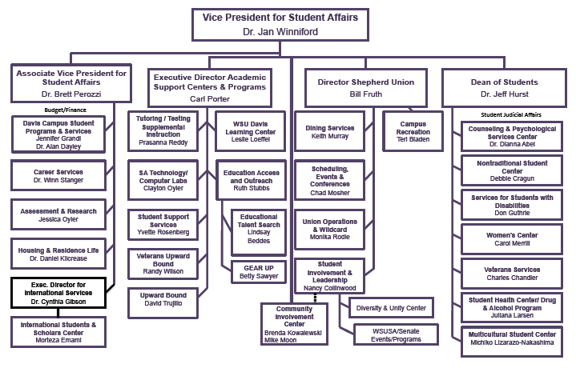

Slide 8

Benefit of AA-SA Integretion
The SA-AA collaboration at Weber State reflects the integrated way that students learn and act. Traditional college departments exist for administrative efficiency, but may impede learning by attempting to segregate learning and behavior.

Slide 9
It is important for faculty and academic administrators to recognize the role of student affairs professional as educators, whose collaboration can enhance "classroom learning" through involvement and application. Student Affairs professional must understand the importance of explicit academic learning objectives and the need to provide authentic assessment.

Slide 10
I hope that the collapsing of the walls that have traditionally separated academic and student affairs professionals who deal with community engagement will be a model that will allow both groups to adopt common language and shared objectives in the education of students. This integrated approach could help the institution understand the interdependence of cognitive and psycho-social development.

Slide 11
It evidences the centrality of engagement as an important mission of the institution. There are many populations that need to be served by the university that would see it as distant and unattainable, but for the presence of the university through students in their schools, shelters and homes. It reinforces the importance of application of knowledge as an approach to learning. Finally, it ensures that students develop civic responsibility and an ethos of service as part of their higher learning.

Slide 12

WSU Mission & Themes
WSU's mission explicitly states that "the university provides excellent educational experiences for students...in and out of the classroom." The CIC integrated structure is a living example of how WSU fosters student learning in a seamless environment. Each of WSU's core themes (Access, Learning, and Community) cross boundaries between AA and SA, which means that the CIC's integrated structure enhances our ability to more successfully achieve our mission.

Slide 13
Champions
One key to making such an integrated approach work is having some champions in both areas of the university (SA & AA) who collaborate together. Modeling effective "collaboration in action" can create momentum for structural changes that foster greater levels of collaboration -- which in turn create opportunities for enhance student learning.

Slide 14
Shared Learning Outcomes
The publication Learning Reconsidered: A Campus-Wide Focus on the Student Experience, which has been widely embraced by student affairs professionals, advocates for transformative education and the importance of student affairs working in partnership with the broader campus curriculum to achieve shared learning outcomes. Civic engagement is one of those shared outcomes where both AA and SA can effectively work together to enhance and integrate student learning.

Slide 15
Community Engagement Helps Accomplish Mission
With a more seamless, collaborative approach to community engagement, students are exposed to opportunities that they may not otherwise learn about -- such as a service learning class or a co-curricular volunteer service opportunity. To achieve our goal of increasing college access for low-income, first-generation students, both types of community engagement are critical, and I believe we have more significant impact as a result of an integrating model.

