Slide 1

FOOTBALL ASSOCIATION OF SINGAPORE
Mission:
Our Mission is to enhance lives by leading innovative development of competitive and recreational football
in Singapore together with all our partners.
Vision:
Our Vision is Excelling in Asia and Competing in World Football:
- Our National Team succeeds at every level
- Our Game is commercially viable
- Our Game ethics and tradition are maintained
- Our Game is growing at every level
Values:
- Inclusiveness
- Innovative
- Openness
- Teamwork
- Dare

Slide 2



FOOTBALL LEAGUES
DOMESTIC
INTERNATIONAL

Slide 3














S-LEAGUE

Slide 4
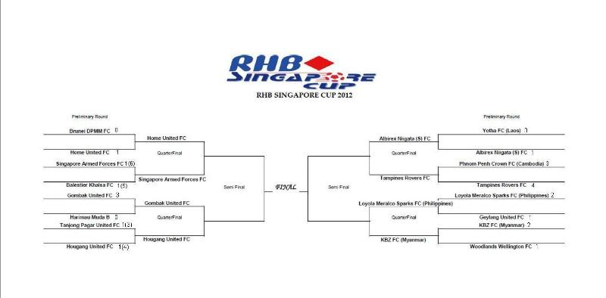
SINGAPORE CUP

