Slide 1

FLYING HUMAN
Click on picture to view

Slide 2
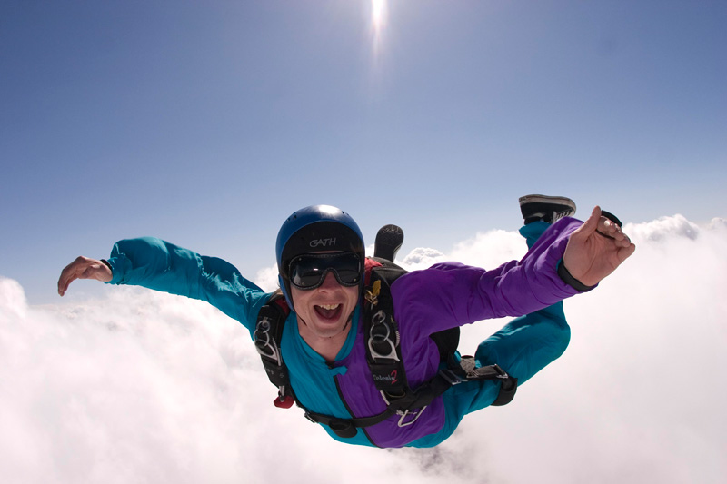

Slide 3
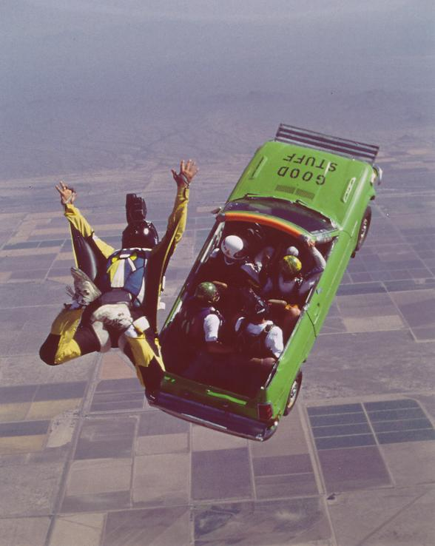

Slide 4
