Slide 1
SCUBA Diving
Which kind of diving is for you?

Slide 2
SCUBA DIVING
This questionnaire is to identify your favorite type of dive.

Slide 3
SCUBA DIVING
Q.1. How do you feel when you dive?
PRESS ME
A. Curious over Wreck?
B. Loves Nature and
exploration?
PRESS ME
PRESS ME
C. Dive Performance?

Slide 4
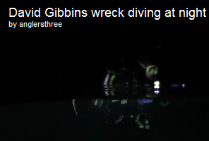
SCUBA DIVING
WRECK DIVING

Slide 5
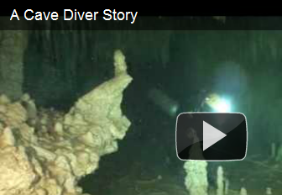
SCUBA DIVING
CAVE DIVING.

Slide 6
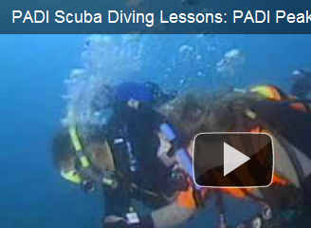
SCUBA DIVING
PEAK PEROFRMANCE BOUYANCY.

Slide 7
FISHOLOGY

