Slide 1
Types of body shapes
WELCOME!
This is a module to teach you all about the different types of bodies.
This knowledge may help you decide which type of body to get.
Click a particular topic in the Navigation Map on the right to go to a particular topic.
Or use the navigation buttons at the bottom right to move between the pages or to return to this Home page.
Enjoy the module!
BODY
M AN
WOMAN
FAT BELLY
MASCULAR
ANOREXIC
B-LINE

Slide 2
MAN

Slide 3
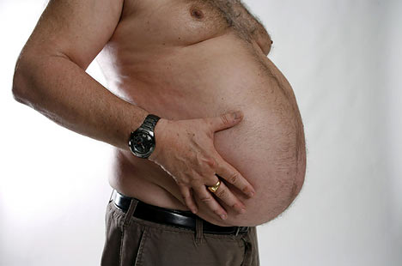
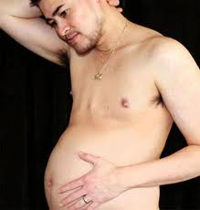

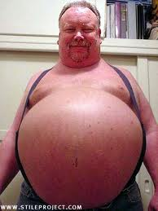
MAN
FAT BELLIES

Slide 4
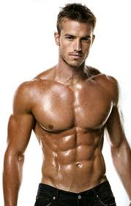
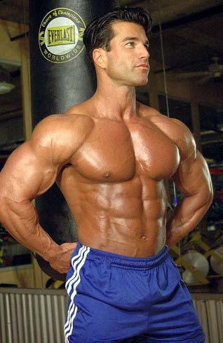
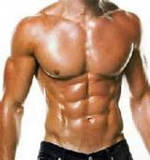
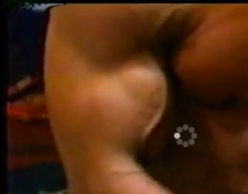
MAN
MASCULINE

Slide 5
WOMAN

Slide 6
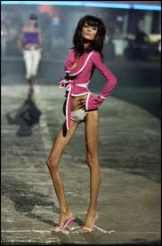
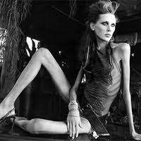
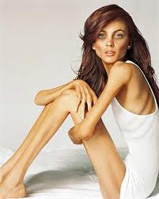
WOMAN
Anorexic

Slide 7
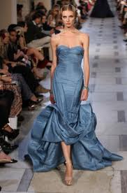
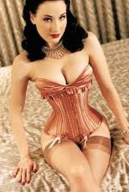
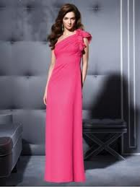
WOMAN
Hour Glass

Slide 8
EnD of presentation

