Slide 1
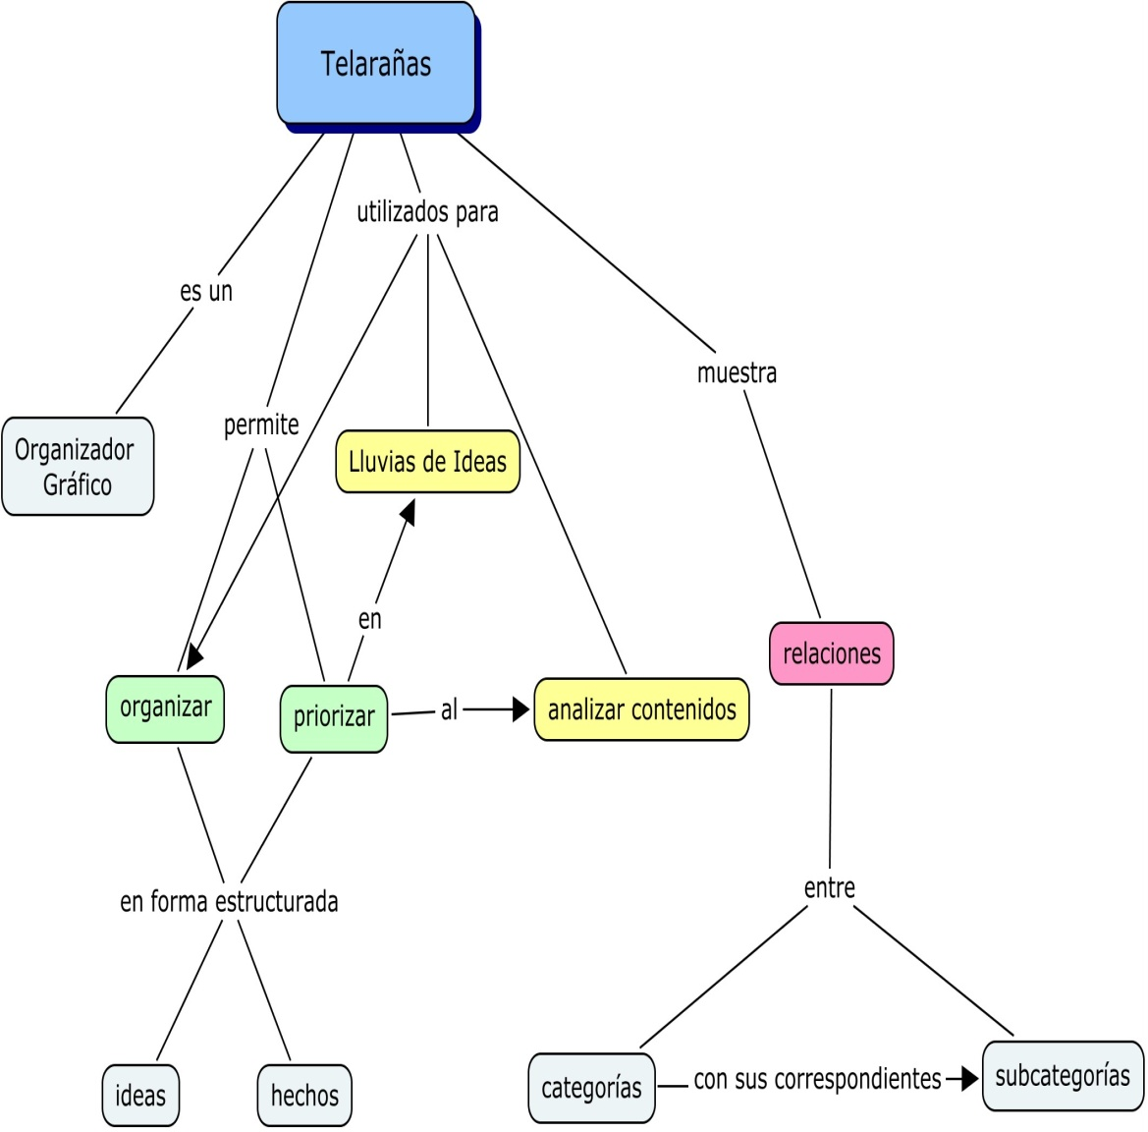
TELARAÑAS
Detalle
Detalle
Detalle
Detalle
Idea principal 1
Idea principal 2
Detalle
Detalle
Concepto/
Tema/
Tópico
Detalle
Detalle
Idea principal 4
Idea principal 3
Detalle
Detalle
Detalle
Detalle

