Slide 1
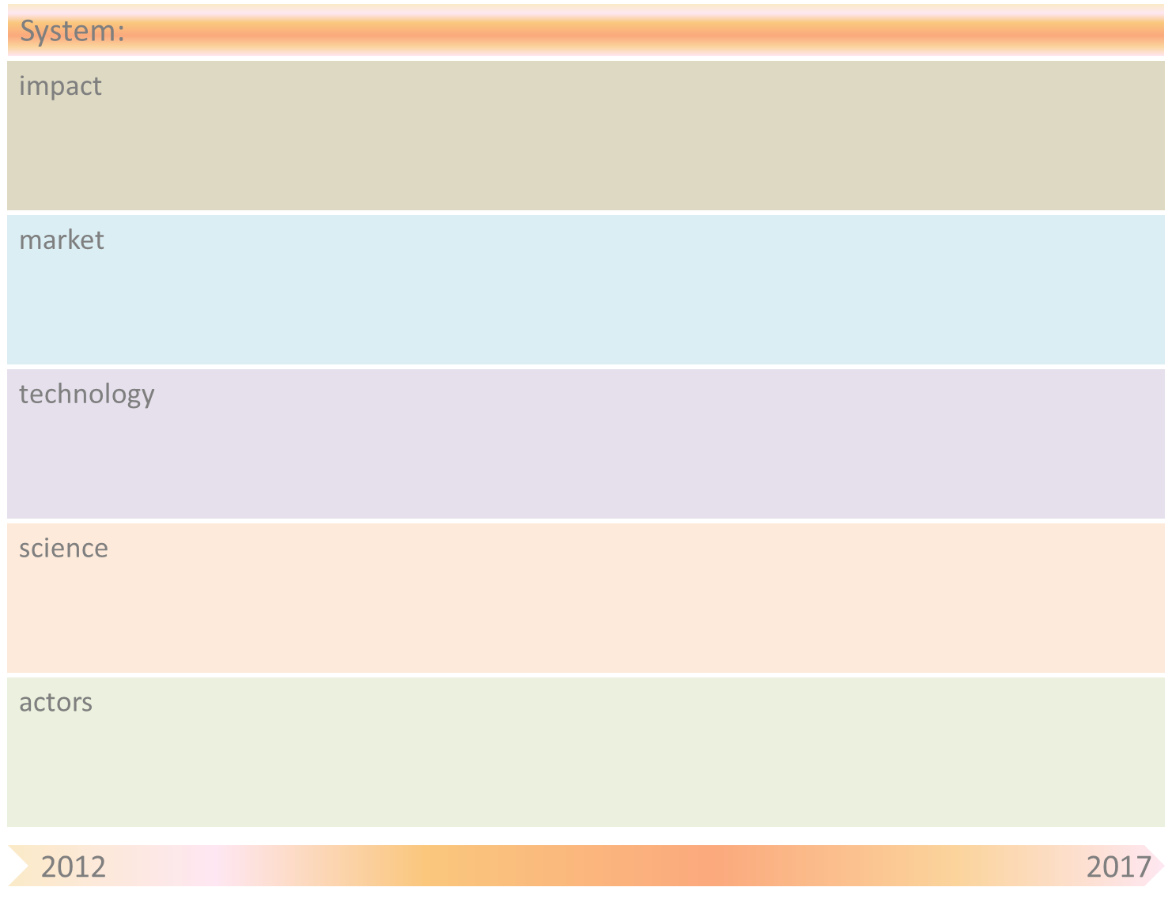
Value Generation driven by entrepreneurs on open webplatforms
Info overload
Ecological impact
obstacle
Digital ability of users
Trust in network tech
Digital Labour Divide
item
Disclaimer fatigue
Platform lock-in
Platform dependency
Platform independence
21 century skills
obstacle
Developer markets
Resistance from big companies
mismatch
Data market
The network is the company
Privacy issues
Personal data management
piracy
20% GDP EU through
webbased open platforms
Language barrier
Global access
Data market
GPS
Search technology
Mimicry based tech
devices
NFC implementation
Privacy aware tech
App store
Grid comp
PET
NFC
OS
Cradle to Cradle tech
Network tech
Cloud comp
Social search tech
Self destructing files
Augmented reality
interoperability
Computer science
Privacy law
Semantic search tech
Data science
nano
Energy harvesting
Multi disciplinarity
MMI
graphene
SNA
Statistic search tech
Sensor
users
Hardware developers
Trust in providers
Gated App Communities
VCs
pirates
Privacy banks
App developers
Privacy auditors
Privacy brokers
Platform providers
SPs
First Global Data Crisis
Content providers
Data intermediaries
communities

Slide 2
Value Generation driven by entrepreneurs on open webplatforms
Obstacle | Mitigation by SOAS principle(s)
Trust in providers | Mobilization through a new network (community)
Energy harvesting | Choice for sustainability ipv economy
interoperability | Central agreement on standard, consequence ….
Privacy Law | Organizing adapted networks of users and producers
Near Field Communication [NFC] implementation (betalen met pda) | Geen zoas
Language barrier | Universal translator functionality
Privacy issues | Personal data management services (bottom up)
Value assessment | Free market mechanism (in kind possible, better in currency)
Platform dependency | Community control/restrictions, inhibiting extremes…
Digital Labour Divide | New ways of organising learning and working
Resistance from big companies | ?
First Global Data Crisis | Security & Protection & Safety

