Slide 1
SOAS Roadmaps Template (in English please)
Instructions:
Collect existing roadmaps in ‘your’ domain (logistics, biology, com-networks, organization-work, organization-collaboration, ict -people)
Choose relevant existing roadmap
Make a copy of slide#2 and slide#3 and insert
Define the system-name and system-goal the roadmap is about
For each horizontal bar (actors, science, technology, market, impact) formulate the development in terms of keywords (use copies of the “item” [ctrl+d]) see also explanation of the dimensions
After all keywords are in place, add key obstacles (use copies of “obstacle” [ctrl+d])
When done, return to step 2 until all relevant roadmaps are made
Save file with domain name in the file name (eg. logistics zoas rm v01.pptx)
Place in following folder \\tsn.tno.nl\data\Projects\041\0\01077\ZOAS knowledge\roadmaps
Think ‘hallelujah’
Explanation of the dimensions:
Actors:
For this dimension name the relevant actors involved with the system and how they are linked and how this network develops through time.
Science:
Name the actual and expected scientific principles involved.
Technology:
Describe the technological development , the actual practical application of science now and expected.
Market:
Name the relationships between producers and consumers (a-b) that benefit from the system, now and expected
Impact:
Name the consequences of the emergent system behavior, positive and negative

Slide 2
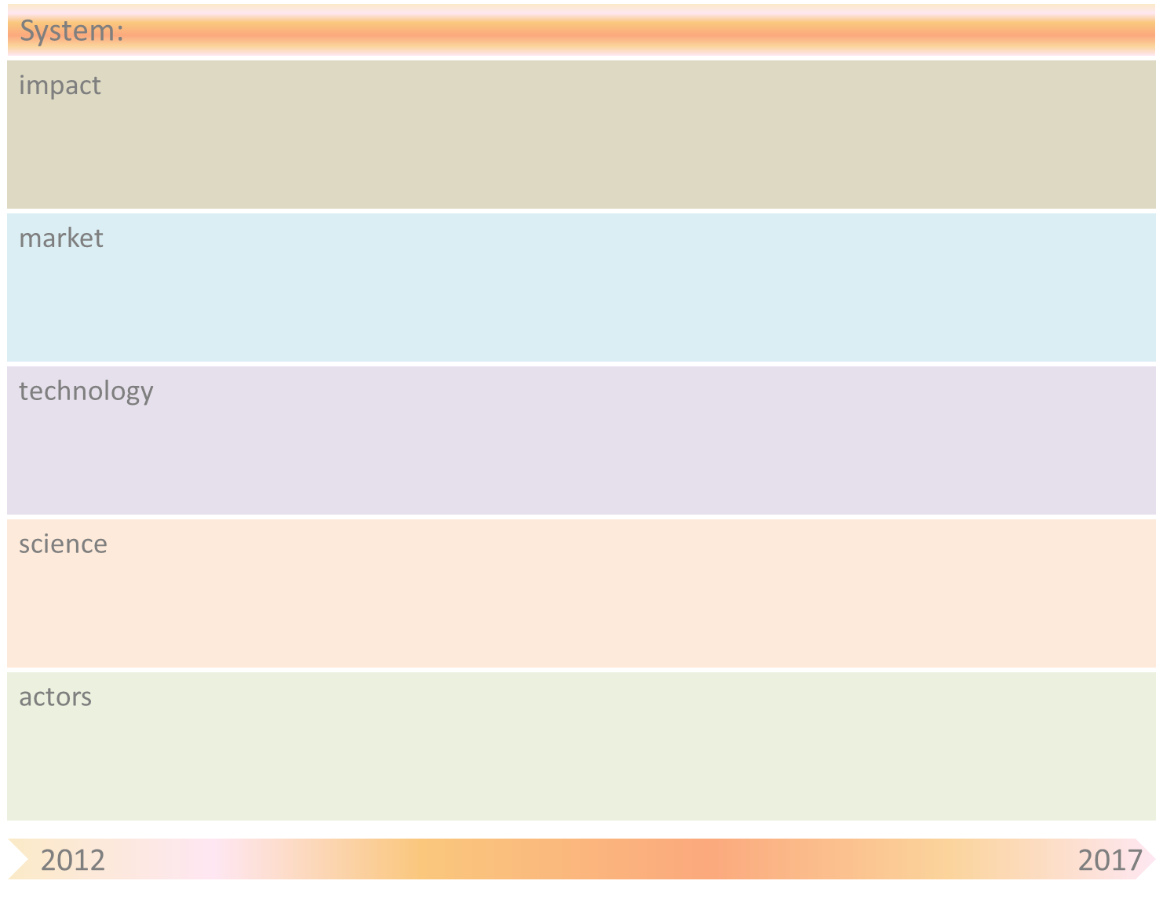
Healthy self-organizing systems – a novel approach for prevention and treatment of infections
Solving antibiotic resistance threat
Personalized medicine
Prevention of infections
Animal feed/Cattle farming
(Point of care) diagnostics
Pharma - antibiotics
Food/Nutrition
- Combinatorial therapies
Molecular microbiology
Systems biology & Omics
In vivo challenge interventions infections
nanotechnology
In vitro screening models- natural products
ICT
In silico modeling
Ingredient library screening
Pathogens
Systems Biology
Interventions on resilience and emergent behaviour pathogens
Host (patho)physiology
Intestinal community
Sciences of Health
Antibiotic resistance
Infections
Veterinary professionals
Food industry
Pharma
Diagnostic companies
Medical professionals
Feed industry

Slide 3
System-name
Obstacle | Mitigation by SOAS principle(s)
Integrated description of ‘system’ | Integration of host physiology, pathogenic pressure and vulnerability in network model enables identification is essential to understand emergence of pathogens and antibiotic treatment. This is a shift from the current and failing “wait and cure” approach.
(In silico) selection biofunctional agents | Pre-selection of bio-functional ingredients is essential for cost-effective development of novel treatments. Since antibiotic development pipelines have dried out, a systems biology network approach enables identification of weak spots and allows development of solutions that sustain biological network complexity and resilience.
diagnostics | Better diagnostics based on the whole biological system is essential to evaluate interventions but also to link status to cure or prevention. These novel diagnostics integrate multiple levels of data, including lifestyle, genetic predisposition and infectious pressure from environment. Diagnostics are not aiming at identification of threats but also aiming at identification of intrinsic resilience. These are based on integrated predictive network models with understanding of emergent behaviour derived from zoas principles
Healthcare professionals | No zoas - Acceptance by care professionals is essential for the success of implementation. This implies a shift from cure to prevention.
ICT infrastructure | Linking appropriate data and sensory information in risk profile to safeguard health of the population

