Slide 1

Newcomers-International Students Orientation 2012
Lehigh University

Slide 2
Schedule
The day before the orientation day (pre-orientation)
Google groups
The orientation day:
Name card
Bingo game
Learning world map
Cooperate on Cmap tool
Video shot

Slide 3
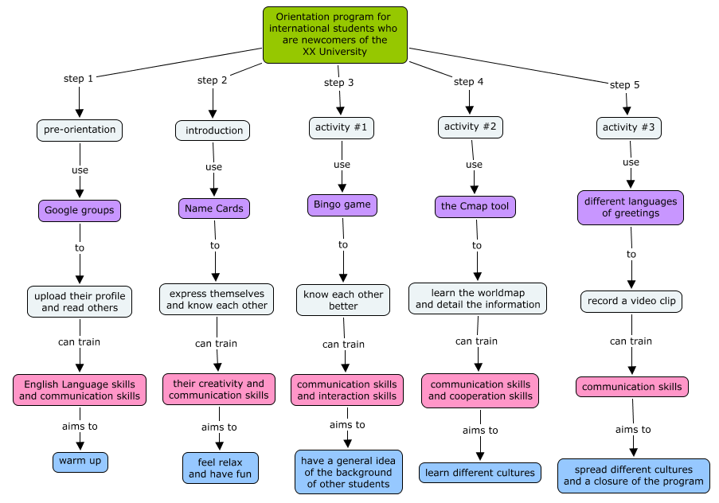
Instructional Design

Slide 4
Pre-Orientation
Log in your google account
Join our google group with the link
Upload the profile picture
Write a description of yourself (refer to the template)
Upload to the forum
Read other’s profiles
Try to remember as many people as you can

Slide 5
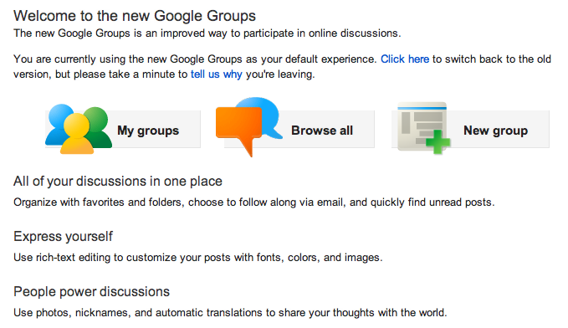
Why “Google groups”?

Slide 6
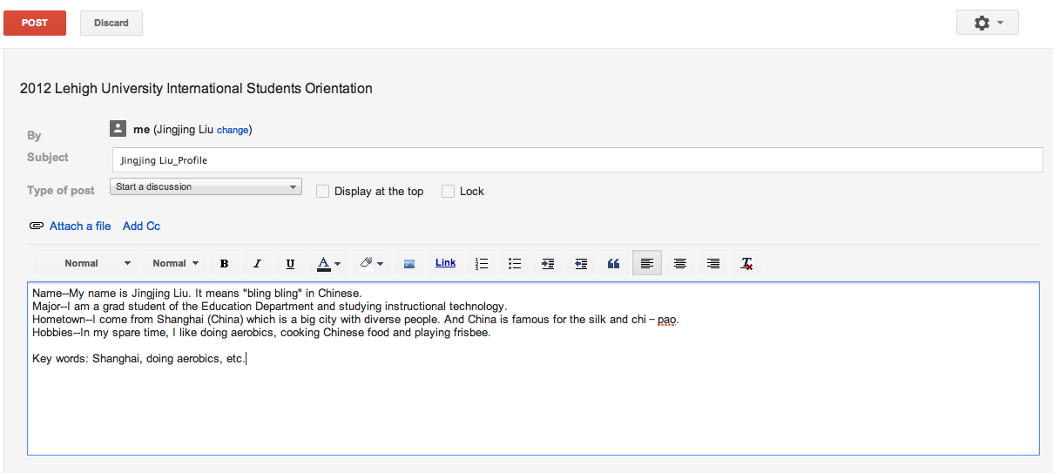
Brief Procedures

Slide 7
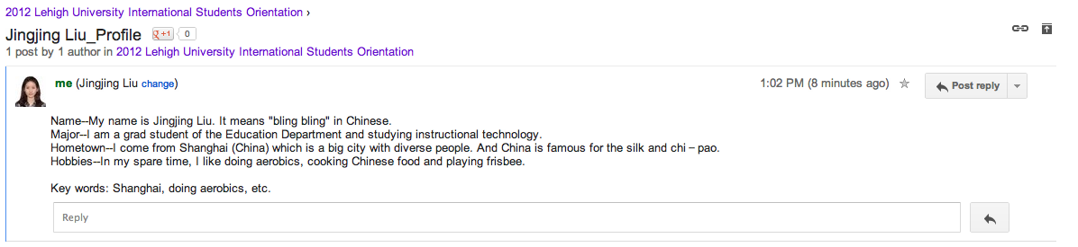
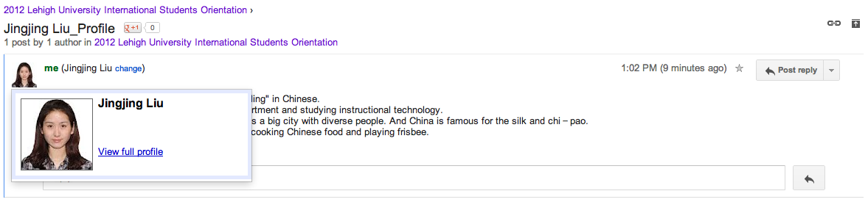
Example

Slide 8
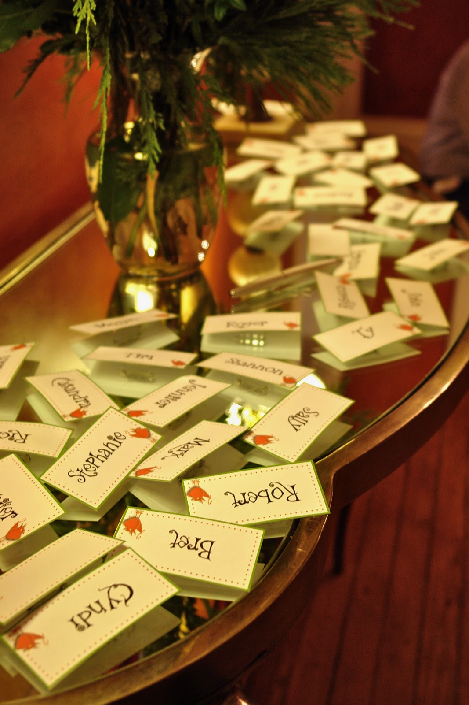
Orientation Day
I. Prepare the Name Cards/Tags

Slide 9

II. Bingo Game

Slide 10
Bingo Game Rules
Within 10 minutes, each of the student has to work independently on the Bingo. Try to search the person’s name to fit each blank.
Another 10 minutes will be given to the students to leave their seats and communicate with the target person to make sure that each blank is filled in correctly.
Try to complete the Bingo Game sheet as fast as possible.
Each student has to complete 20 out of 25 or more blanks in 20min with 100% accuracy.

Slide 11



Bingo Game Winners
Sure you have rewards!!!
1st place
2nd place
3rd place

Slide 12

III. Cooperation Activity

Slide 13
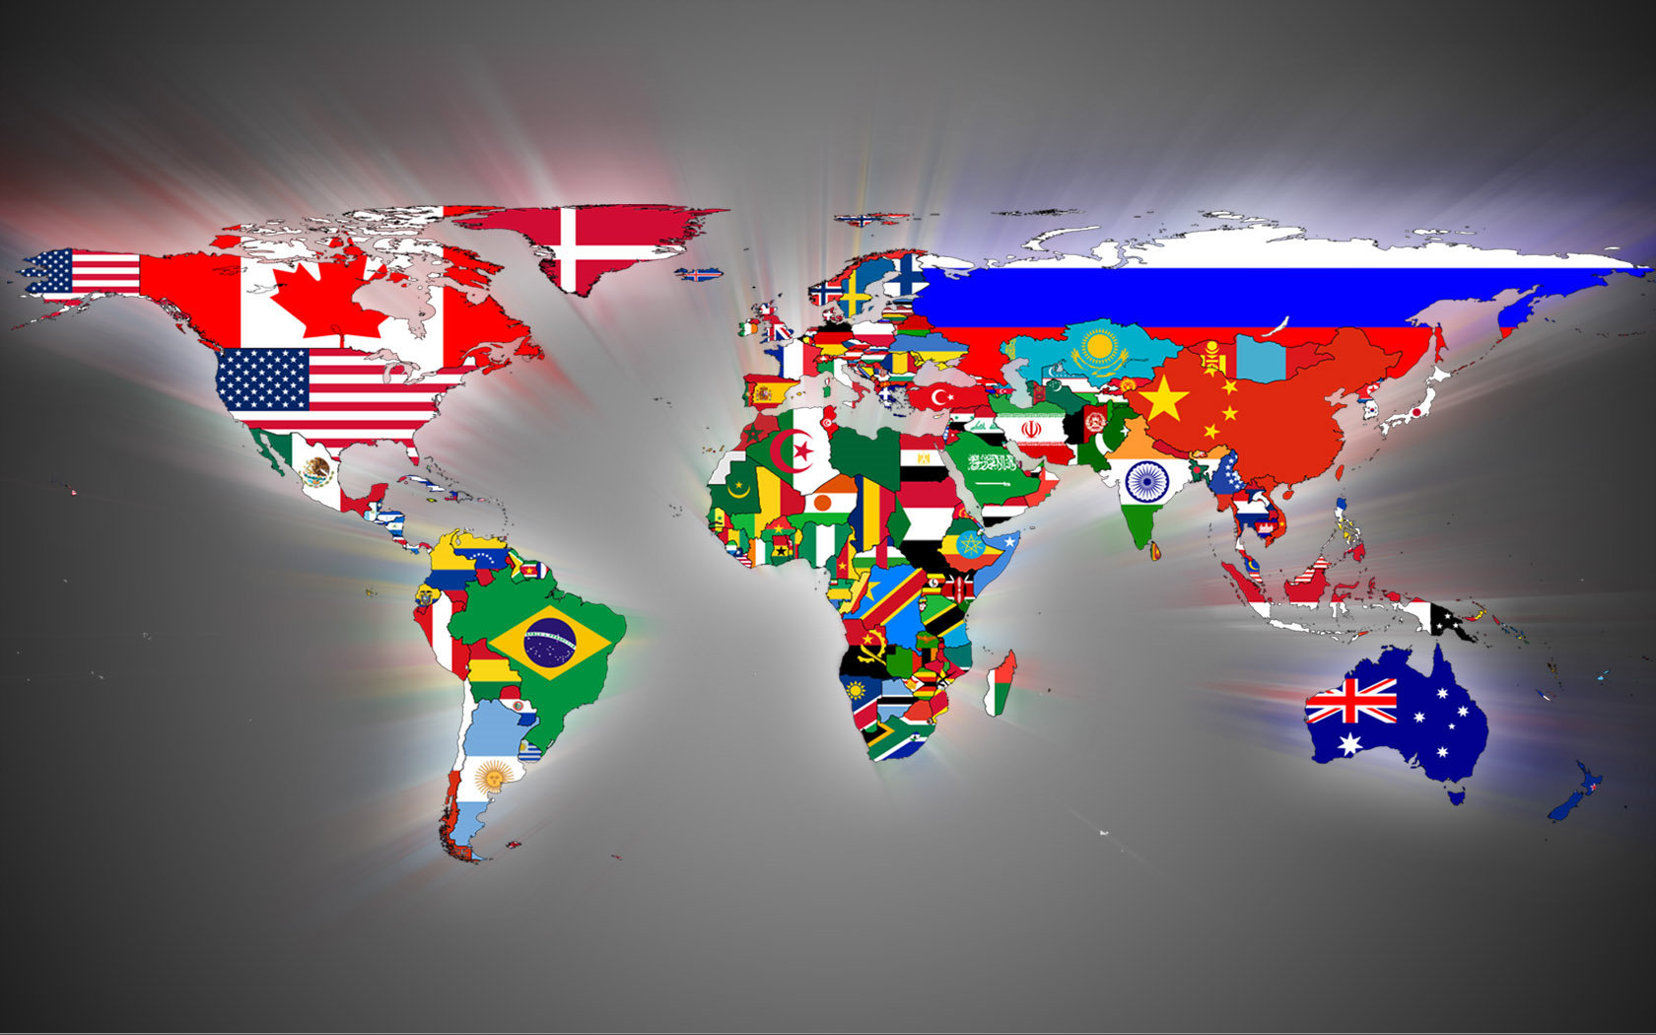
World Map

Slide 14
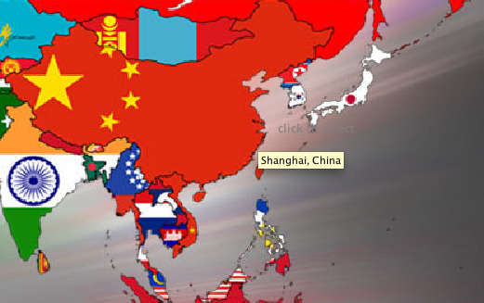
Using Cmap Tool

Slide 15
Using Cmap to
Work Together
Nice concept tool
Visually learning
Develop cooperation skills
Effectively learning
Learning different cultures
Project available for review

Slide 16
How to work together on
Cmap tool?
Cmap allows multiple people to work on the same Cmap at the same time.
Have one person open the Cmap from the SERVER.
When others try to edit the same Cmap, a “request to edit” message will be sent to the first person.
The first person grants the access.
Each new person can work on the same Cmap at the same time.

Slide 17
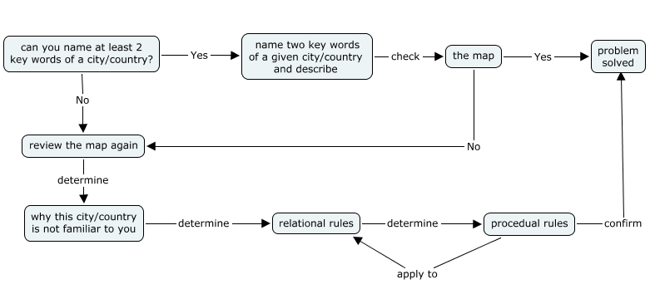
Check the Learning Outcomes
Problem Solving procedural steps

Slide 18

IV. Greetings in Different Languages
This activity needs:
Big, colorful and thick paper
Colorful Markers
Video camera

Slide 19

Closure
Free chat
Enjoy some refreshments

