Slide 1
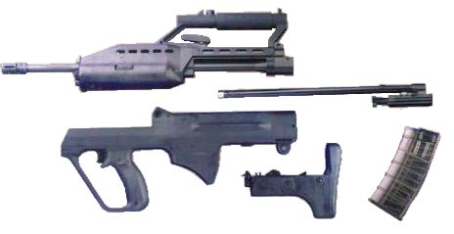
Five Main Parts
Caliber: 5.56x45mm NATO
Action: Gas operated, rotating bolt
Overall length: 805 mm
Barrel length: 508 mm
Weight: 3.82 kg without magazine and accessories, 4.44 kg loaded with magazine and 30 rounds of ammunition
Magazine capacity: 30 rounds
Rate of fire: 450-650 rounds per minute
Effective range: about 500 meters
Technical Data

Slide 2

Technical Handling Test

Slide 3

Live Firing Training
Zeriong and Train fire practice

