Slide 1
Bitácora 0
Rocío Currea

Slide 2
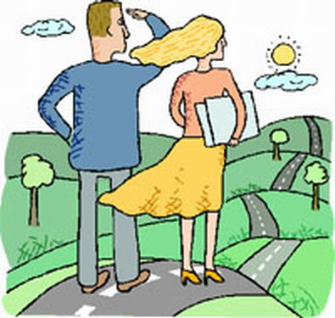
My expectations are knowing about all the new technologies related to the leaning of languages. It is important to learn how manage this kind of sources and would be interesting using them for our own knowledge about English, for example. However, it is necessary, to improve the use of these tools because we will be teachers, who will have to implement them for teaching languages.

Slide 3
I never was taught with ICTs. My classes were traditional and in that age technology was not very popular. Although, the use of ICTs were been a good help for getting a best learning of English.
My experience has been at the university few time ago, and it has been interesting. I have proved the really good content that Second Life, for example, has.

Slide 4
I think that it is important to develop grammar, writing, vocabulary and all kind of skills to students in a traditional way. ICTs should be applied when students have a basic level of the language. Also, I think that ICTs are a good way for practicing a language. Students can be autonomous in their own learning and the sources that they offer are authentic, which guarantee an improvement in the development of the learning.

