Slide 1
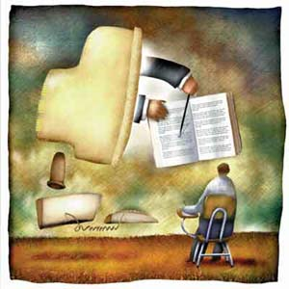
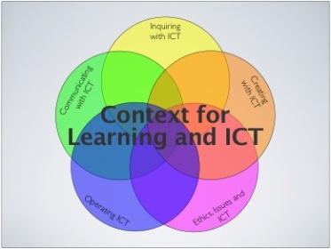
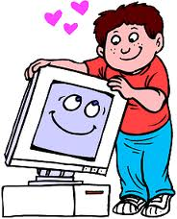
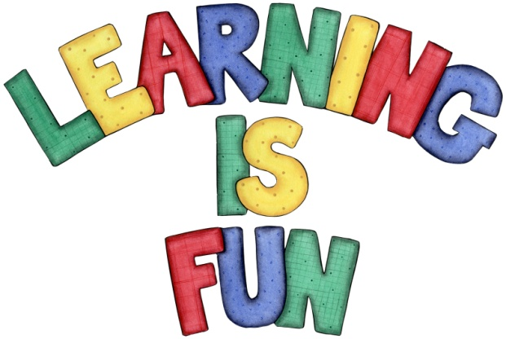
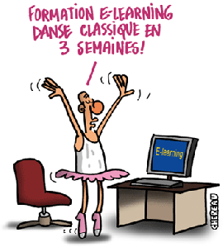
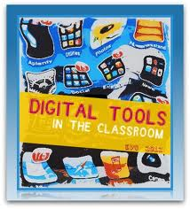
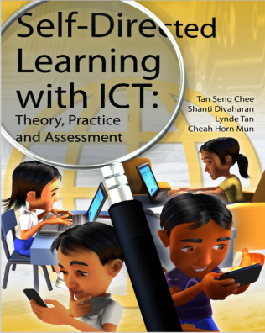
MARIA PAULA FORERO
BITÁCORA ZERO

Slide 2
What are your expectations ?
My for this class includes to acquire knew
knowledge In regards to ICT´S and to
some to show that learning
languages with the help of is a good
way for them to improve their process.

Slide 3
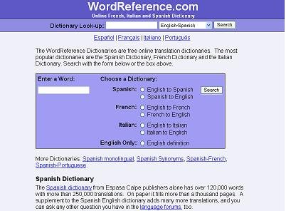
Have you taught? If yes, have you used ICT´S in your classes? Yes, I have taught few one to one classes.
ICT´S
dictionary
Readings

Slide 4
Why would you use ICT´S in your language lessons?
New strategies
Contact with native speakers.
Language improvement.
Essential tools.
Students motivation.
Keep them in touch with reality.

