Slide 1
PEDAGOGÍA Y DIDÁCTICA 3
BITÁCORA # 0
Jeniffer Cardona G.

Slide 2
MY EXPECTATIONS
I believe that in this course I'm going to learn a lot about web pages. By this I meant, I going to take advantages of online sites to improve my language skills due to the easy access to games, communities, groups, blogs that are online.
I think that the Teacher will show us the pros and cons using technology for teaching. It will be useful when we, as students, will be required to teach lessons through internet.
Moreover, I consider, as a future teacher, I'm going to learn how to manage the information that is online, and choose the appropriate subjects for teaching.

Slide 3
I believe ICT is an easy tool to handle. For this reason, i will teach my student the benefits of having lessons on internet. Moreover, I think people from all ages will be glad to attend online courses. And also, people who has not enough money , need to work, online courses will be suitable at any moment.

Slide 4
My first class as a teacher was few months ago. It was when my 12 years old neighbour asked me if I could teach him English because of his low grades in this subject. I started giving him classes for free because his mother doesn't have enough money, besides he assists to a public school. This experience for me was pleasant, I felt like I was doing the right thing. Moreover, I think I was gaining experience for future formal classes. So I consider this opportunity a good alternative to have more confidence.

Slide 5
PEDAGOGÍA Y DIDÁCTICA 3
BITÁCORA # 1
Jennifer Cardona G.

Slide 6
SECOND LIFE
My avatar in Second life is called Jh3nyfer. When I stared to move around this world the first place I visit was Sena. I wanted to know it first because I did not want to be lost for our first virtual class. So I began hanging around at this place.

Slide 7
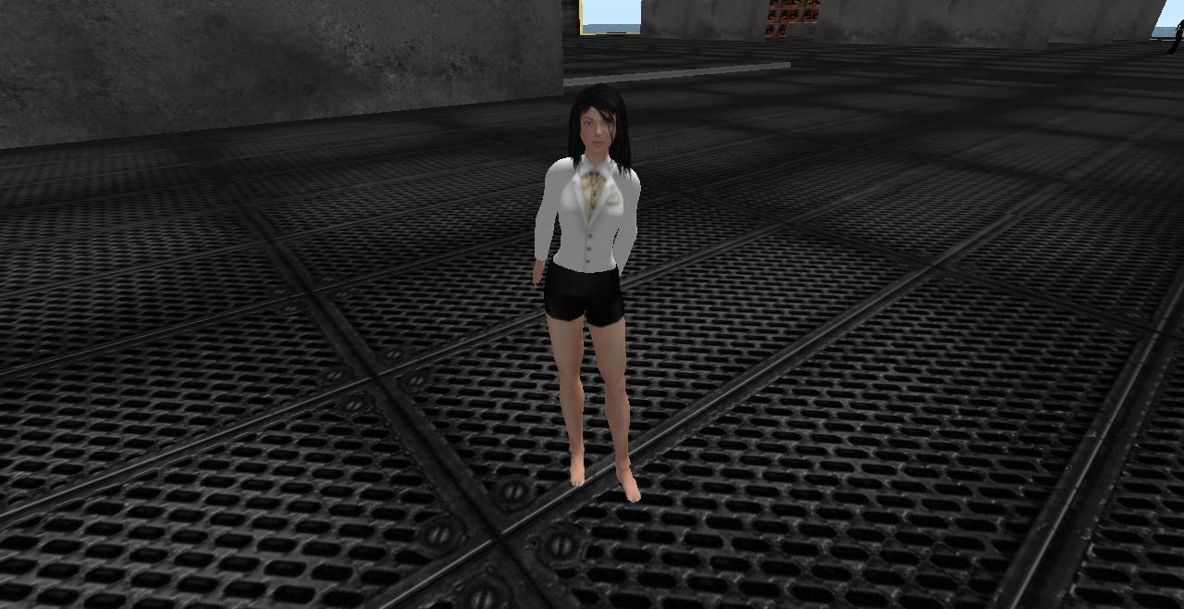
FREEBIES
After Sena visit, I went to change my old fashionable clothe, I tried different looks. But I did not find something really matchy with my hair.

Slide 8
Finally, I went for a casual look. And I was prepared and excited to star my first virtual class.

Slide 9
It felt almost as real as any university class.
My experience in Second life was very constructive. Through all the activity I was introduced to the habitual context an avatar is surrounded. I learnt many expression, specific words, related to SL. For instead, fly, transport, etc.

Slide 10
When we started the virtual class, I was a little bit nervous. I thought that maybe my connection could stop working, and I probably could fail the test.
Certainly it happened, but I was quite skillful to reset SL again. So I was on time to make the groups and start moving around the station.
As We started moving, my leader group, Angelica, start giving her opinion, and then she started asking us if we could agree. There were different points of view so we began the discussions.
Quiclkly, We moved through all the stations, and I felt happy that We accomplished the mission. It seemed to me stressful that I could lost the internet connection again, but everything worked well.

