Slide 1
My experience in Second Life
Alejandra Rodríguez
A.K.A
Alondra7

Slide 2
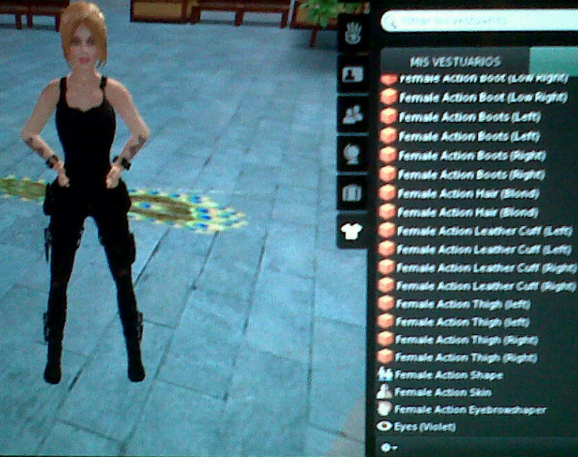
Jusl love this outfit!!

Slide 3
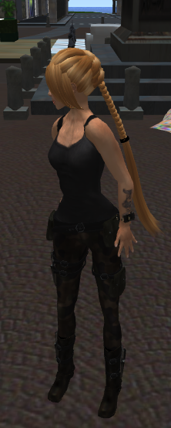
Alondra7
Lost in Torino
Where am I ????

Slide 4
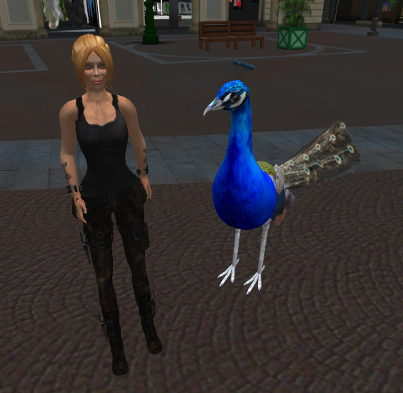
Mai stato in Colombia signorina!
Excuse me sir ! How do I do to teleport me to Colombia???

Slide 5
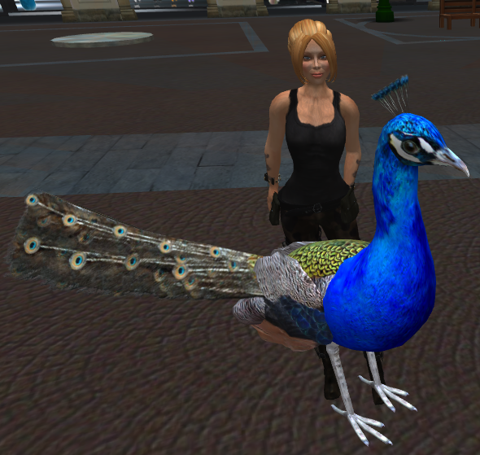
Torino???
Prego! Benvenuta a Torino signorina!

Slide 6
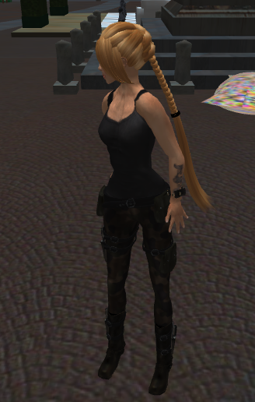
For goodness sake! I have to go to class how can I teleport me..? This MacBook is so difficult to hand!!!!

Slide 7
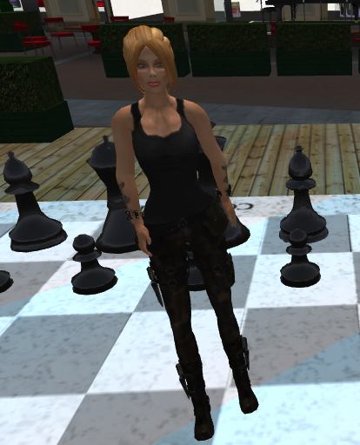
Cata help me!!!!

Slide 8
Thx Cata !!! Everything is completely different in this MacBook!

Slide 9
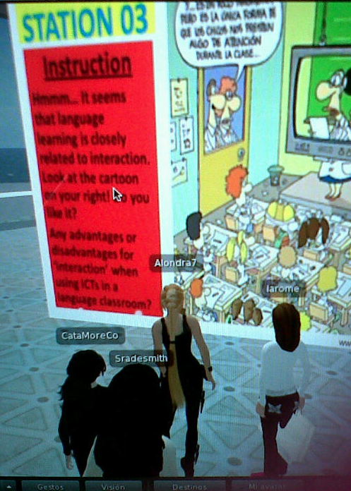
Well after all this is funny and intersting! LOL!
Wow ! This is the real future of classes!
Yes , BTW! Did you know that we can fly?

Slide 10
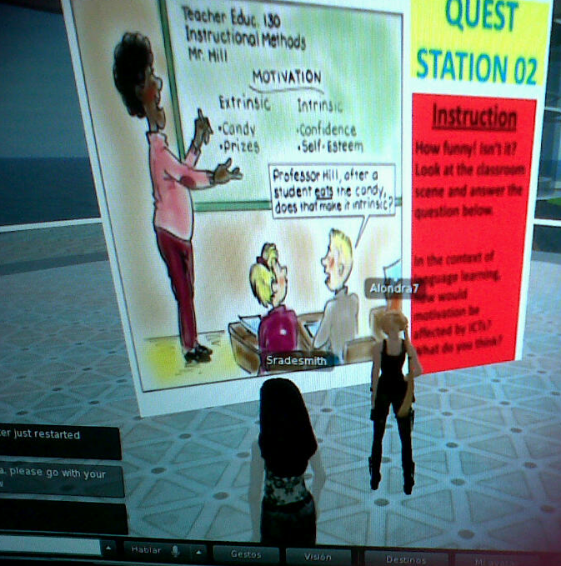
I hope to have more classes like this one Aleja!
INDEED!

Slide 11
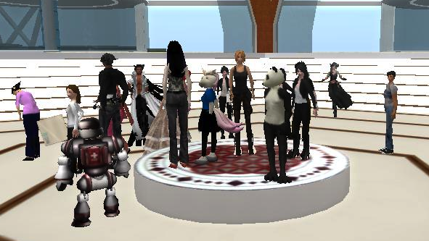
Someone take me a pic , please ! :-P
Done Aleja!

Slide 12
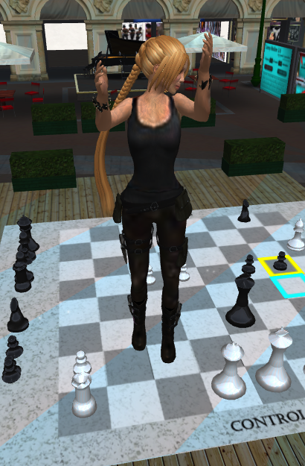
Yay!!!! I’m flying and taking photos!!!

