Slide 1
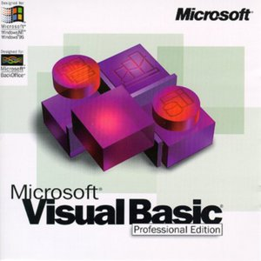
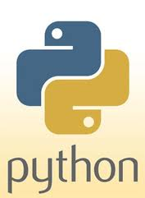
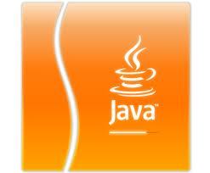
Programming language
A programming language is an artificial language designed to communicate instructions to a machine,
particularly a computer. Programming languages can be used to create programs that control the behavior
of a machine and/or to express algorithms precisely.

Slide 2
Types of Programming language
Python
Java
Visual Basic

Slide 3
Python
Python is a general-purpose, high-level programming language^{[5]} whose design philosophy emphasizes code readability.^{[6]} Python claims to "[combine] remarkable power with very clear syntax",^{[7]} and its standard library is large and comprehensive. Its use of indentation for block delimiters is unique among popular programming languages.
Python supports multiple programming paradigms, primarily but not limited to object-oriented, imperative and, to a lesser extent, functional programming styles. It features a fully dynamic type system and automatic memory management, similar to that of Scheme, Ruby, Perl, and Tcl. Like other dynamic languages, Python is often used as a scripting language, but is also used in a wide range of non-scripting contexts. Using third-party tools, Python code can be packaged into standalone executable programs. Python interpreters are available for many operating systems.
Click for more info.

Slide 4
Java
Java is a programming language originally developed by James Gosling at Sun Microsystems (which is now a subsidiary of Oracle Corporation) and released in 1995 as a core component of Sun Microsystems' Java platform. The language derives much of its syntax from C and C++ but has a simpler object model and fewer low-level facilities. Java applications are typically compiled to bytecode (class file) that can run on any Java Virtual Machine (JVM) regardless of computer architecture. Java is a general-purpose, concurrent, class-based, object-oriented language that is specifically designed to have as few implementation dependencies as possible. It is intended to let application developers "write once, run anywhere." Java is currently one of the most popular programming languages in use, particularly for client-server web applications
Click for more info.

Slide 5
Visual Basic
Visual Basic (VB) is the third-generation event-driven programming language and integrated development environment (IDE) from Microsoft for its COM programming model. Visual Basic is relatively easy to learn and use.^{[1][2]}
Visual Basic was derived from BASIC and enables the rapid application development (RAD) of graphical user interface (GUI) applications, access to databases using Data Access Objects, Remote Data Objects, or ActiveX Data Objects, and creation of ActiveX controls and objects. Scripting languages such as VBA and VBScript are syntactically similar to Visual Basic, but perform differently.^{[3]}
Click for more info.

