Slide 1
CHARATERISTIC OF AIRCRAFT
AH64 D APACHE
F16 FALCON
F15 EAGLE

Slide 2
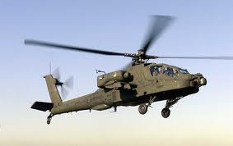
CHARATERISTIC OF AH64 D APACHE
General characteristics
Crew: 2: pilot, co-pilot/gunner
Length: 58.17 ft (17.73 m)
Rotor diameter: 48 ft (14.63 m)
Height: 12.7 ft (3.87 m)
Empty weight: 11,387 lb (5,165 kg)
Loaded weight: 18,000 lb (8,000 kg)
Max takeoff weight: 21,000 lb (9,500 kg)
Engines: two T700 turboshaft engines
Fuselage length : 49 ft 5 in (15.06 m)
Rotor systems : 4 blade main and tail rotor
Performance
Maximum speed: 158 knots (182 mph, 293 km/h)
Cruise speed: 143 knots (165 mph, 265 km/h)
Combat radius: 260 nmi (300 mi, 480 km)
Rate of climb: 2,500 ft/min (12.7 m/s)
Armament
Guns: 1× 30x113 mm M230 chain gun
Rockets: Hydra 70 unguided rockets
Missiles: AGM-114 Hellfire, AIM-92 Stinger, and AIM-9 Sidewinder

Slide 3
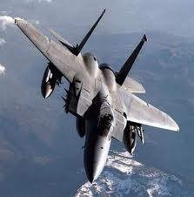
CHARATERISTIC OF F15 FALCON
F-15 Eagle - General characteristics
Crew: 1 (A/C), 2 (B/D/E)
Length: 63.8 ft (19.44 m)
Wingspan: 42.8 ft (13 m)
Height: 18.5 ft (5.6 m)
Wing area: 608 ft² (56.5 m²)
Empty: 28,000 lb (12,700 kg)
Loaded (C variant): 44,500 lb (20,200 kg)
Maximum takeoff:
  C/D: 68,000 lb (30,844 kg)
  E: 81,000 lb (36,700 kg)
Powerplant: Engines
F-15 Eagle - Performance
Maximum speed: 1,875 mph (3000 km/h) (Mach 2.5) - other sources say 2 655 km
Range: 3,450 km ferry range (approx. 2156 miles), approx 5, 500 km with drop tanks
Service ceiling:
  A/B/C/D: 65,000 ft (19,812 m)
  E: 50,000 ft (15,000 m)
Rate of climb: 50,000 ft/min (15,240 m/min)

Slide 4
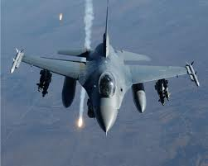
CHARATERISTIC OF F16 FALCON
General Characteristics
Primary Function: Multirole fighter
Builder: Lockheed Martin Corp.
Power Plant: F-16C/D: one Pratt and Whitney F100-PW-200/220/229 or General Electric F110-GE-100/129
Thrust: F-16C/D, 27,000 pounds
Length: 49 feet, 5 inches (14.8 meters)
Height: 16 feet (4.8 meters)
Wingspan: 32 feet, 8 inches (9.8 meters)
Speed: 1,500 mph (Mach 2 at altitude)
Ceiling: Above 50,000 feet (15 kilometers)
Maximum Takeoff Weight: 37,500 pounds (16,875 kilograms)
Range: More than 2,000 miles ferry range (1,740 nautical miles)
Armament: One M-61A1 20mm multibarrel cannon with 500 rounds; external stations can carry up to six air-to-air missiles, conventional air-to-air and air-to-surface munitions and electronic countermeasure pods
Unit cost: F-16A/B , $14.6 million (fiscal 98 constant dollars); F-16C/D,$18.8 million (fiscal 98 constant dollars)
Crew: F-16C, one; F-16D, one or two
Date Deployed: January 1979
Inventory: Active force, 732; Reserve, 70; and ANG, 579

