Slide 1
Rare & exotic cars
By Alan Poh

Slide 2

MAIN PAGE
LUXURY CARS
FAST CARS
SPORTS CAR

Slide 3

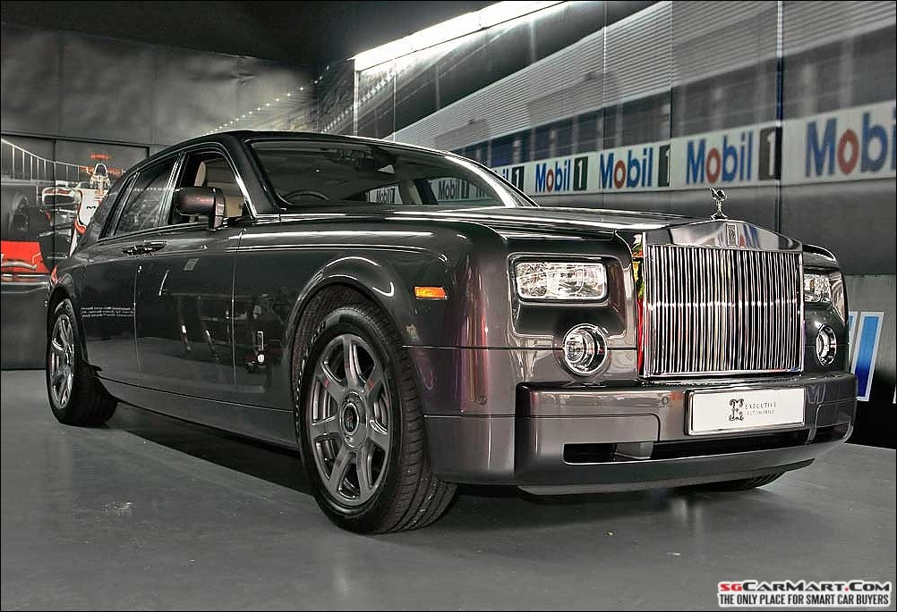
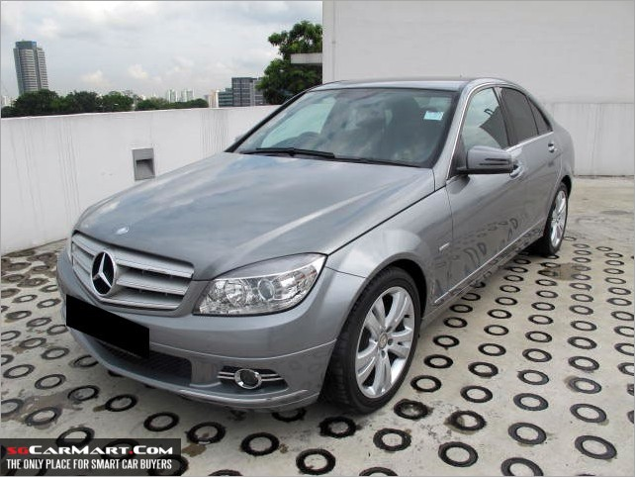
LUXURY CARS
BENTLY
ROLLS ROYCE
MERCEDES

Slide 4
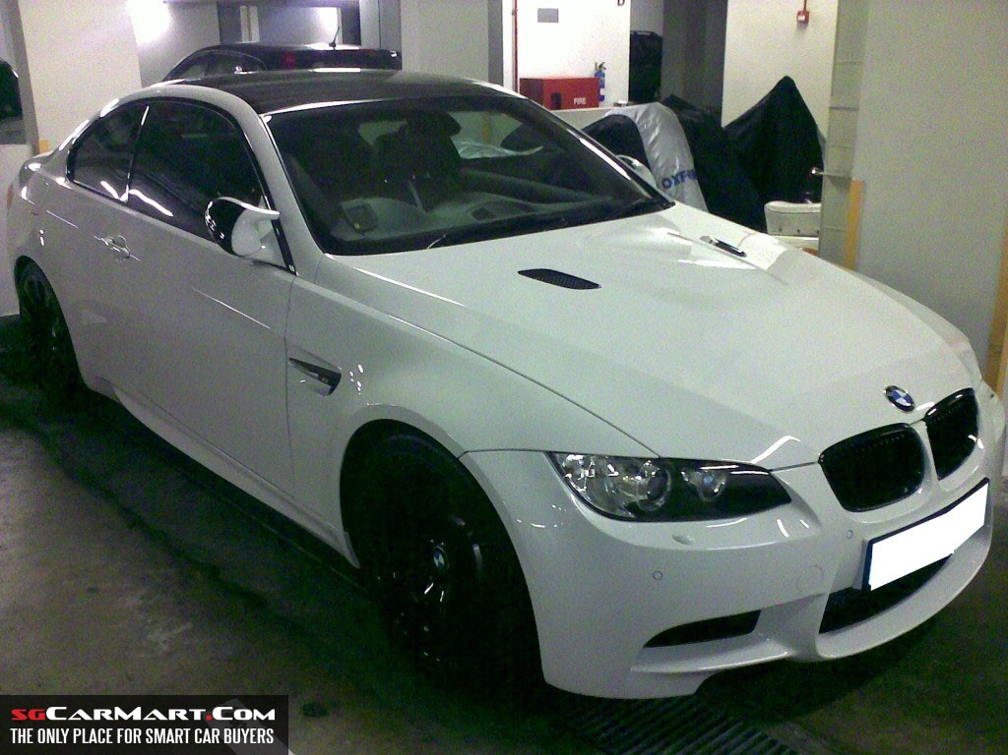
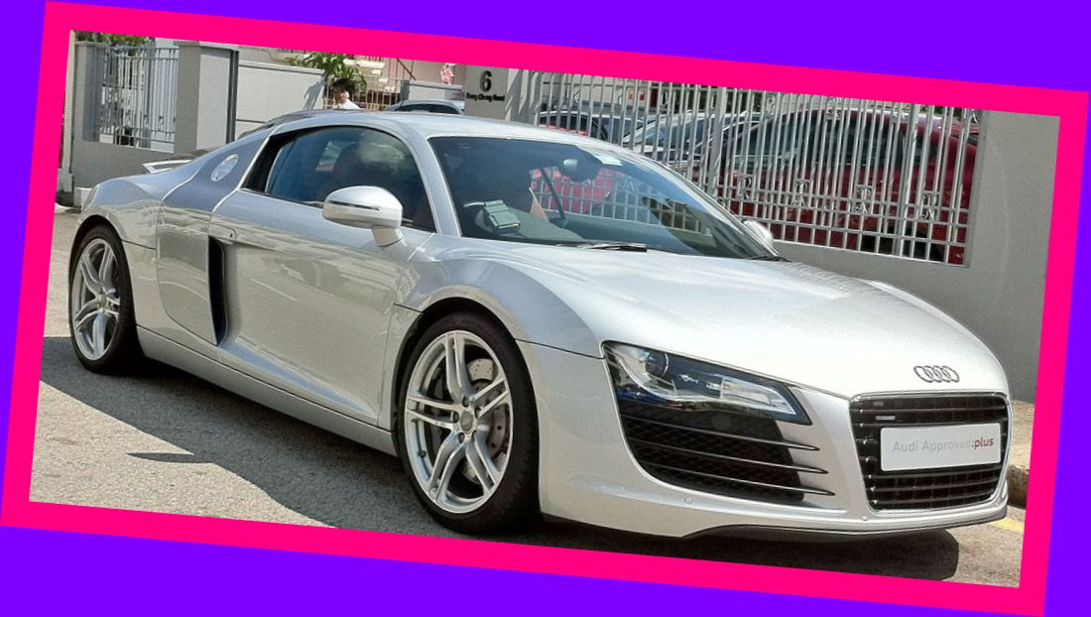
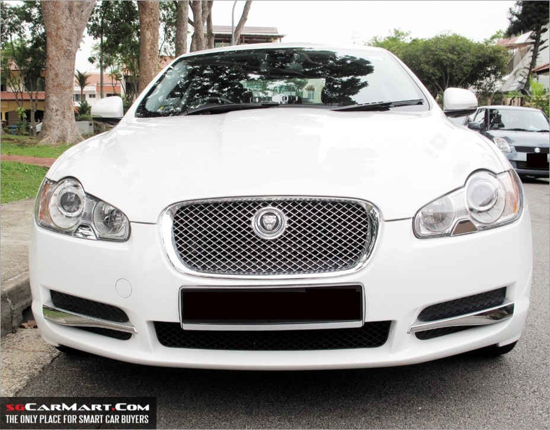
FAST CARS
BMW M3
AUDI R8
JAGUAR

Slide 5
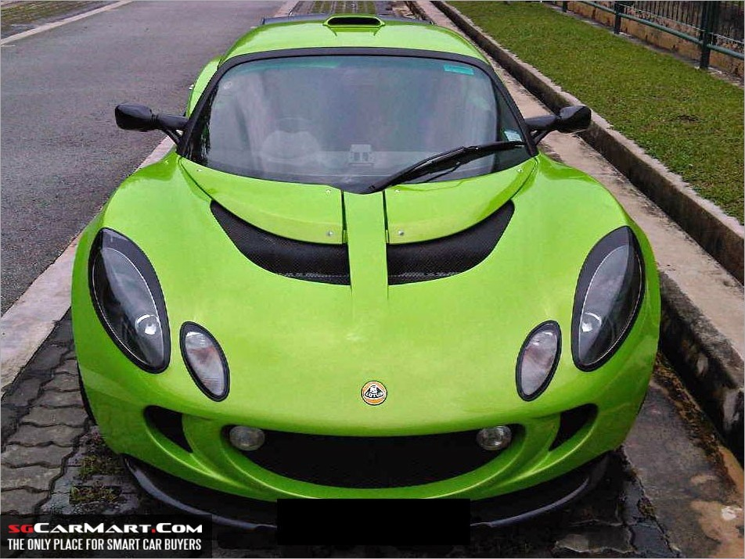
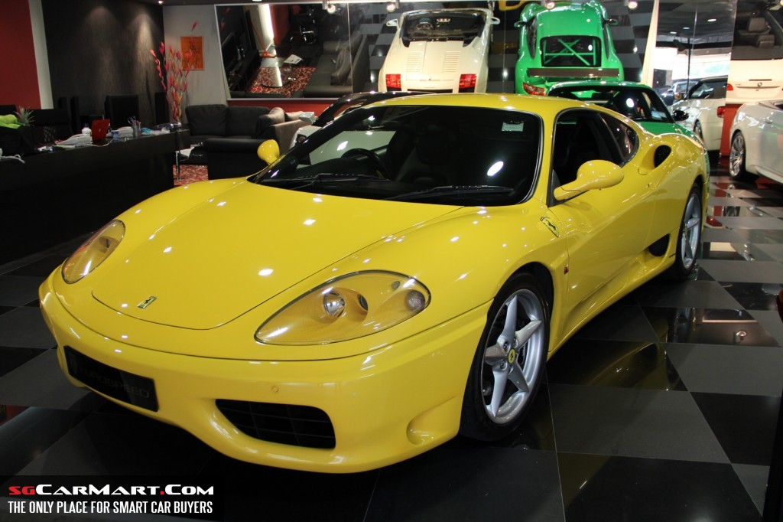
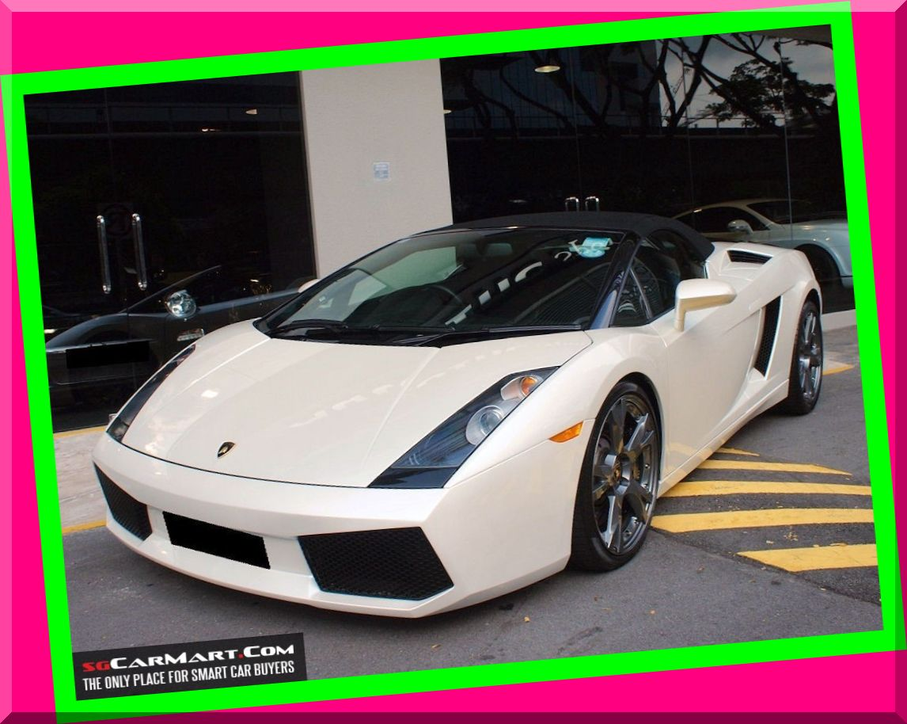
SPORT CARS
LOTUS
PORSCHE
LAMBOGINI

