Slide 1
Valuing Diversity in Higher Education
Nancy Cantor, Chancellor and President Kal Alston, Senior Associate Provost Syracuse University
Texas A&M University October 1, 2010

Slide 2
Valuing Diversity = Valuing Our Public Mission
Create opportunities and social mobility for underserved and fast-growing populations
Change the face of our faculties and break the glass ceiling to tap into a wider talent pool and increase competitiveness globally
Increase faculty diversity ➔ increase academic success of previously underrepresented/underserved groups
Create diverse learning environment that fosters civic learning and better prepares students for the complex global world
Energize our disciplines—diverse faculty better positions institution to address pressing issues; research shows women and faculty of color are more likely to build publicly-tuned research agendas

Slide 3
Valuing Diversity = Valuing Our Public Mission
Create opportunities and social mobility for underserved and fast-growing populations
Change the face of our faculties and break the glass ceiling to tap into a wider talent pool and increase competitiveness globally
Increase faculty diversity ➔ increase academic success of previously underrepresented/underserved groups
Create diverse learning environment that fosters civic learning and better prepares students for the complex global world
Energize our disciplines—diverse faculty better positions institution to address pressing issues; research shows women and faculty of color are more likely to build publicly-tuned research agendas

Slide 4
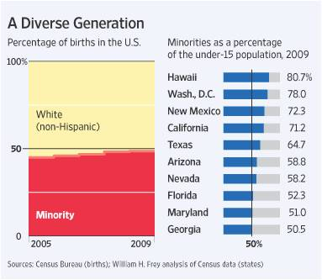
The More Diverse Future is Now
Chart source: Conor Dougherty, “U.S. Nears Racial Milestone,” The Wall Street Journal, June 11, 2010

Slide 5
Valuing Diversity = Valuing Our Public Mission
Create opportunities and social mobility for underserved and fast-growing populations
Change the face of our faculties and break the glass ceiling to tap into a wider talent pool and increase competitiveness globally
Increase faculty diversity ➔ increase academic success of previously underrepresented/underserved groups
Create diverse learning environment that fosters civic learning and better prepares students for the complex global world
Energize our disciplines—diverse faculty better positions institution to address pressing issues; research shows women and faculty of color are more likely to build publicly-tuned research agendas

Slide 6
Inching Toward Faculty Diversity
Doctorates Earned by Women Who Are U.S. Citizens, 2008
TOTAL, ALL FIELDS | 52.10%
Education | 67.70%
Engineering | 25.50%
Humanities | 51.30%
Biological/biomedical sciences | 51.10%
Health sciences | 74.30%
Physical sciences | 29.00%
Psychology | 71.30%
Source: The Chronicle of Higher Education, Diversity in Academe supplement, September 24, 2010; aggregate social sciences data for women N/A

Slide 7
Valuing Diversity = Valuing Our Public Mission
Create opportunities and social mobility for underserved and fast-growing populations
Change the face of our faculties and break the glass ceiling to tap into a wider talent pool and increase competitiveness globally
Increase faculty diversity ➔ increase academic success of previously underrepresented/underserved groups
Create diverse learning environment that fosters civic learning and better prepares students for the complex global world
Energize our disciplines—diverse faculty better positions institution to address pressing issues; research shows women and faculty of color are more likely to build publicly-tuned research agendas

Slide 8
Valuing Diversity = Valuing Our Public Mission
Create opportunities and social mobility for underserved and fast-growing populations
Change the face of our faculties and break the glass ceiling to tap into a wider talent pool and increase competitiveness globally
Increase faculty diversity ➔ increase academic success of previously underrepresented/underserved groups
Create diverse learning environment that fosters civic learning and better prepares students for the complex global world
Energize our disciplines—diverse faculty better positions institution to address pressing issues; research shows women and faculty of color are more likely to build publicly-tuned research agendas

Slide 9
Valuing Diversity = Valuing Our Public Mission
Create opportunities and social mobility for underserved and fast-growing populations
Change the face of our faculties and break the glass ceiling to tap into a wider talent pool and increase competitiveness globally
Increase faculty diversity ➔ increase academic success of previously underrepresented/underserved groups
Create diverse learning environment that fosters civic learning and better prepares students for the complex global world
Energize our disciplines—diverse faculty better positions institution to address pressing issues; research shows women and faculty of color are more likely to build publicly-tuned research agendas

Slide 10
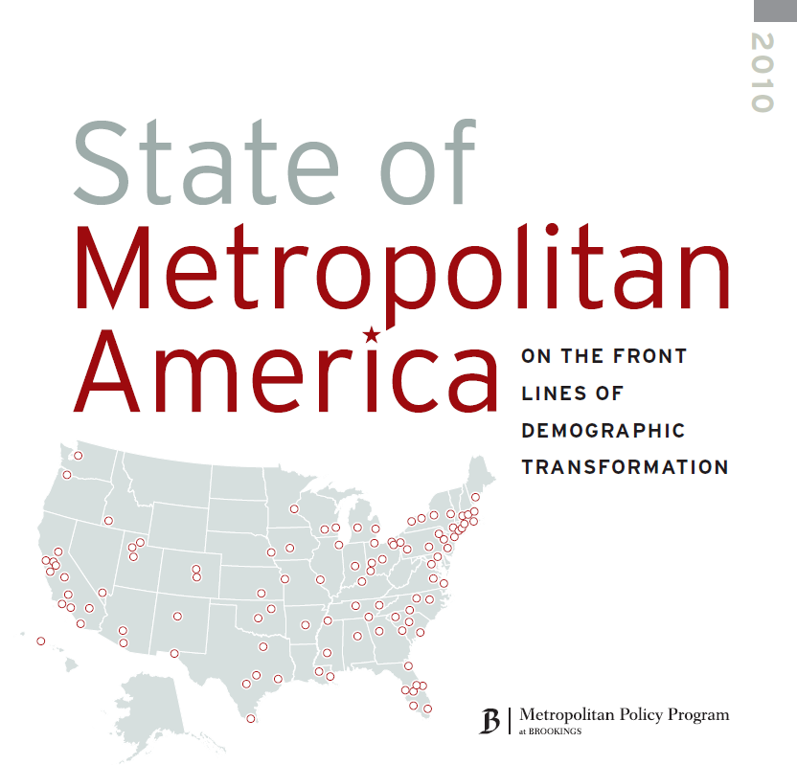
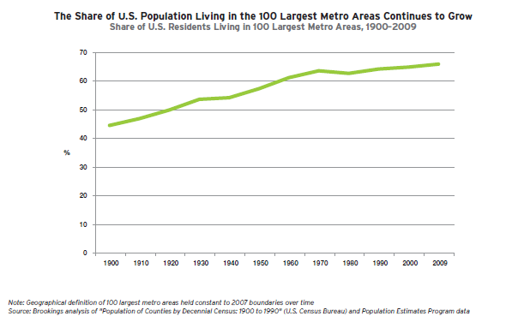
Getting Connected in a Flat World
Notes:
The Brookings Institution and CEOs for Cities—among many other think tanks and nonprofits have pointed out—have been drawing attention to the fact that universities have a huge opportunity at hand to help remake metropolitan America.
This translates to a huge opportunity for our students to be engaged in cutting-edge interdisciplinary and cross-sector work that can become a prototype for economic and social growth all over our country and the world.
Because we know that the issues we address locally here in Syracuse really are the same issues faced by cities all over America and all over the world. So, we know that by engaging these issues here through our expansive partnerships, our students will be prepared to go anywhere and hit the ground running, ready to make a difference.

Slide 11
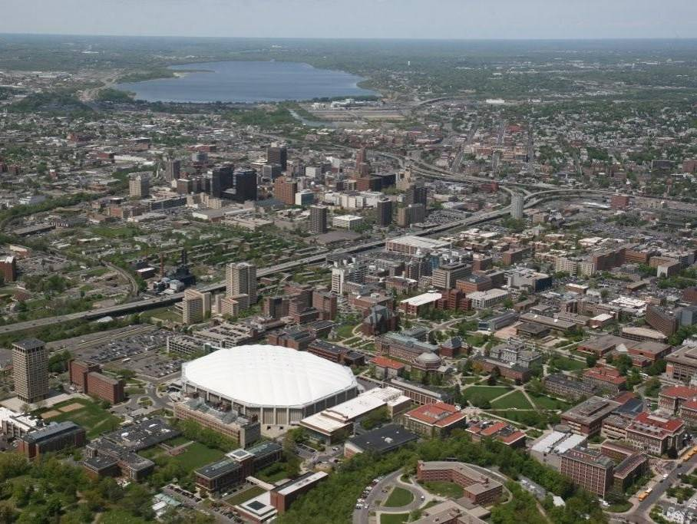
SU: A Community Anchor
Arts, Technology & Design
Environmental Sustainability
Neighborhood & Cultural Entrepreneurship
Inclusive Urban Education
Global Connections

Slide 12
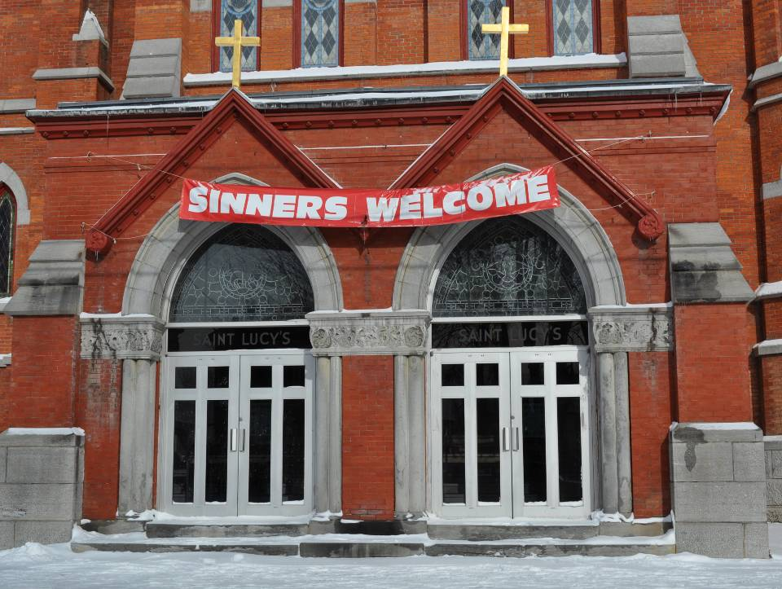
Syracuse’s Near Westside

Slide 13
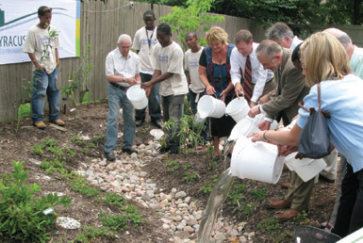
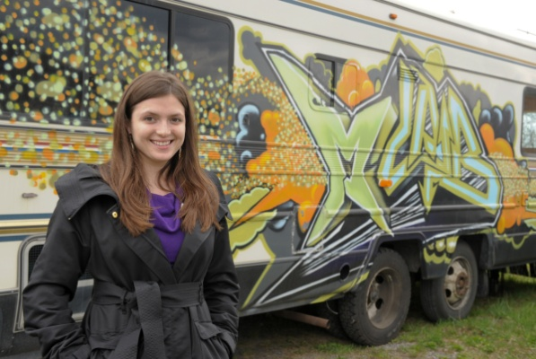
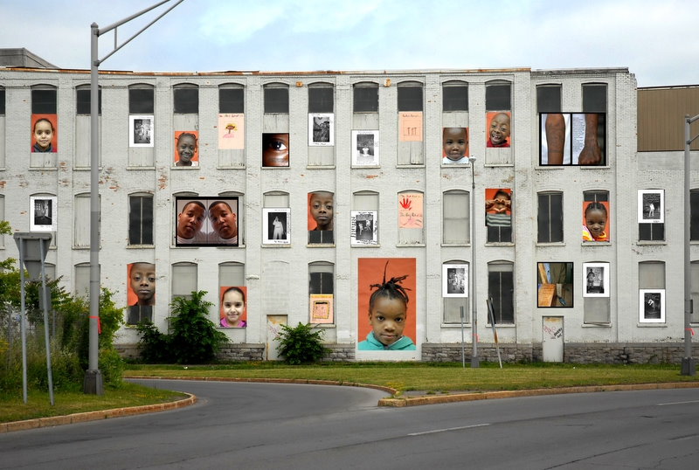
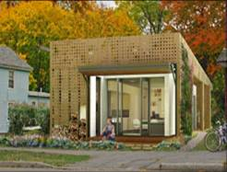
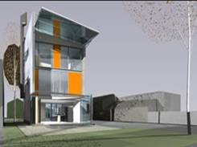
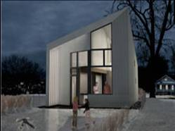
Scholarship in Action On the Near Westside
From the Ground Up
Notes:
9th poorest census tract in US; Latino/a and Native population.
Looking to maximize the Green dividend and the Opportunity dividend.
Neighborhood 501c3 board, university partners with HomeHeadquarters to renovate and/or build 150 houses.
Green innovation companies; artists; green homes.
Build schools as centers of community; sustainable food markets and WCNY and Blue Highway.
La Casita (a Latino/a Cultural Center); SEED-urban farm
The neighborhood is now called the Syracuse Art Life and Technology District (SALT)

Slide 14
Valuing Our Public Mission = Valuing Diversity
Civically-engaged pedagogy – educating in the world, for the world – builds an authentic context for speaking across differences and for valuing different perspectives, and breaking boundaries of race, ethnicity, culture, class, nationality.
Builds more inclusive climate via creating a wider sense of belonging by engaging the voices of a more diverse set of individuals and community members.

Slide 15
Valuing Our Public Mission = Valuing Diversity
Scholarship in Action that is tuned to the pressing challenges of the world and of our communities embraces the expertise of a more diverse faculty doing a range of scholarship.
Fosters equity via a more deliberate and conscious effort to evaluate and reward a diverse set of contributions to excellence.

Slide 16
Valuing Our Public Mission = Valuing Diversity
Engaged disciplines in turn encourage all of our disciplines to recognize the value of a diverse professoriate who can help have impact.
Promotes accountability to the public mission across the institution – everyone should be tuned to impact, not just some disciplines, and this becomes a natural way to get more attention paid to diversity within all of the disciplines – i.e. caring about their public impact makes them more attuned to welcoming the expertise of a diverse professoriate.

Slide 17
Scholarship in Action = Institutional Transformation
Transforms our thinking about:
Our students
Our faculty recruitment
How we build contexts for diverse interaction
Our partnerships in our community, across our nation, and around the world
The nature of our signature programs and research clusters

Slide 18
Drill Down: School of Education
RESULT: School of Education has established itself as a leader in pursuit of the University vision and key partner for other schools/colleges

Slide 19
Drill Down: School of Education

Slide 20
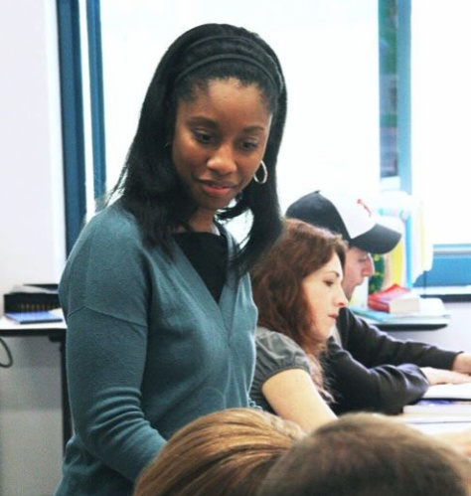
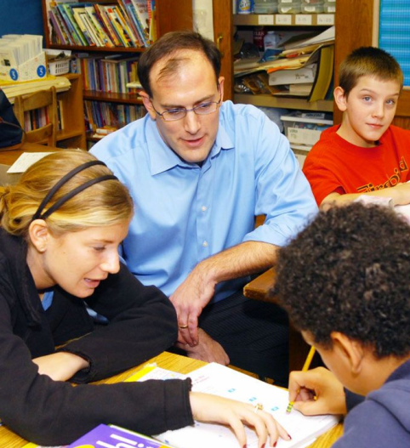
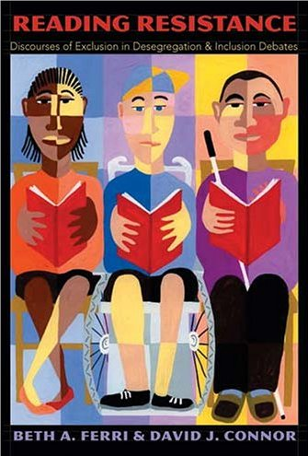
Inclusive Urban Education
Schools as centers of community
Schools as locus of educational, social, and health services
Identify and address real-world problems
Youth provide, as well as receive, service
Universities catalyze collaboration across sectors to promote college completion

Slide 21
Drill Down: School of Education

Slide 22
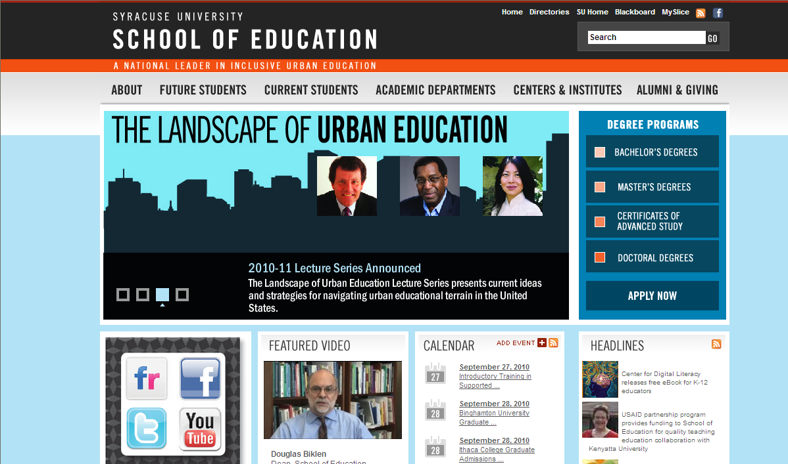
Internal Realignment of Goals

Slide 23
Dean's Message
Welcome to Syracuse University’s School of Education, a national leader in inclusive urban education. There is no career more critical to the health and sustainability of our world than creating opportunities to engage persons of all abilities in learning. Education is fundamentally about innovation, growth, cultivation of talent and the translation of that human capital to benefit the world. Access and inclusion are critical to the global knowledge economy and at the center of the School of Education’s mission. Our leadership in inclusive urban education is built on a legacy of pioneering work in advancing educational opportunities for all learners. By linking research to practice and bringing what we learn from inquiry to every day teaching, our community of scholars and innovators collaborate to lead nationally recognized centers and institutes and serve in leadership roles on national posts, research projects and international conferences. We continue in the commitment to technological advances in the classroom, local partnerships with the Syracuse City School District as well as other schools, agencies and research centers in the region and nationally, dynamic research and scholarship alongside students and alumni and a heightened dedication to understanding our role as global citizens. Join us here at Syracuse University, take part in our centers abroad in London, Florence and Beijing or in our research and training projects in Asia, Australia, Latin America and Africa. Be a part of the School of Education’s mission to address issues and seek solutions that can define the future of education in America and around the world.

Slide 24
Drill Down: School of Education

Slide 25
Strengthen and Deepen Collaboration Say Yes to Education
SUPPORTS
+
INCENTIVES
=
RESULTS
STUDENT MONITORING AND GROWTH PLAN
SAY YES HIGHER EDUCATION COMPACT
LONGITUDINAL EVALUATION BY AIR
Academic:
Research-based school models
After School programs
Summer School programs
One-on-one Tutoring
Social/Emotional:
Research Based Programs
Mentors/Advocates
Social Workers/Counselors
(ratio of 1:200)
Legal Support
Health:
Quality Medical Care
Quality Mental Health
Assessments and Services
Quality Family Supports
Tuition Scholarships at
24 Private Institutions
plus
SUNY/CUNY
College/Career Prep:
Early College High School
SAT/ACT Prep
College Visits
FAFSA Workshops
Hillside Work-Scholarship Program
On-Point for College
High School Graduation
College Graduation
Quality of Work Force
Worker Tax Contribution
Real Estate Values
Commitment to Community
Welfare Dependency
Criminal incidents
Notes:
This model plays out through a robust set of programming, including across the entire K-16 continuum, and with evaluation (by AIR) and a student and school monitoring assessment system for continuous improvement.
Key examples across continuum:
Socio-emotional and health and legal supports
International Baccalaureate
Literacy through the Arts in after school and summer school
Hillside Work Scholarship
Learning Academies
Early College High School (Woodrow Wilson in the schools and PBE on campus)
College Access Initiative – family and high school counselor training on options, interviewing, essays, test preparation, FAFSA etc.
On Point to College
All of these have the effect of ramping up toward success in college.

Slide 26
Drill Down: School of Education
RESULT: School of Education has established itself as a leader in pursuit of the University vision and key partner for other schools/colleges

Slide 27
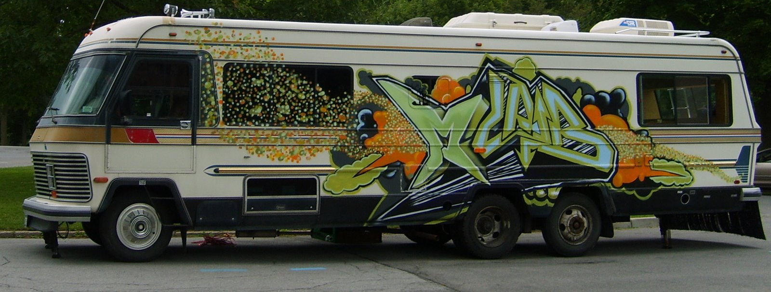
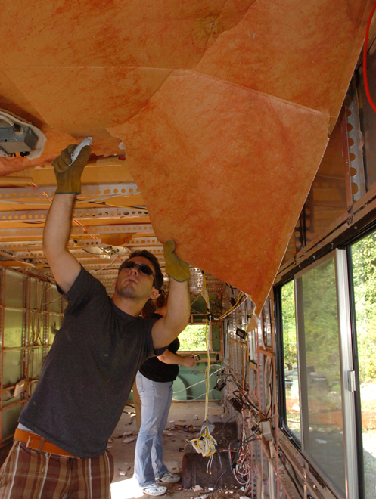
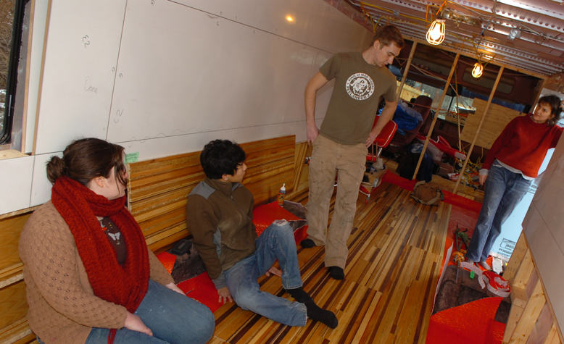
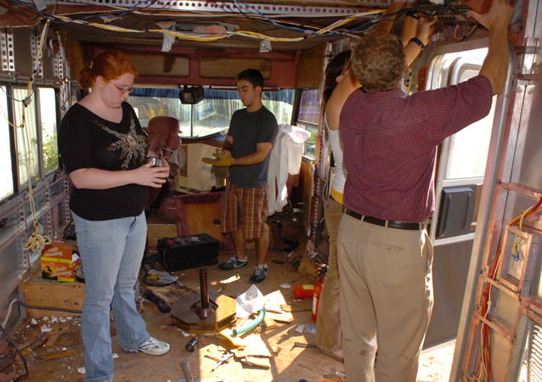
Collaborate Across the University

Slide 28
Drill Down: School of Education

Slide 29
Leverage University Tenure Criteria & Budget System
Syracuse University recognizes success in teaching among its tenured faculty to be of vital importance and values innovation and intellectual pursuit embedded within teaching. Teaching involves the art and skill required for the diffusion of knowledge and guidance toward its effective and independent use. The successful teacher, among other things, instructs in consonance with the School/College mission, has knowledge of subject matter, skillfully communicates and contributes to student learning and development, acts professionally and ethically, and strives continuously to improve. Quality teaching includes providing substantive feedback to students, revising curriculum to reflect developments in the field, and mastering appropriate pedagogical approaches. In addition to the instruction of individual courses, activities under the heading of teaching may include supervising independent study projects; advising; arranging and supervising internships, clinical placements or student research; serving on graduate examination committees and thesis, dissertation, dossier, and portfolio review committees; providing professional development for teaching assistants; involving students in community engagement projects; and instructing non-SU students or community members in a variety of venues.

Slide 30
Syracuse University is committed to longstanding traditions of scholarship as well as evolving perspectives on scholarship. Syracuse University recognizes that the role of academia is not static and that methodologies, topics of interest, and boundaries within and between disciplines change over time. The University will continue to support scholars in all of these traditions, including faculty who choose to participate in publicly engaged scholarship. Publicly engaged scholarship may involve partnerships of University knowledge and resources with those of the public and private sectors to enrich scholarship, research, creative activity, and public knowledge; enhance curriculum, teaching and learning; prepare educated, engaged citizens; strengthen democratic values and civic responsibility; address and help solve critical social problems; and contribute to the public good.

Slide 31
Generating Opportunity

Slide 32
Valuing Diversity in Higher Education
Nancy Cantor, Chancellor and President Kal Alston, Associate Provost Syracuse University
Texas A&M University October 1, 2010

