Slide 1
Food Chains / Webs

Slide 2
What’s to Eat?
Producers: produce their own food
Plants that carry out photosynthesis
Trees, vines, shrubs, ferns, mosses,

Slide 3
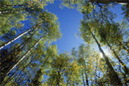
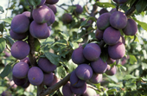
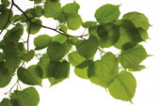
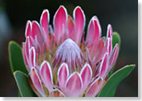
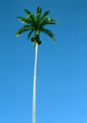
Producers

Slide 4
Consumers
Organisms (animals) that obtain energy from eating other organisms
Must eat producers (plants) or other consumers (animals)
Squirrels, owls, deer, coyotes, humans

Slide 5
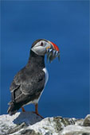
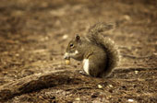
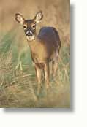
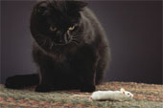
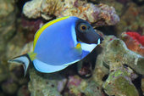
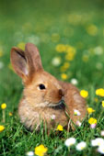
Consumers

Slide 6
Decomposers
Feed on the wastes of living organisms and on dead, decaying, plants and animals
Release nutrients from the animals waste and decaying matter and return the nutrients to the soil.
Fungi, bacteria, worms

Slide 7
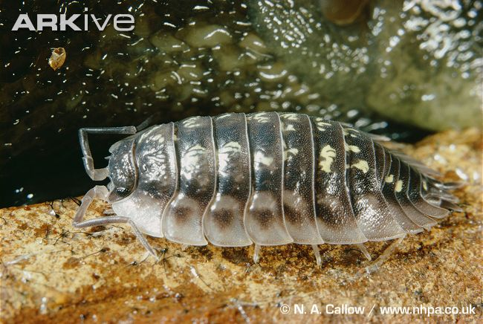
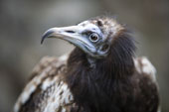
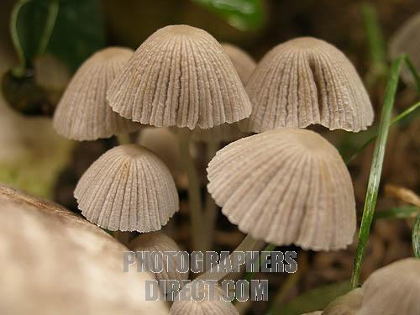
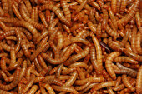
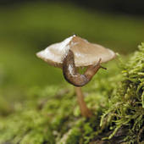
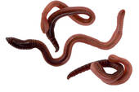
Decomposers

Slide 8
Specific Consumers
Herbivores: plant eating – squirrel, deer, mice, rabbits
Carnivore: meat eating – wolves, tigers,
Omnivore: plant and meat eating – many birds, humans, box turtle,

Slide 9
Predator – Prey Relationship
Predator: hunts other animals for food
Prey: hunted and eaten by other animals
Predator and prey population increase and decrease according to hunting
Lynx / Hare Population

Slide 10
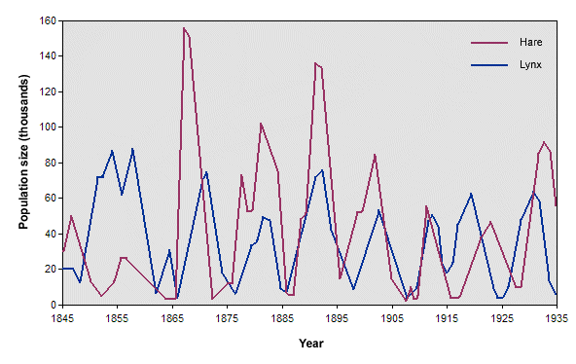
Hare and Lynx Relationship

Slide 11
Close Relationships
Symbiosis: long term close relationship between
plants and microscopic organisms
Animals and plants
Animals and other animals

Slide 12
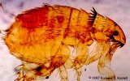
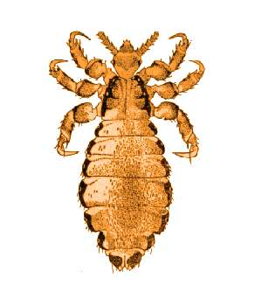
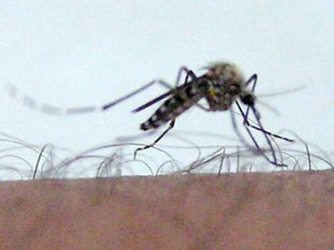
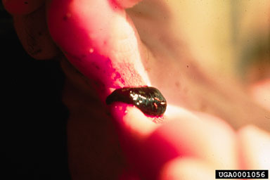
Parasitism: one organism lives in or on, feeds upon, and harms another organism
Fleas, ticks, leeches

Slide 13
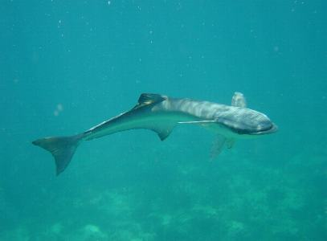
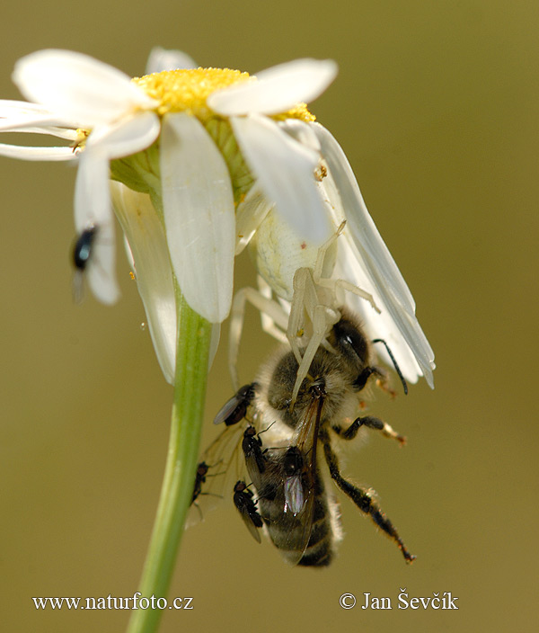
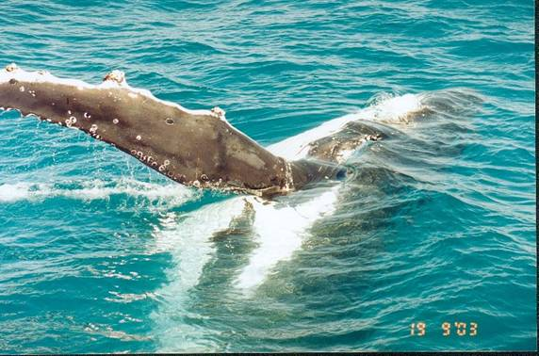
Commensalism: one species benefits, while the other specie seems unaffected
Example: crab spider and flower

Slide 14
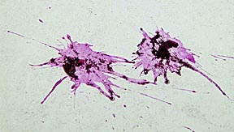
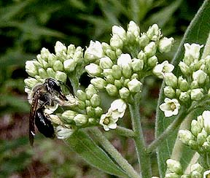
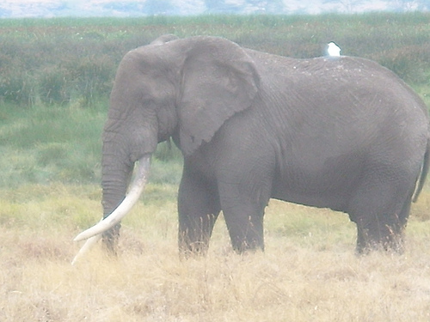
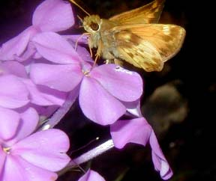
Mutualism: all species benefit from the relationship
Example: bees & flowers

