Slide 1
Ecosystems
Organisms interacting with one another in their physical surroundings

Slide 3
What make an ecosystem?
Biotic: living things
Examples: bugs, plants, humans, things that have died
Abiotic: nonliving things – never been alive
Water, air, rain, sun, weather, rocks

Slide 4
Community Dwellers
Community: organisms that dwell together
Contains many different types of animals and plants
Population: all the same type of organism
Just dogs or just cats or just birds
Species: specific type of population; have similar characteristics
Example: dogs – great dane, cocker spaniel, german shepherd

Slide 5
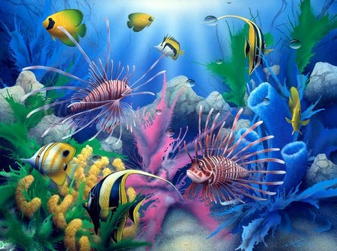
Community

Slide 6
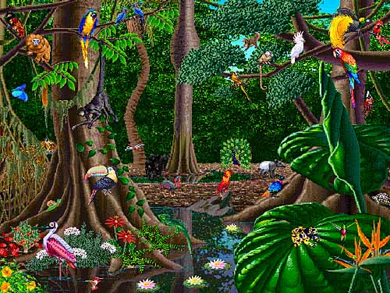
Community

Slide 7
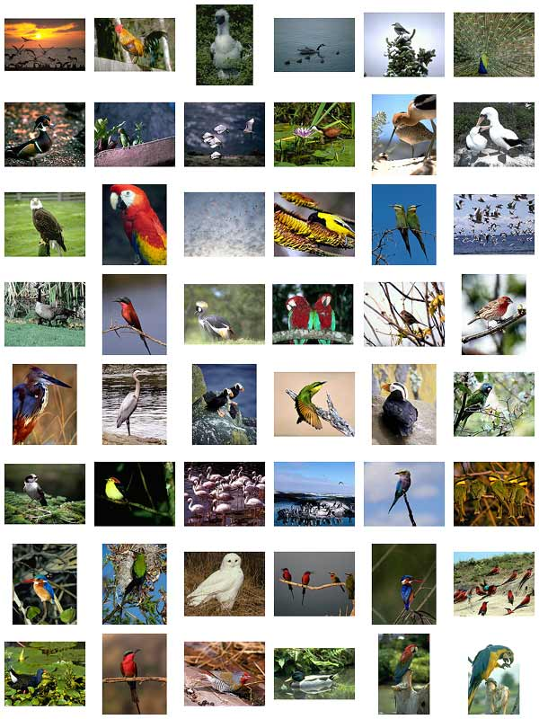
Population

Slide 8
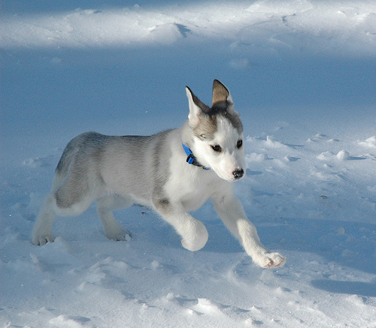
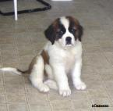
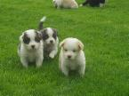
Populations

Slide 9
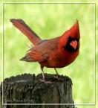
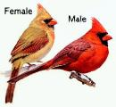
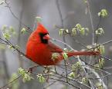
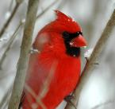
Species

Slide 10
Adaptation: structure or behavior that enables a species to survive and reproduce
Niche: special role an animal has in its enviornment
Worm: decomposer, breaks down rotting things, adds nutrients (nitrogen) to the earth

Slide 11
How big can an ecosystem be?
Can be as small as a puddle
Or as big as an ocean
Many ecosystems are made up of many ecosystems!!

Slide 12
Changing Ecosystems
How can ecosystems change?
Human impact
Deforestation – cutting down forests for cities
Pollution –
Natural Disasters
Earthquakes
Volcanic Eruptions
Violent Storms
Drought

Slide 13
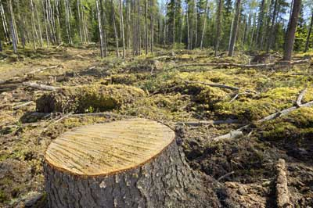
Deforestation

Slide 14
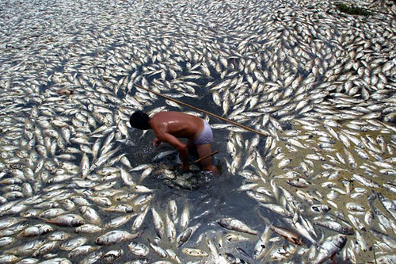
Pollution

Slide 15
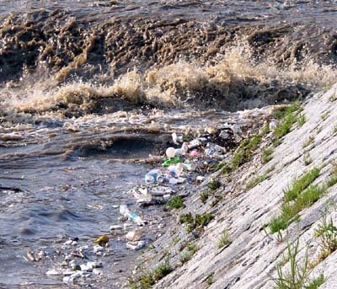
Pollution

Slide 16
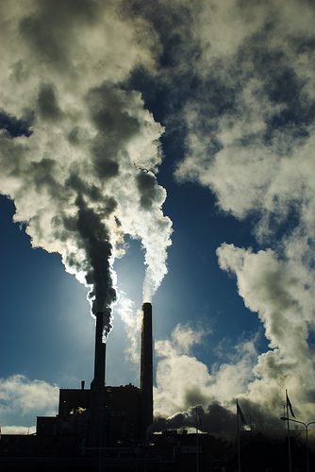
Pollution

Slide 17
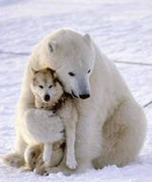
Adaptation
Clear fur to camouflage
Black skin to absorb heat
Hollow fur to trap heat and help bear to float
Thick patting on feet to insulate from cold
Wide paws act as snowshoes on the snow and ice
Claws are used to catch prey and to climb on the ice
Hair grows between the pads of the feet to help prevent the bear from slipping on the ice

Slide 18
The importance of the Sun
Plants convert the Sun’s energy through photosynthesis
ALMOST all life of earth depends on the Sun for energy either directly or indirectly
Plants take in water and CO2 and changes them into sugar and oxygen.
Sugar is the plant’s food and contains the plant’s stored energy.
**When animals eat the plants they also use the solar energy stored in the sugar.**

Slide 19
Photosynthesis
Organisms that carry out photosynthesis contain chlorophyll (makes plants green)
Stores light energy from the Sun
Non-green need the Sun too!
We obtain energy from plants
We obtain energy from animals that get energy from plants!
Fungi gets energy from breaking down remains for dead animals and plants.
Draw picture from page 15

Slide 20
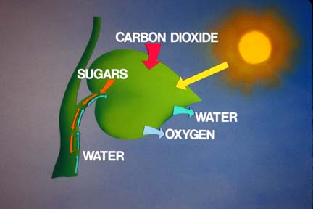
PHOTOSYNTHESIS

