Slide 1
Space
The final frontier

Slide 2
The Universe
Includes all existing matter, energy, and space
Includes all planets (can’t count them), solar systems (billions), galaxies (billions), stars (can’t count them)

Slide 3
Galaxies
Huge groups of stars held together by gravity
May look like a foggy haze
Many stars included
Universe is everything in existence

Slide 4
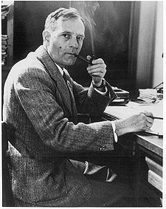
Edwin Hubble
Astronomer
Studied galaxies and classified them
Three main types of galaxies
Galaxies rotate on an imaginary axis
Hubble discovered galaxies are moving away from one another.

Slide 5
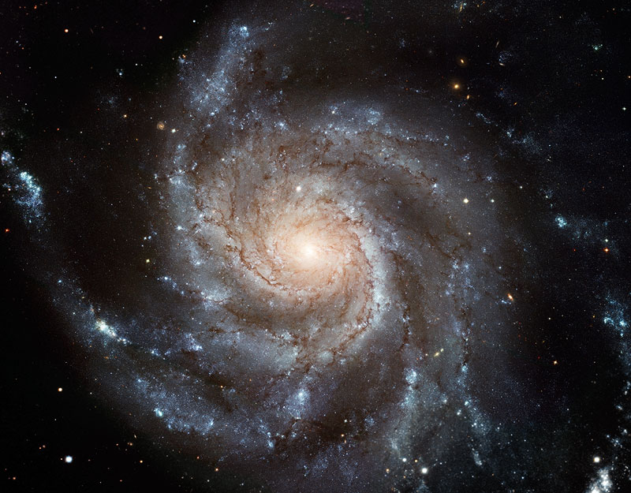
Spiral Galaxy
Have arms swirling
Look like a pinwheel

Slide 6
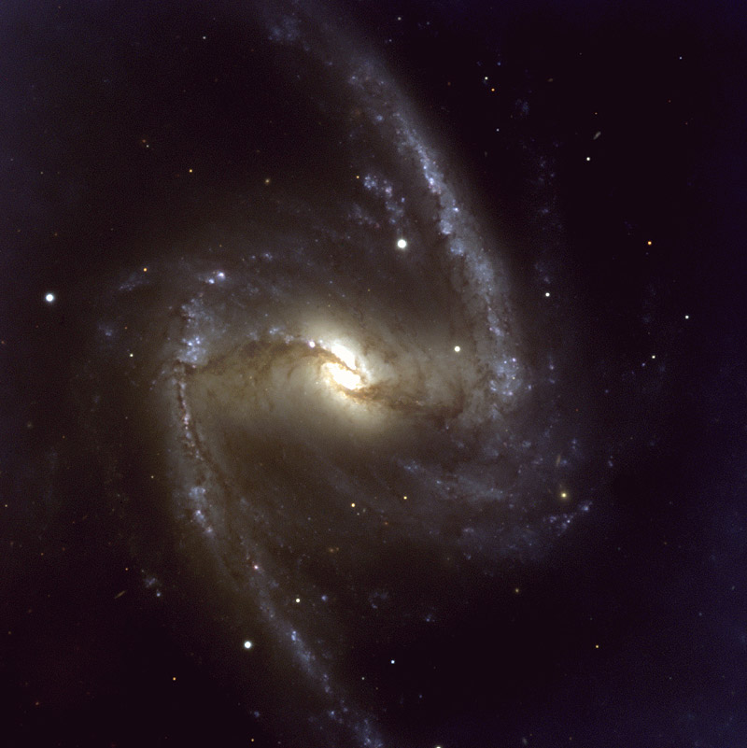
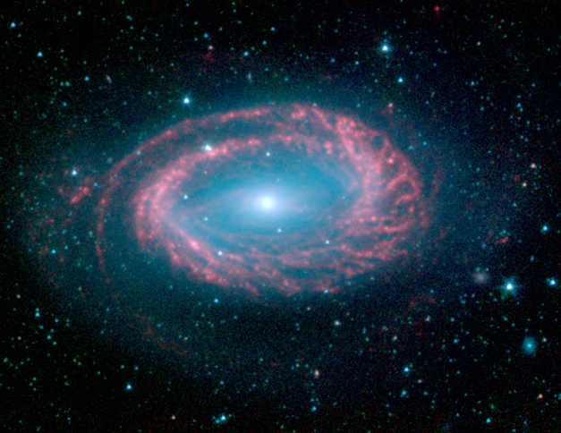
Spiral Galaxies

Slide 7
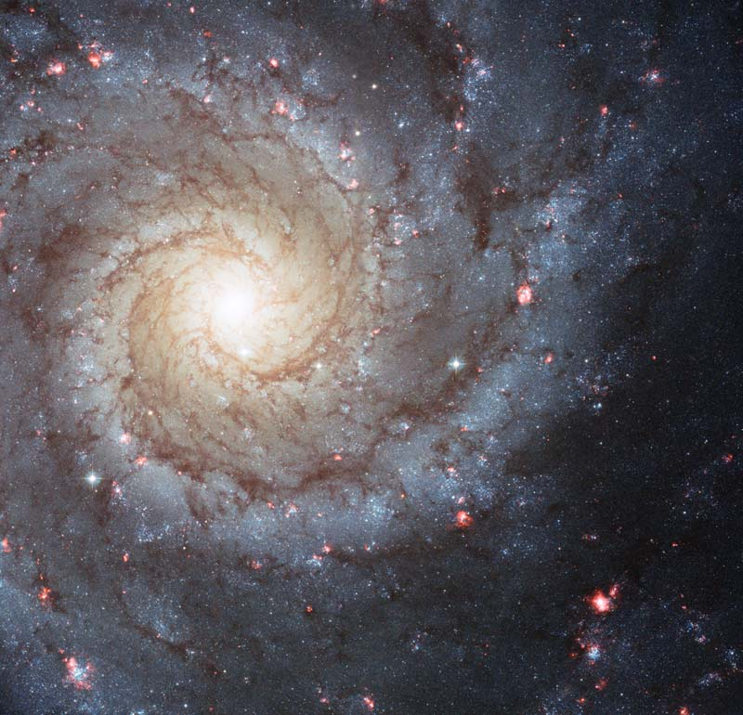
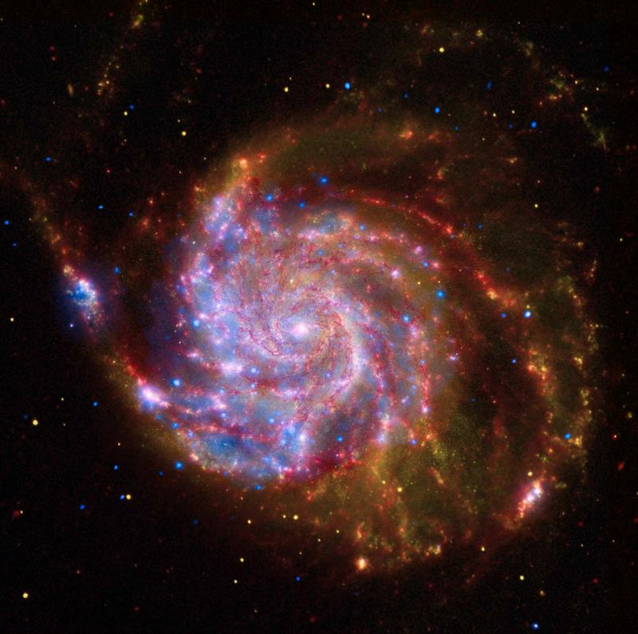
Spiral Galaxies

Slide 8
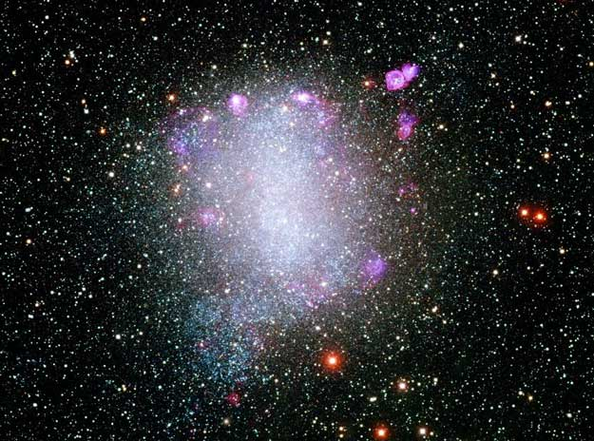
Irregular Galaxy
Galaxies have no shape
No arms
Blob

Slide 9
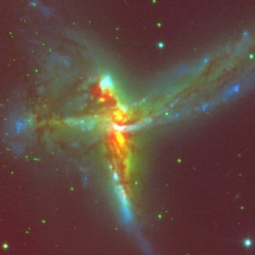
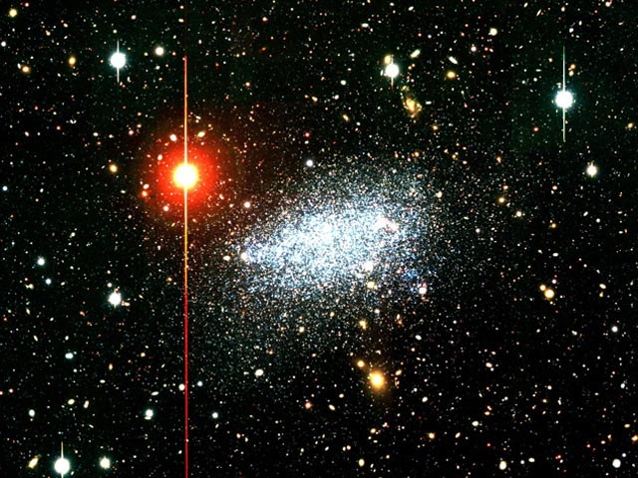
Irregular Galaxies

Slide 10
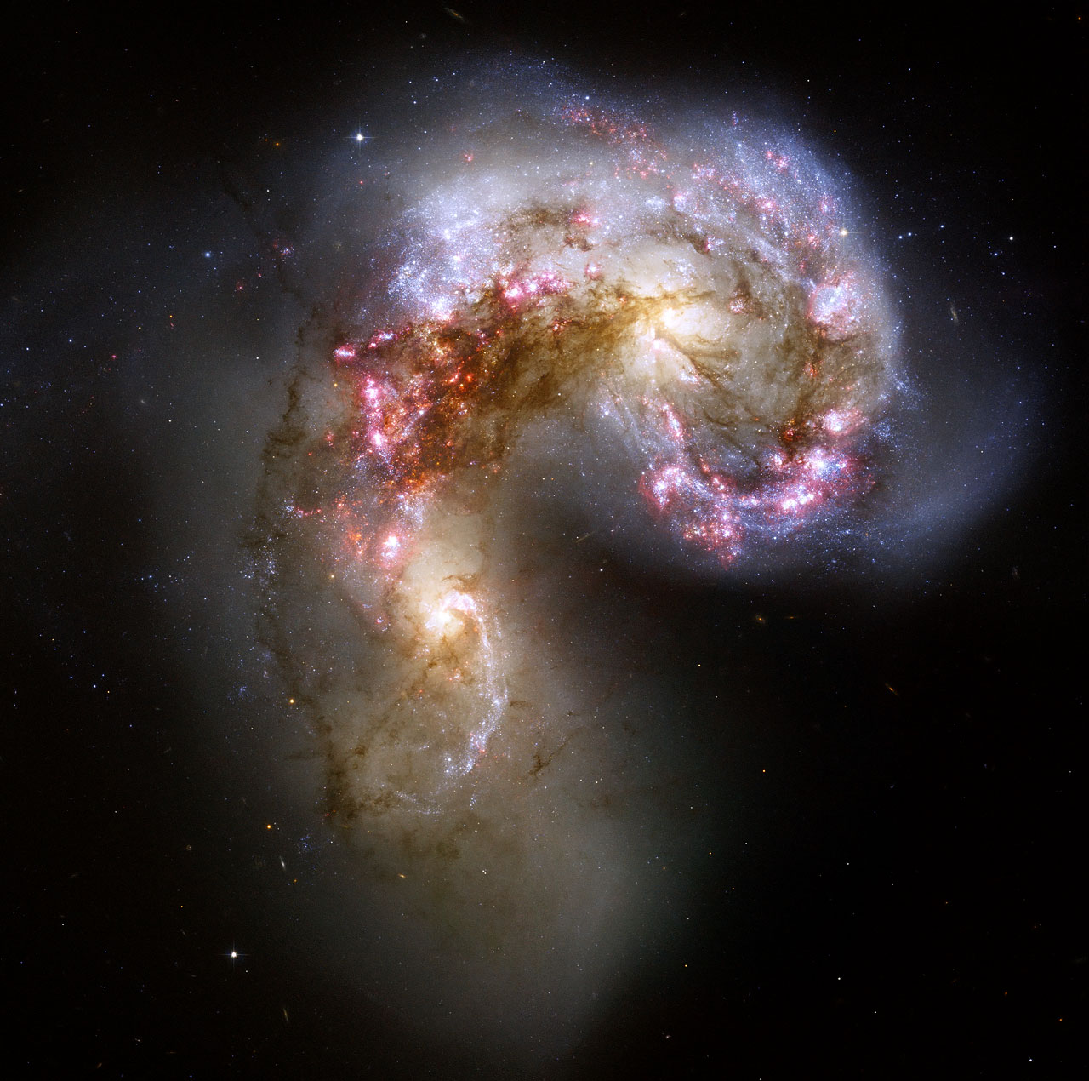
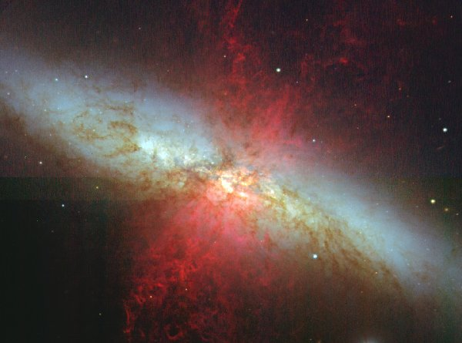
Irregular Galaxies

Slide 11
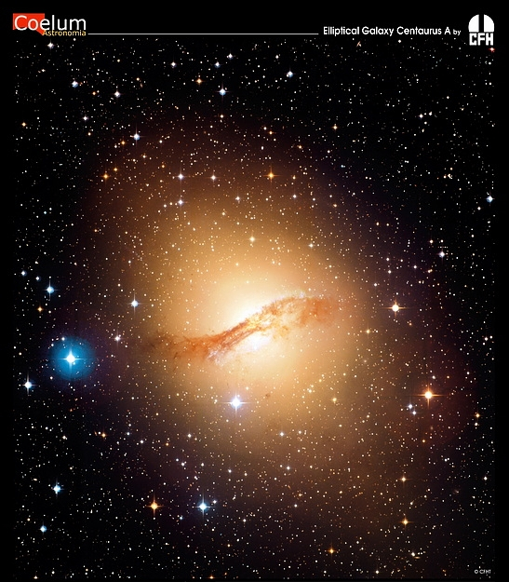
Elliptical Galaxy
Most common
Shaped like a swished ball
Oval in shape

Slide 12
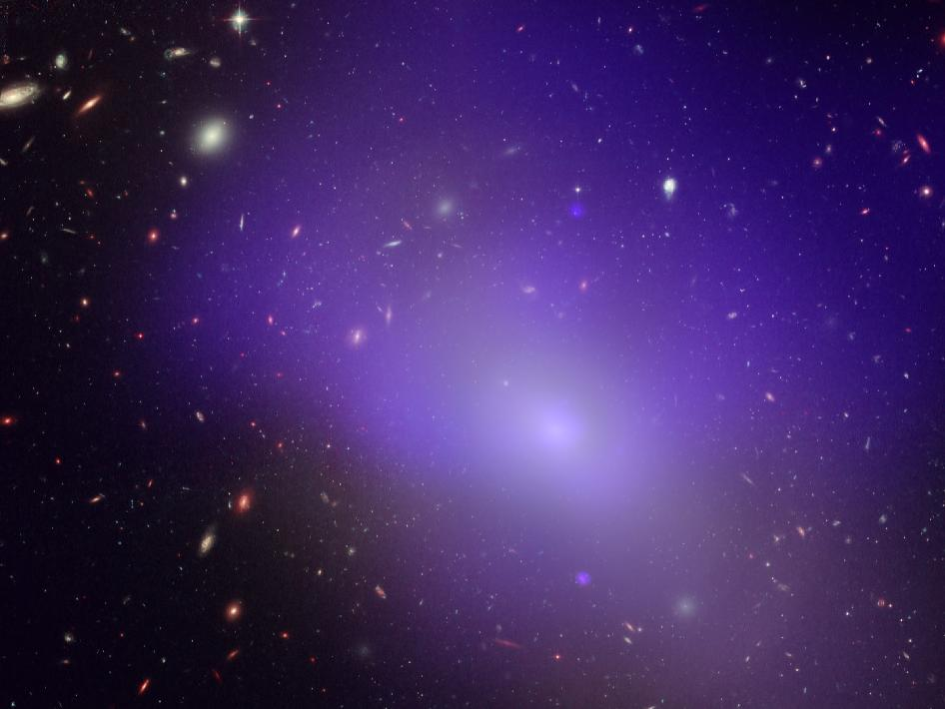
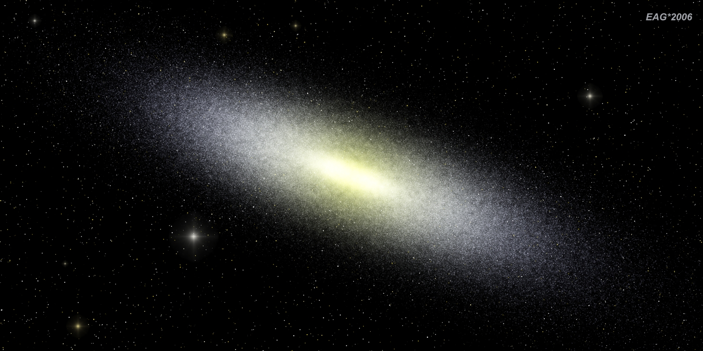
Elliptical Galaxies

Slide 13
Light year = the distance light travels in one year
Speed of light = 186,000 miles per second
Light year = 5.9 trillion miles
Why do we measure space in light years?
Space is so large, we need to measure in a large unit.

Slide 14
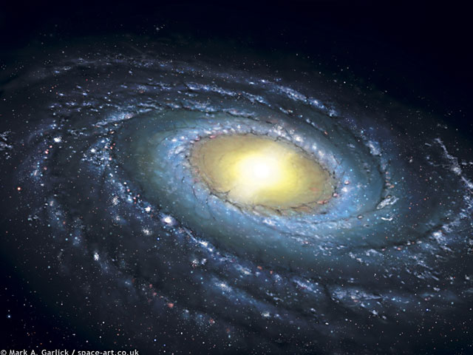
The Milky Way
(Our home)
Is a Spiral Galaxy
Has two main arms
3,000 light years in diameter (center bulge)
Our Solar System is 26,000 light years from the center

