Slide 1
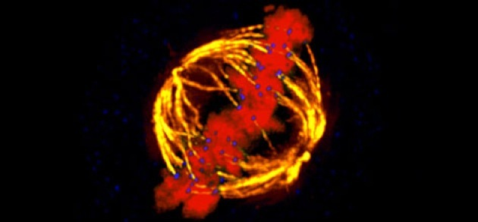
Meiosis Notes

Slide 2
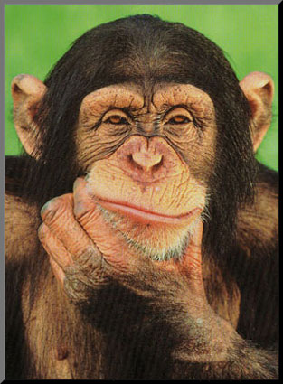
Chromosomes
Chromosomes:
Occur in __________
Are made of genes
Humans have ____chromosomes, or 23 pairs.
Number of chromosomes does ____ relate to species complexity.
48 chromosomes
1260 chromosomes

Slide 3
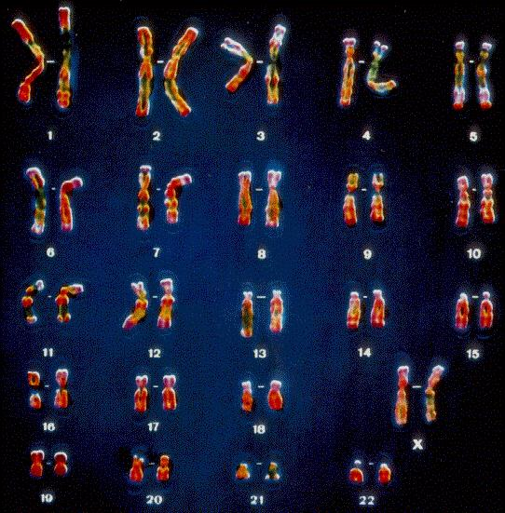
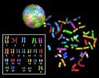
_______________: Picture of chromosomes

Slide 4
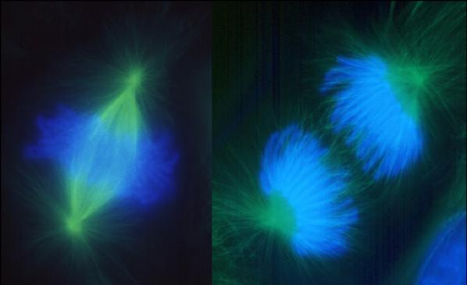
Can’t we just reproduce by Mitosis???
Mitosis=new cells containing the_______same # and kind of chromosomes as the original cell
Why is this a problem?
When fertilization occurs, offspring would have _____________ the chromosomes of parents.
How many chromosomes would humans have?________
46
46
46

Slide 5
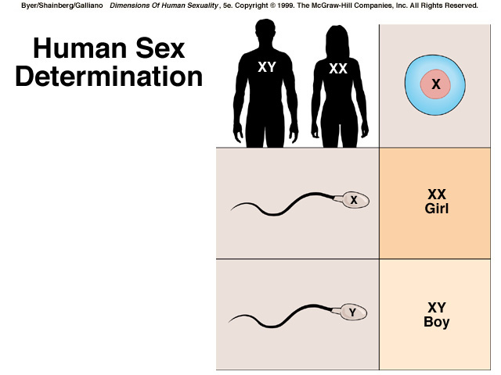
Karyotype: Picture of chromosomes
Egg(from mom) always has an______chromosome

Slide 6
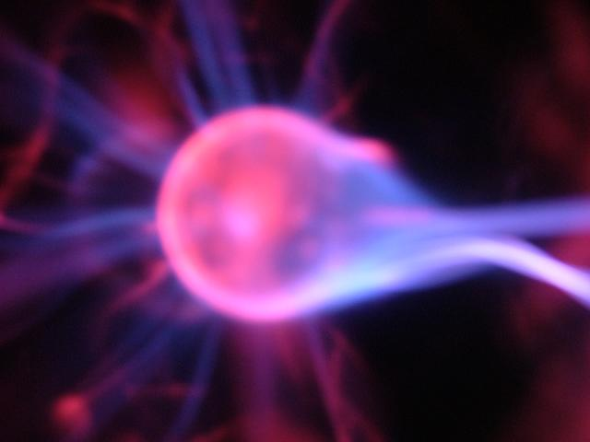
Diploid and Haploid Cells
Cells can be:
________(2n)=contain same amount
of chromosomes as parents
All cells except egg/sperm are diploid
__________(n)=contain ½ amount of chromosomes as each parent
Think half the normal number(hap sounds like half)
Only egg/sperm are haploid

Slide 7
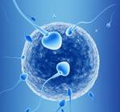
Meiosis=Egg and Sperm
Makes offspring have same # chromosomes as parent
2 separate ____________:
Meiosis I: begins with one diploid(2n) cell
Meiosis II: ends with four haploid(n) cells, or gametes.
Produces__________sperm or egg
When sperm fertilizes egg, zygote is diploid(2n)! Yay!
23
23
46

Slide 8
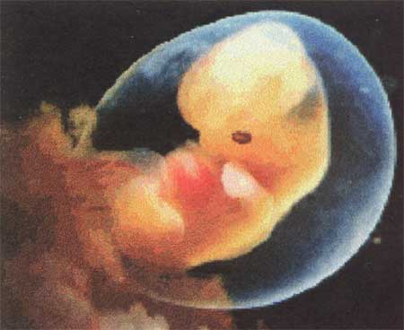
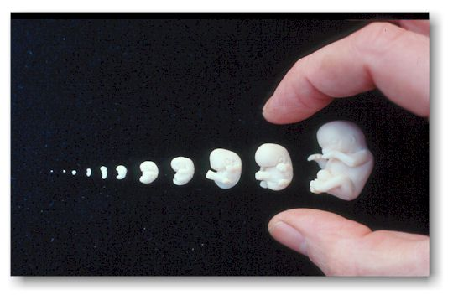
So what’s next?
50 days
8 weeks
After the egg and sperm meet(_____________), the zygote develops by mitosis.
The fusion of haploid gametes is known as SEXUAL REPRODUCTION.

Slide 9
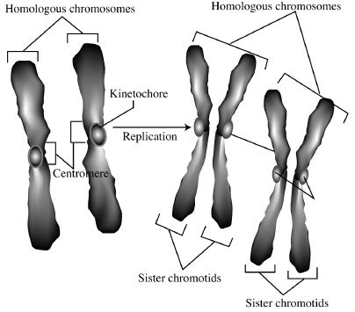
Homologous Chromosomes
Definition: the 2 chromosomes of each pair which have genes for the __________ _______
Occur in a DIPLOID(2n) cell
Class Activity
Draw some examples:

Slide 10
Why are we different from our siblings if we have the same parents?
Crossing over: change in gene order in _____________________
Chromosomes line up at cells equator 2 different ways
Each meiotic cell=23 chromosomes (2²³)
This makes over ___________different kinds of egg or sperm.
Fertilization→ 2²³ x 2²³ = _____________ different zygote possibilities

Slide 11
Nondisjunction
Definition: the failure of chromosomes to properly ___________(Anaphase I or II).
Causes gametes to have too few or too many chromosomes.
Too few chromosomes
usually= _____
Too many usually= developmental problems

Slide 12
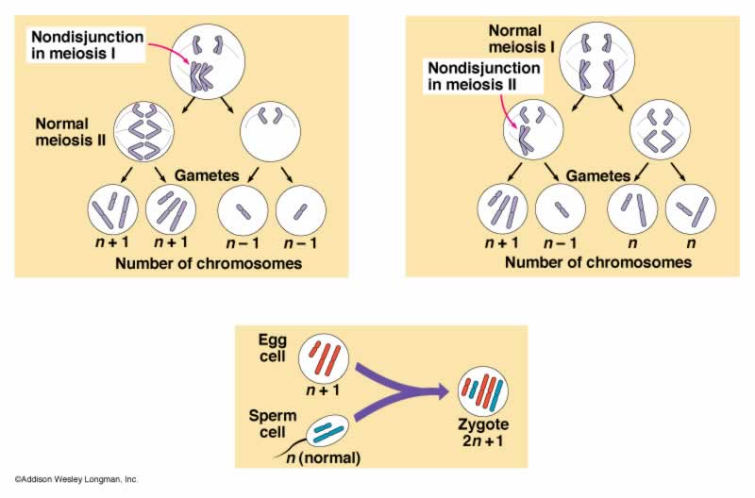
Nondisjunction

Slide 13
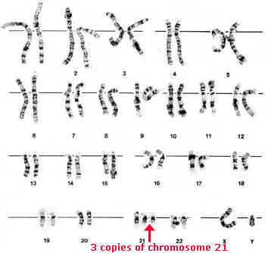
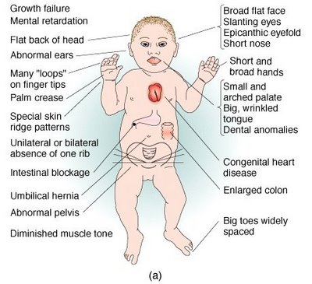
Too many chromosomes
Trisomy 21(Down syndrome):
Zygote has an __________
Chromosomes. 3 instead of 2
on 21st pair
-Total # of chromosomes=47
Causes mental and
physical abnormalities
-Chances ________ with age

Slide 14
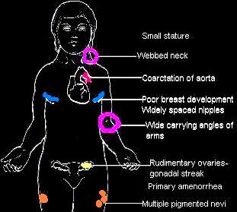
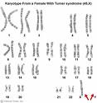
Too few chromosomes
Monosomy X: normal gamete fuses with a gamete ___________ a chromosome
Turner syndrome: Females have only one X chromosome
No known cause
98% fetuses miscarried

Slide 15
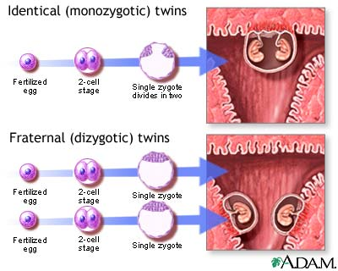
So, what about twins?
Monozygotic(-________ egg):
-Have nearly the same DNA
-Same gender
-Can share or have own placenta.
Dizygotic(2 diff. eggs):
-May be genetic
-Only _________ has influence because only she can release eggs
-Can be different genders

Slide 16
Polyploidy
Definition: organisms with _________ than the usual number of chromosome sets
Rare in animals(can result in death)
Turner syndrome, Trisomy 21, etc.
Frequently occurs in ____________
Can cause plants to grow larger
Beneficial for agriculture
Understanding of genetics could be beneficial for _______(use chemicals to cause nondisjunction)

Slide 17
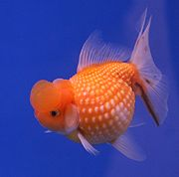
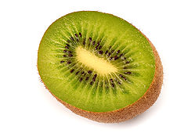
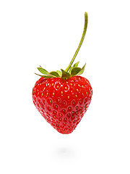
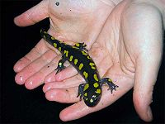
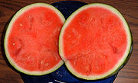
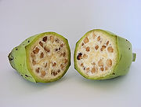
Did you know these are polyploids?
Tetraploid(4n)
Hexaploid(6n)
Cavendish
(propagation)
Decaploid(10n)
Triploid(3n)

