Slide 1
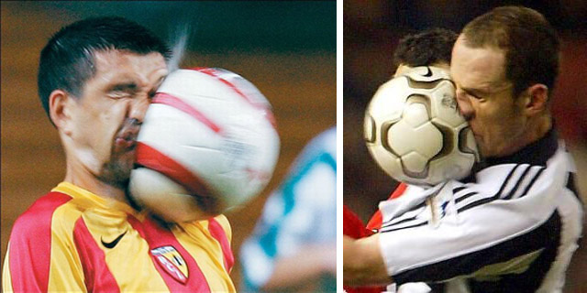
SOCCER

Slide 2
SOCCER
Introduction
It is a 2-sided game.
Each team need 11players on field.
The game need 1 ref , 2 lineman and a res ref.
Game is divided into 2 session (1st half and 2nd half. )
Each half of the game is 45mins.
1

Slide 3
SOCCER
2

